Slide 1

WHAT
WHERE
WHEN
HOW
TO
PUBLISH

Slide 2
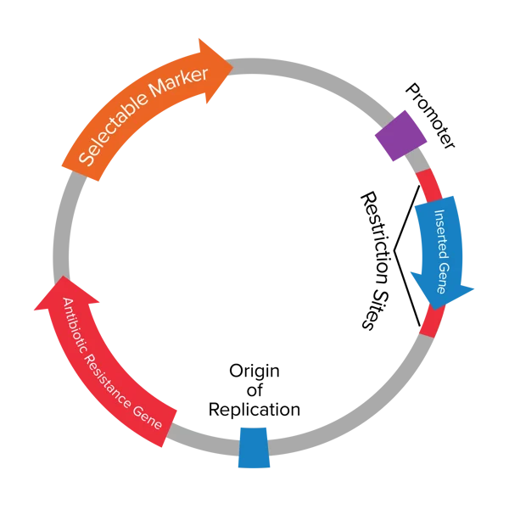

you are in good hands but
trust but VERIFY

Slide 3
collaborate
teamwork is dream work

Slide 4
what to publish?
think about multiple opportunities
Primary research papers
The most common type of publication for scientists that is used to communicate primary research to the academic community.
Reviews
Another commonly used format for scientists to summarize and review the of progress made in a particular field or area of research. A review typically also contains the author’s perspectives and take on the field.
Perspectives, commentaries, and opinions
A format that enables scientists to communicate their perspectives and opinions on various topics, including but not limited to areas of research and social and political issues that may affect science.
News articles
News articles are used to communicate scientific research to the general public and are written without field-specific jargons and technicalities.
Blog posts, magazine articles, etc.
Other forms of publications include blog posts, magazine articles, and other social media posts. These are typically aimed at diverse audiences and can often be used to serve a range of purposes, from scientific education to research dissemination.

Slide 5
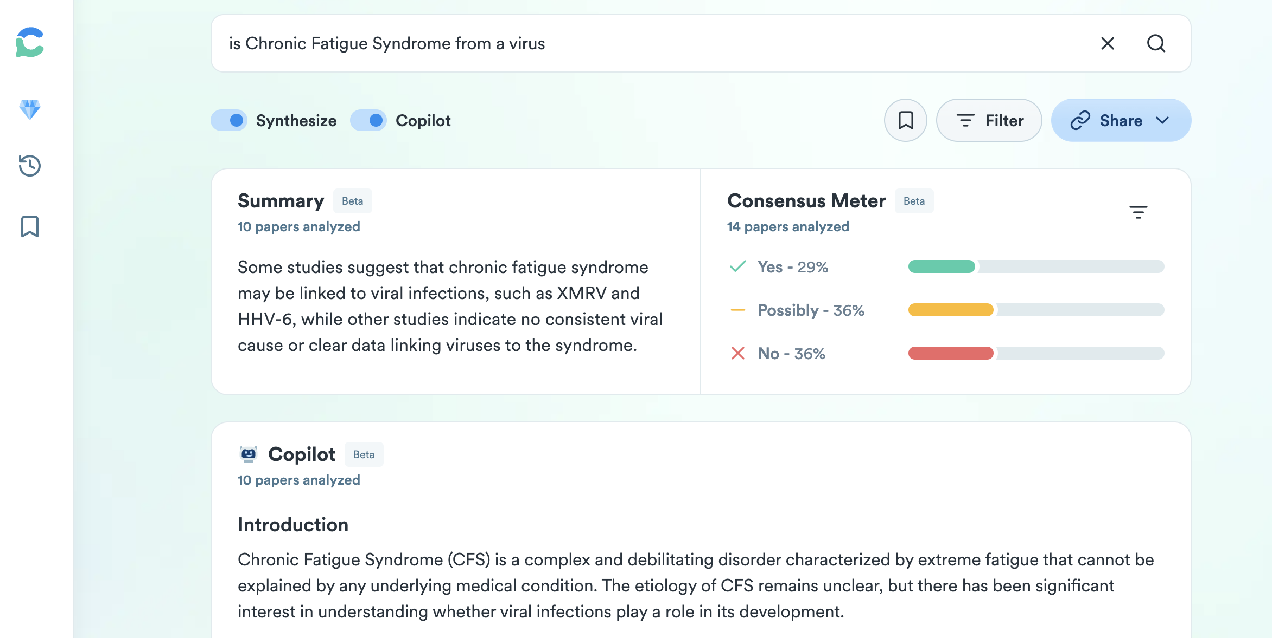
how to publish?
read the literature and look for gaps
https://consensus.app

Slide 6

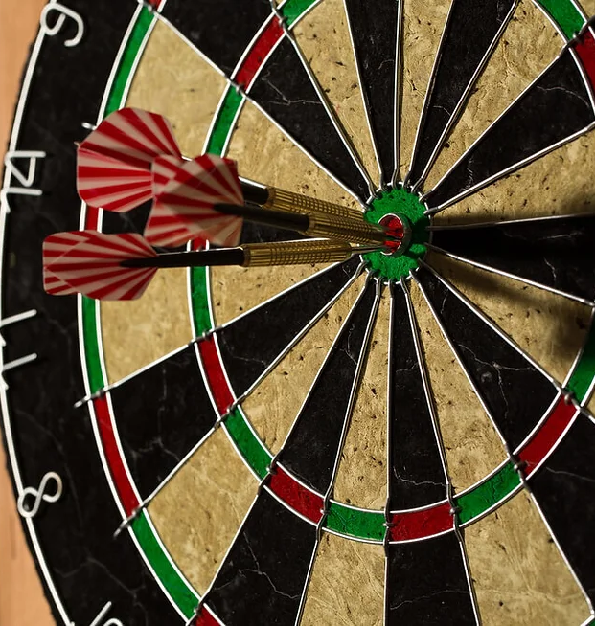

how to publish
aim for impact and plan smart

Slide 7
when to publish?
be realistic about your timeline
In biology, it takes on average 3 years to publish a scientific paper (from idea conception to acceptance to the journal). This is best case scenario.
In the US, we know based on stats that a typical PhD 5-6 years to graduate. A postdoc takes about 3-5 years to complete training.
This means you have to start planning your paper as soon as you get into the lab ☺

Slide 8
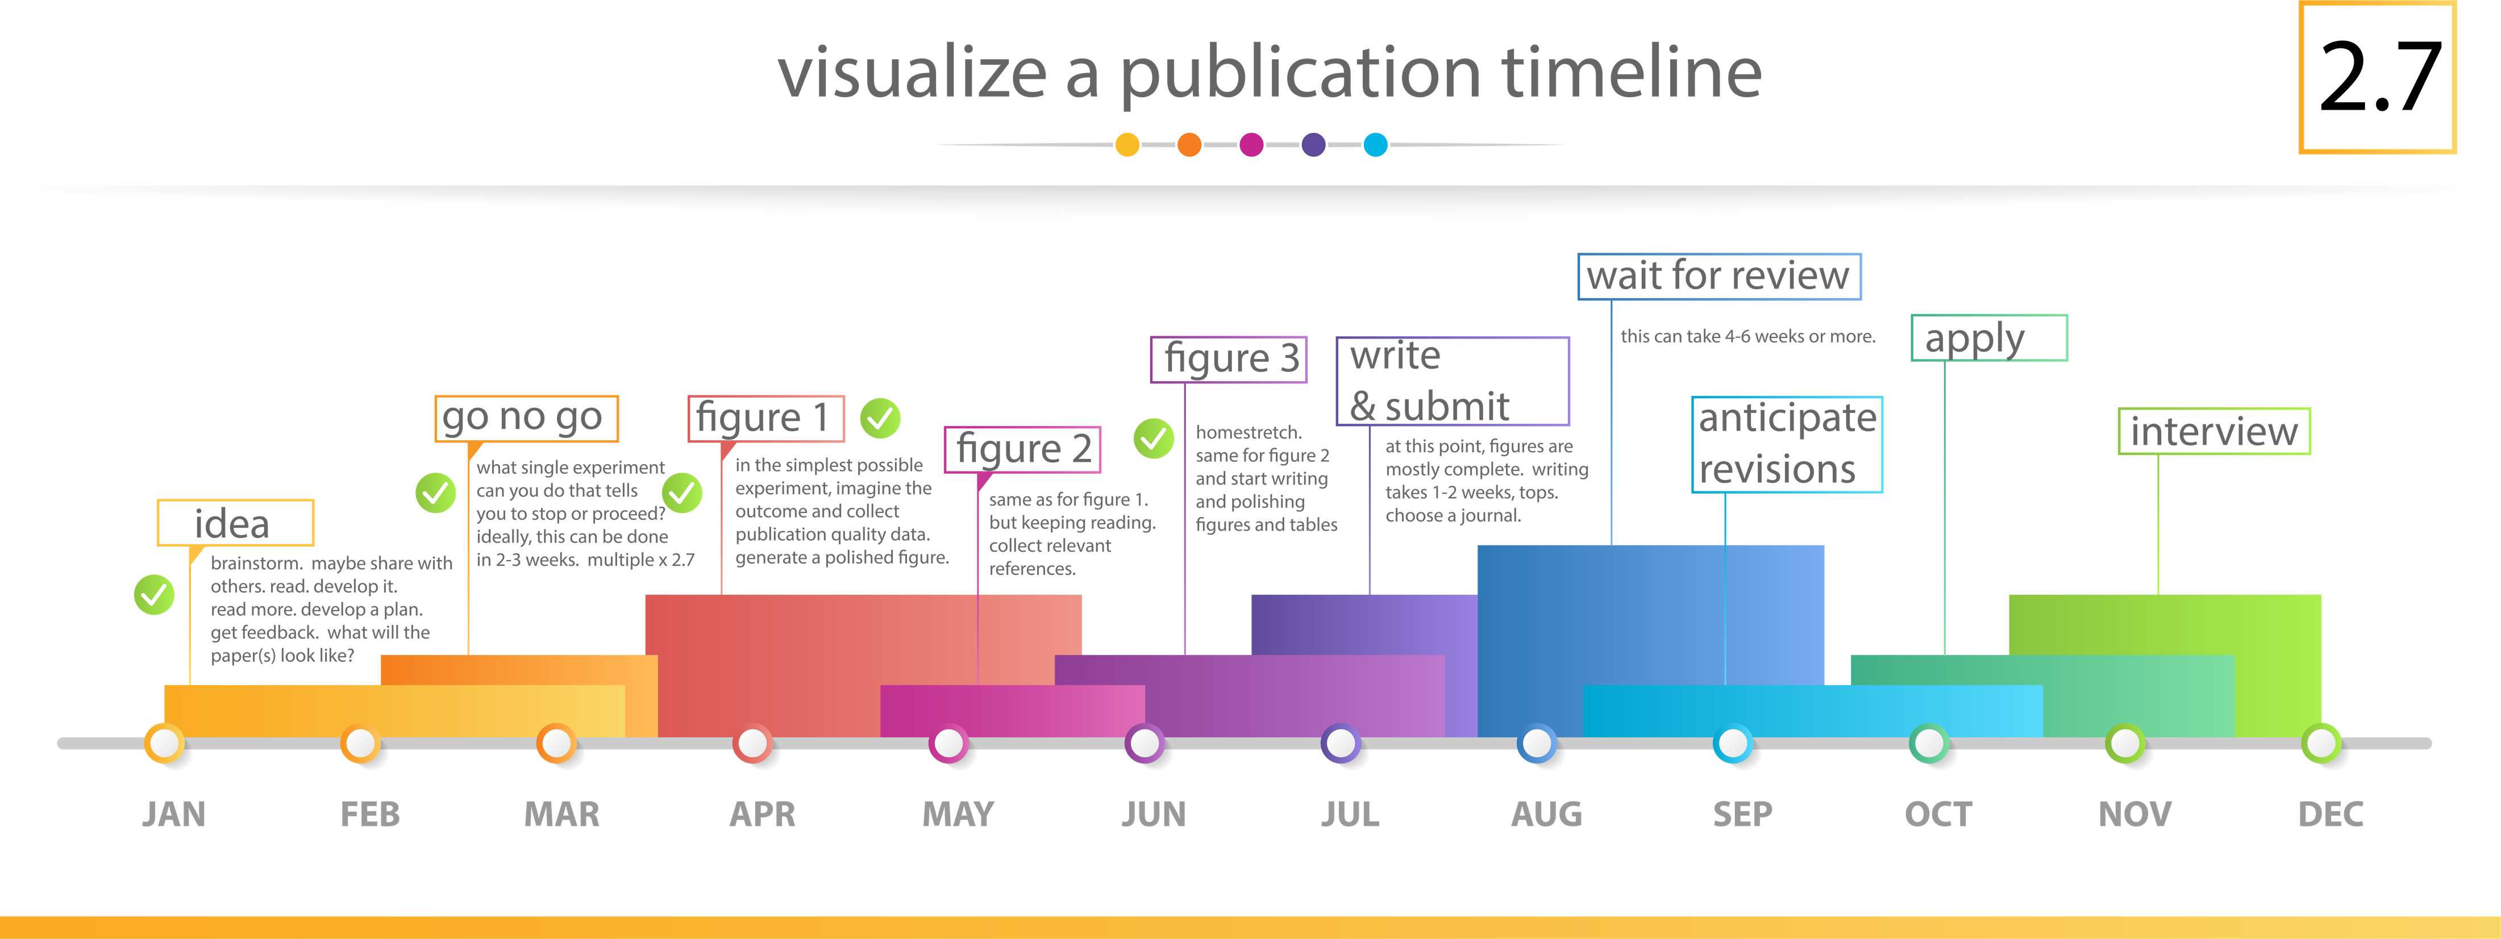
set a realistic timeline
on paper it may take a year, but multiple by 2.7

