Slide 1
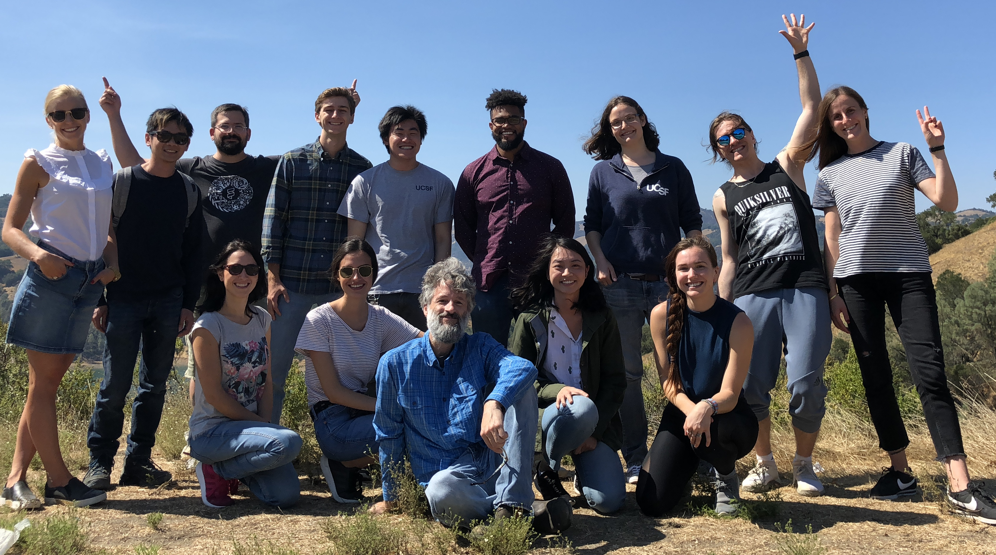
soft skills workshop week
Michael T. McManus, PhD
Professor, Stella Coates Endowed Chair
University of California, San Francisco
Imposter You are Not
July 28, 2025

Slide 2

imposter syndrome
most of us probably experience a bit of it. or a lot.
A syndrome where sufferers are unable to internalize their accomplishments.
Regardless of what level of success they may have achieved, they remain convinced internally that they do not deserve the success and are really frauds.
Proof of success are generally dismissed as luck, timing, or ability to deceive others.
This syndrome is typically associated with academics (70%).
have you ever felt like
a fraud in science?
Notes:
A syndrome where sufferers are unable to internalize their accomplishments.
Regardless of what level of success they may have achieved or what external proof they get, they remain convinced internally that they do not deserve the success and are really frauds.
Proofs of success are dismissed as luck, timing, or ability to deceive others.
This syndrome is typically associated with academics (70%).

Slide 3
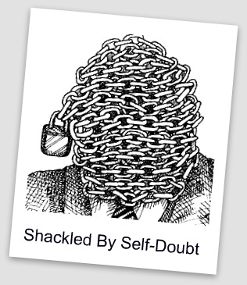
what is imposter syndrome
why is this so prevalent in academia
People tend to attribute their failures to a stable, inner core of ineptness.
While discounting successes as accidental…
Why?
self-doubt and negative feedback weigh heavily on the mind, but praise barely registers.
Notes:
Human minds amplify failure and self-doubt while discounting praise– nobody ever notices perfection.
If you do your job perfectly, nobody, including you, notices. But that doesn’t mean it didn’t matter. It means you made it look easy.
And that is the mark of expertise, not fraudulence.

Slide 4

imposter syndrome
the myth of linear discovery
how do we portray science
in papers or talks?
Notes:
Science is uncertain, but we are trained to believe in absolute truths.
Research is often messy, random, and full of failure—yet we only hear polished success stories in papers and talks.
This is because of our distorted take on science!
We are often taught that Science deals with objective things and absolute truths and think that doing science is the same.
When we find that our own discoveries have a big element of randomness we feel that we were just lucky.
It can seem like people around us discovered things in a logical way since that is the way papers and seminars are presented.

Slide 5

pyramid effect
our peer group gets better and better…

Slide 6
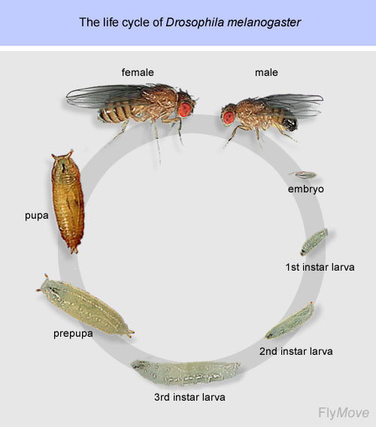
stages in science
what is your goal?
an academic
PostDoc (After....)
Group leader
Start undergraduate school
B.A
PostDoc
(before you publish)
M.SC
Ph.D
Notes:
Transition-- As you move up in academia, the peer group becomes more elite, increasing comparison and self-doubt.

Slide 7


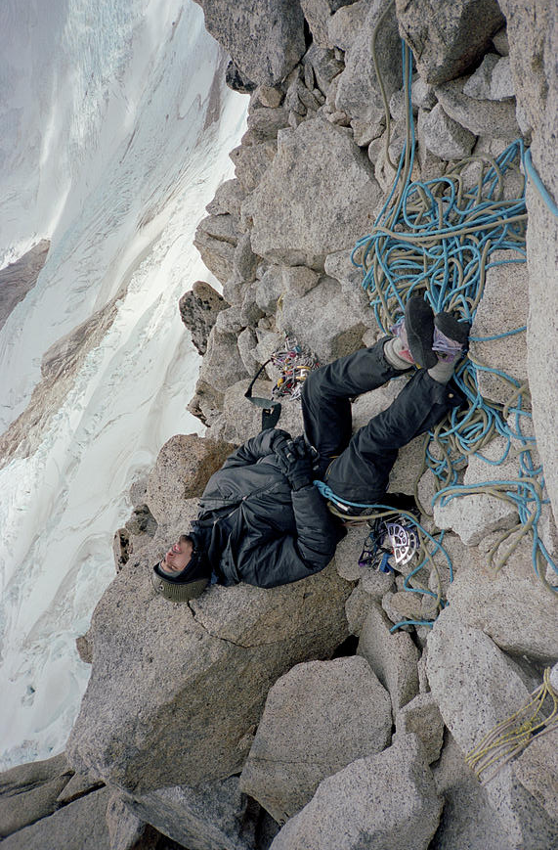
we all feel the wind at the peak
academia is a mountain—everyone struggles with the altitude
It can make you less inclined to compete for higher positions (such as postdocs or faculty positions).
It can instill a fear to pursue new ideas and to take scientific risks.
It can make you reticent about offering potentially valuable insights, ideas, opinions and solutions to problems for fear of being wrong or exposing your “ignorance.”
It can prevent you from asking big questions… hence block your learning and advancement
Notes:
Climbing the academic mountain is like ascending a high peak. At the base, the path is crowded — everyone’s finding their footing, helping each other, asking questions. You don’t feel out of place.
As you climb, the trail narrows. The terrain gets harder. Fewer people are around. And the ones you do see? They look strong, confident, prepared.
You feel like the only one gasping for air, slipping on rocks, unsure if you packed the right gear. But here’s the truth: most of them feel exactly the same.
They’re just wearing mirrored sunglasses — so you see your own uncertainty reflected back at you.

Slide 8

believe in yourself
set your own goals, measured against what you want to achieve
I think I can. Don’t let your own self-doubt limit what you can accomplish.
Mediocrity is OK too. You can still be amazing.

Slide 9
imposter syndrome
how it affects mental health
It can make you prone to procrastination. This often causes delays in graduation of students.
It can cause stress-related problems leading to disease. M.Sc and PhD students are under VERY high risk for psychological stress
It makes you more likely to see constructive criticism as proof of your ineptitude, rather than using it to improve skills and knowledge.
Notes:
How It Affects Mental Health
Leads to procrastination and stress.
Increases likelihood of burnout.
Mental health risks in PhD/postdoc trainees are extremely high.

Slide 10
imposter syndrome
what to do?
Name it to tame it!

Slide 11
imposter syndrome
what to do?
Break the silence. Knowing there’s a name for these feelings and that you are not alone can be tremendously freeing.
Separate feelings from fact. Just because you may feel stupid, doesn’t mean you are.
Recognize it. Instead of taking your self-doubt as a sign of your ineptness, recognize that it might be a normal response to being a beginner – which you will often be in an academic environment.
Accentuate the positive. Forgive yourself when the inevitable mistake happens.
Develop a new response to failure and mistake making. Henry Ford once said, “Failure is only the opportunity to begin again more intelligently.”
Notes:
Slide: Name It to Tame ItRecognizing Imposter Syndrome reduces its power.
Separate Feelings from FactsFeeling inadequate ≠ Being inadequate.
Reframe FailureHenry Ford: "Failure is only the opportunity to begin again more intelligently."
Develop a New ScriptInstead of: "I don’t belong here", think: "Everyone feels this way when they start."
Celebrate SuccessScientists rarely stop to appreciate their wins.
Learn to celebrate small victories (a successful PCR, a paper submission, etc.).
Fake It ‘Til You Make ItConfidence is not about knowing everything—it’s about being willing to figure things out.

Slide 12
imposter syndrome
what to do?
‘Right’ the rules. Recognize that you have just as much right as the next person to be wrong, have an off-day (or day off….), or ask for assistance.
Develop a new script in your head. When you start a new job don’t think: “Wait till they find out I have no idea what I’m doing,” try thinking, “Everyone who starts something new feels off-base in the beginning. I may not know all the answers but I’m smart enough to find them out.”
Visualize success. Spend time beforehand picturing yourself making a successful presentation or calmly posing your question in class.
Fake it ‘til you make it. Instead of considering “winging it” as proof of your ineptness learn to view it as a skill.
Reward yourself. Break the cycle of continually seeking and then dismissing validation outside of yourself by learning to pat YOURSELF on the back.
Notes:
Slide: Name It to Tame ItRecognizing Imposter Syndrome reduces its power.
Separate Feelings from FactsFeeling inadequate ≠ Being inadequate.
Reframe FailureHenry Ford: "Failure is only the opportunity to begin again more intelligently."
Develop a New ScriptInstead of: "I don’t belong here", think: "Everyone feels this way when they start."
Celebrate SuccessScientists rarely stop to appreciate their wins.
Learn to celebrate small victories (a successful PCR, a paper submission, etc.).
Fake It ‘Til You Make ItConfidence is not about knowing everything—it’s about being willing to figure things out.

Slide 13

reward ourselves
celebrate!
If you do your job perfectly, nobody, including you, notices. But that doesn’t mean it didn’t matter. It means you made it look easy.
And that is the mark of expertise, not fraudulence.

Slide 14

reward ourselves
celebrate!
We never celebrate when we send a paper/grant/PhD proposal out because we fear it still might get rejected or criticized.
By the time news of the submission comes back you can only feel relief.
If you learn to measure yourself and celebrate your OWN finish lines you will increase your own self assessment skills.

Slide 15
imposter syndrome
where to learn more
Dr. Valerie Young
webpage: http://impostorsyndrome.com/
John Gradem
webpbage: http://www.johngraden.com/impsyn.html
Pauline Clance
webpbage: http://www.paulineroseclance.com
Maya Schuldiner
http://mayaschuldiner.wixsite.com/schuldinerlab

