Slide 1
difficult conversations
what are some examples of difficult conversations?
Giving a negative performance review
Confiding personal issues
Giving the group leader feedback
Talking about changes in career plans
Asking in-laws to stop interfering
Notes:
You need to know how to do this.

Slide 2

barriers to difficult conversations
fear of negative repercussions
fear of damaging relationship
fear of a bad reference letter
fear of ‘making things worse’
resentment, anger, and frustration
fear of legal consequences

Slide 3

conflict resolution
how do we engage in healthy conflict?
Conflict is inevitable. Without conflict, there can be no growth.
Healthy conflict is a respectful, debate-style conversation. Strong passion is A-OK, providing there is no personalization.
Unhealthy conflict is toxic. Toxic conversations often involve power play and can involve personalization and be unfocused.
Notes:
Healthy conflict is when those who are engaged in the process respect and appreciate the other’s point of view. This type of conflict usually manifests in a debate-style conversation where each person is presenting their case and the conversation goes back and forth. While passions may run high on the topic, there is no personalization of the conversation. At the end of the conflict both people know their relationship is still intact and may even be stronger.
Unhealthy conflict is toxic. It works its way into conversation or topics where it doesn’t belong. Sometimes it is conflict for conflict’s sake. Other times it presents as a power play where one person seeks to gain power over another or gain prestige in the eyes of the team or their boss. Unhealthy conflict is like school yard bullying…it can catch you off guard and tear you down before you know what is happening. It seeps into every day conversation and can make most interactions adversarial.
Examples of Toxic Conversations in Academic Research Environments
Toxic Conversations
Grant Competition Undermining Senior Researcher: "I saw your latest grant proposal draft. The approach is fundamentally flawed - everyone in the field has moved beyond that methodology. I'm surprised you'd even pursue this." Context: Said in front of other lab members, without specific constructive feedback, when both researchers are competing for the same limited funding.
Lab Meeting Humiliation PI to Graduate Student: "These results are completely useless. Did you even bother to read the literature before wasting lab resources? This is why we're falling behind other groups." Context: Public criticism focusing on the person rather than the scientific issue, without offering guidance.
Authorship Dispute Postdoc: "I don't care how much analysis you did, I conceptualized this project three years ago. You're lucky to even be included in the acknowledgments." Context: Private conversation that disregards actual contributions and uses seniority to claim credit.
Equipment Access Control Lab Manager: "You clearly don't have the expertise to use this equipment. Your results last time were suspicious. Let's have someone more experienced handle this part of the experiment." Context: Said without offering training or specific concerns, effectively blocking a researcher from completing their work.
Committee Feedback Committee Member: "Your literature review misses fundamental papers that any first-year should know. I question whether you're cut out for this program if these basics aren't clear to you." Context: Feedback that attacks competence rather than addressing specific improvements needed.
Healthy Difficult Conversations
Data Interpretation Disagreement Colleague: "I'm looking at these results differently. The control group shows patterns that might suggest our conclusion isn't as strong as we thought. Can we walk through the analysis together to see if there are alternative explanations we should address?" Context: Focus on the science rather than the researcher, with an invitation to collaborate on understanding.
Experimental Design Critique PI: "I have concerns about the statistical power in this design. With these sample sizes, we risk missing important effects. Could you run some power calculations and we can discuss modifications that would strengthen our confidence in the results?" Context: Specific criticism with constructive suggestions and a path forward.
Publication Strategy Debate Senior Researcher: "I believe we should split this into two papers rather than one comprehensive manuscript. The methodological innovation deserves its own focus, and I'm concerned the main finding gets lost in the current structure. What do you think about that approach?" Context: Presents a different viewpoint with reasoning and invites discussion.
Resource Allocation Discussion Lab Director: "We need to prioritize projects given our budget constraints. I notice your project requires significant resources but hasn't shown progress benchmarks we discussed. Can you help me understand the challenges you're facing and what you need to move forward effectively?" Context: Addresses difficult resource decisions while seeking understanding rather than making accusations.
Mentorship Boundary Setting Mentor: "I've noticed you're waiting for my approval before proceeding with each step. While I appreciate your thoroughness, I think your development as a scientist would benefit from more independent decision-making. How can I support you in building that confidence while still providing guidance when needed?" Context: Addresses a difficult pattern while focusing on growth rather than deficiency.

Slide 4

avoiding difficult conversations
here are the risks
No growth, no improvement
Problem gets worse
Resentment
Relationship erodes
Stress and health issues
Notes:
What will happen if you have this conversation? What will happen if you don’t?

Slide 5
conflict resolution
how do we engage in healthy conflict?
Set the Tone
Listen to the Person
Remain Calm
Provide Feedback
Express Empathy
Notes:
Stay focused on the goal of the conversation. What is the agenda? What are the immediate vs longer term objectives? Can you begin with the positives? What is the purpose? Establish a shared understanding before you begin.

Slide 6

conflict resolution
how do we engage in healthy conflict?
Set the Tone
Listen to the Person
Remain Calm
Provide Feedback
Express Empathy
Notes:
After establishing the goal of the conversation, ask questions. Listen. What are they saying? Some personalities are indirect… can you hear the words that they are ‘not saying’? What is their body language saying?

Slide 7
conflict resolution
how do we engage in healthy conflict?
Set the Tone
Listen to the Person
Remain Calm
Provide Feedback
Express Empathy
Notes:
Recognize their emotions, deal with anger quickly and reject any unacceptable behavior.
Consider cultural and personality differences. It’s OK for professional heated discussion, providing that it is not directed at the person.
10 Examples of Healthy Heated Discussions in Academic Research Labs
Competing Interpretations of Results Researcher A: "These results strongly support our hypothesis about membrane permeability!" Researcher B: "I disagree completely. The control data suggests these effects could be explained by temperature fluctuations. Look at this scatter plot—the pattern is consistent with environmental factors." Researcher A: "But our calibration accounts for that. Let's run the statistical analysis again with those variables isolated." Why it's healthy: Both parties are passionate but focused on data and methodological approaches, not personal competence.
Theoretical Framework Debate Postdoc: "The behavioral economics model explains these findings far better than any neurobiological framework could." PI: "That's an oversimplification! The neural circuits we've identified provide a mechanistic explanation that behavioral models can't. We need to incorporate both levels of analysis." Why it's healthy: Strong disagreement about scientific approach that respects both perspectives as valuable while advocating for integration.
Research Priority Disagreement Lab Manager: "We need to focus on replicating these findings before moving forward!" Graduate Student: "But that could take months! The field is moving quickly, and we risk being scooped if we don't pursue the next step now." Lab Manager: "Scientific integrity is more important than publication speed. What if we divide the team to do both simultaneously?" Why it's healthy: Addresses real tensions between scientific rigor and competitive pressures with a solution-oriented approach.
Methodological Critique Researcher: "This Western blot technique is introducing too much variability. We should switch to ELISA." Collaborator: "Absolutely not! We lose critical information about protein size and modification. Our problem is inconsistent sample preparation, not the technique itself." Researcher: "Then let's systematically test both hypotheses with controlled comparisons." Why it's healthy: Passionate defense of approaches with a willingness to test assumptions empirically.
Publishing Strategy Conflict Senior Researcher: "We should submit to Nature first. This finding is groundbreaking!" Junior Researcher: "I strongly disagree. The specialized journal will give us better peer review and more appropriate audience. Nature will likely reject without review, wasting months." Senior Researcher: "What if we prepare both manuscripts simultaneously? The specialized paper can be more technical while we craft a broader narrative for Nature." Why it's healthy: Strategic disagreement that acknowledges both perspectives and finds a compromise.
Ethical Research Design Ethics Committee Member: "This protocol puts too much burden on participants. We need to reduce the testing time." Principal Investigator: "But without that data, we can't answer the research question effectively! The participants understand the value of their contribution." Ethics Member: "Then let's redesign to make it more efficient or split it into two sessions. Participant welfare must come first." Why it's healthy: Balances scientific goals with ethical considerations, focusing on finding solutions rather than winning the argument.
Resource Allocation Debate Lab Member A: "The new sequencing technology should be dedicated to the cancer project—it has the most immediate clinical implications!" Lab Member B: "That's short-sighted! The evolutionary biology project has broader scientific impact and could lead to multiple high-impact publications." PI: "Let's create a schedule that allows both projects access based on clear milestones and deliverables." Why it's healthy: Passionate advocacy for different research priorities leading to a fair solution.
Interdisciplinary Approach Conflict Physicist: "This biological system needs rigorous mathematical modeling to truly understand the dynamics." Biologist: "Models oversimplify the complex regulatory networks! We need more experimental data before abstracting to models." Physicist: "What if we develop models iteratively, using each round of experimental data to refine the mathematics?" Why it's healthy: Disciplinary perspective clash that leads to stronger interdisciplinary methodology.
Mentorship Philosophy Debate Mentor: "You need to let students struggle more with problem-solving. You're providing too much guidance and limiting their development." Co-mentor: "These techniques are too complex for trial and error! Detailed guidance prevents wasted time and resources." Mentor: "Perhaps we need a staged approach—more guidance initially, then progressively less as they develop competence?" Why it's healthy: Strong disagreement about pedagogical approach that respects both perspectives and seeks a principled compromise.
Data Sharing Disagreement Open Science Advocate: "We should release all raw data with the publication. Transparency is non-negotiable for scientific progress!" Cautious Researcher: "That's premature! We haven't mined the dataset fully yet. We need at least a one-year embargo to complete our planned analyses." Third Researcher: "What about releasing processed data now with raw data under embargo? This maintains transparency while protecting the team's investment." Why it's healthy: Principled disagreement about scientific values that works toward a solution respecting multiple concerns.

Slide 8
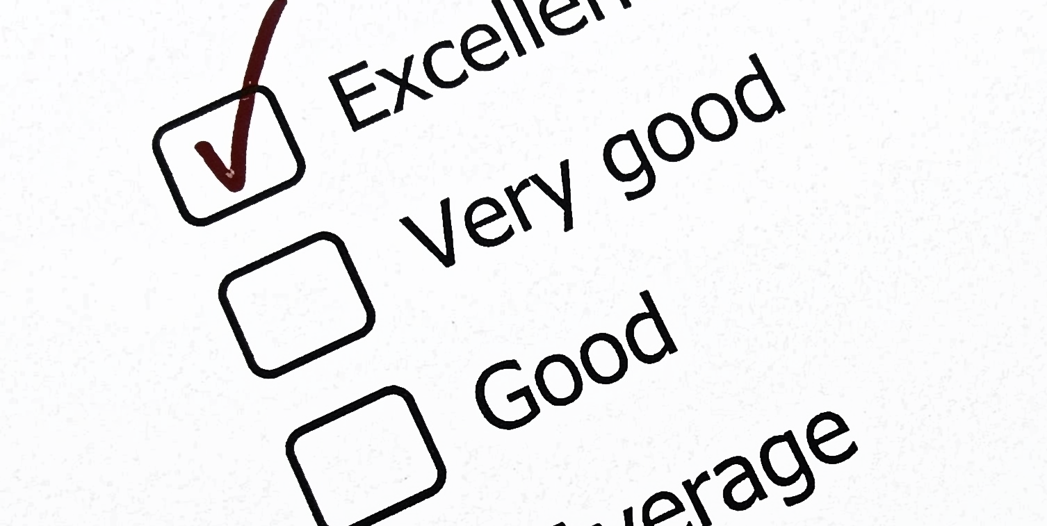
conflict resolution
how do we engage in healthy conflict?
Set the Tone
Listen to the Person
Remain Calm
Provide Feedback
Express Empathy
Notes:
Feedback includes asking clarity questions to ensure a thorough understanding and awareness of the key points. When possible, paraphrasing and summarize. Feedback also involves providing constructive guidance.

Slide 9
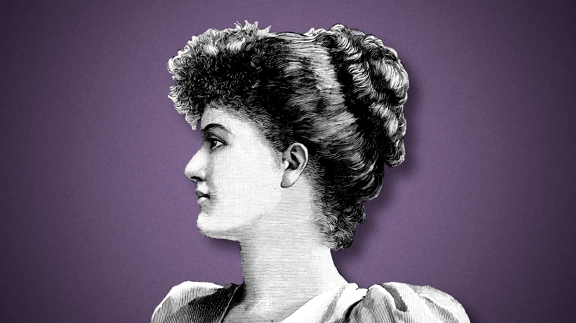
Acknowledge their circumstances and feelings. Ask ‘how are you feeling?’ and show empathy. Not everyone is naturally empathic; think about what you would do in their shoes. Show sympathy when appropriate.
conflict resolution
how do we engage in healthy conflict?
Set the Tone
Listen to the Person
Remain Calm
Provide Feedback
Express Empathy
Notes:
Acknowledge their circumstances and feelings. Ask ‘how are you feeling?’ and show empathy. Not everyone is naturally empathic; think about what you would do in their shoes. Show sympathy when appropriate.

Slide 10
tips to difficult conversations
BEGIN with the END in mind
Know your opening line.
Always start with an agenda, the end goals, “If this is a successful conversation, then…”
I want to leave the conversation with zero confusion. Don’t be afraid to be direct, even blunt.
I want to leave the conversation having said/intimated that I care about the person.
I want to leave the conversation letting the person know that although it is over, the door is still open for further discussion.
I want to leave the conversation not “burning bridges.”

Slide 11
tips to difficult conversations
from a business perspective
Keep your goals realistic. You can't eliminate the stress, but you can reduce it. Some things can’t change easily.
Give bad news upfront. Tough messages should be simply & clearly stated in the first few sentences.
Adopt the "And Stance". Take control of the conversation by pre-empting distractions, objections & blame by using "and". "I know you worked all night, and I know you want to do well, and I know you are new, and I know I could have been clearer..." and, and, and.
Get out of the "blame frame." Each person involved in the situation has a different objective story. Your goal is not to judge right & wrong, it's to manage better outcomes.
Dowling, Harvard Business Review

Slide 12
more tips to difficult conversations
from a business perspective
Paraphrase. Create clarity & let people know you're genuinely listening, summarize what they're telling you.
Be prepared for bad reactions. Finger-pointing, denial, arguments & tears are all possible outcomes of tough conversations. You cannot control the other person's reactions but anticipate & be ready.
Pretend it's 3 months or 10 years from now. Put the conversation in perspective by thinking about the future. Conversations that are hardest right now will seem less daunting.
Dowling, Harvard Business Review

Slide 13
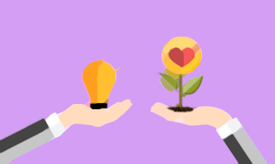
productive difficult conversations
here are the benefits
  build trust
  increased empathy and understanding
  comfort and creativity
  energized motivating climate
  desire to collaborate
  growth and opportunities

Slide 14

case study
imagine the following…
You are in the early stages of writing a publication (or dissertation proposal) and your advisor wants you to go in a different direction with your topic.
What is the issue here?
What are the costs and benefits of approaching this issue with your advisor?
What is your advisor’s position and interest, and what is yours?
What is your strategy?

Slide 15
common difficult conversations
in trainee:mentor relationships
Scenario | Trainee's Role | Advisor's Role
You want to change your research topic | You feel the current topic doesn’t align with your goals | You think the current topic is feasible and well-funded
You’re burned out and need time off | You’re overwhelmed and need a short break | You’re focused on meeting project deadlines
You're unclear on expectations | You feel confused about priorities and deadlines | You assume the trainee is keeping up and hasn’t raised concerns
You’re upset over authorship | You thought you’d be first author on the paper | You see the advisor or another student as deserving first authorship
You want more feedback/support | You’re feeling lost and want regular check-ins | You’re busy with other responsibilities and think the student is doing fine

Slide 16
common difficult conversations
in trainee:mentor relationships
Tip | What to Avoid | What to Try Instead | Why It Works
Use "We" Language | "You never respond to my emails on time." | "I wonder if we could find a way to make communication easier for both of us." | Shifts from blame to collaboration.
Focus on Shared Goals | "You're not giving me what I need." | "I think we both want this project to move forward smoothly..." | Emphasizes mutual investment in outcomes.
Separate Person from Problem | "You’re not a good mentor." | "I’ve been feeling stuck and could use more guidance — can we talk about mentoring?" | Keeps the focus on the issue, not their character.
Be Curious, Not Accusatory | "Why do you always do it this way?" | "Can you help me understand the reasoning behind this approach?" | Invites open dialogue and shows respect.
State Impact, Not Intent | "You don’t care about my time." | "When meetings run long, it’s hard for me to manage other commitments — can we adjust?" | Focuses on your experience rather than assuming bad motives.
Suggest Solutions, Don’t Just Vent | "This isn’t working." | "Would it be possible to check in weekly so I can stay on track?" | Moves from complaint to constructive action.
Normalize the Conversation | (Avoiding the conversation entirely) | "I know this might be awkward, but I really value your mentorship and want to improve." | Frames the conversation as a sign of respect and commitment.

Slide 17
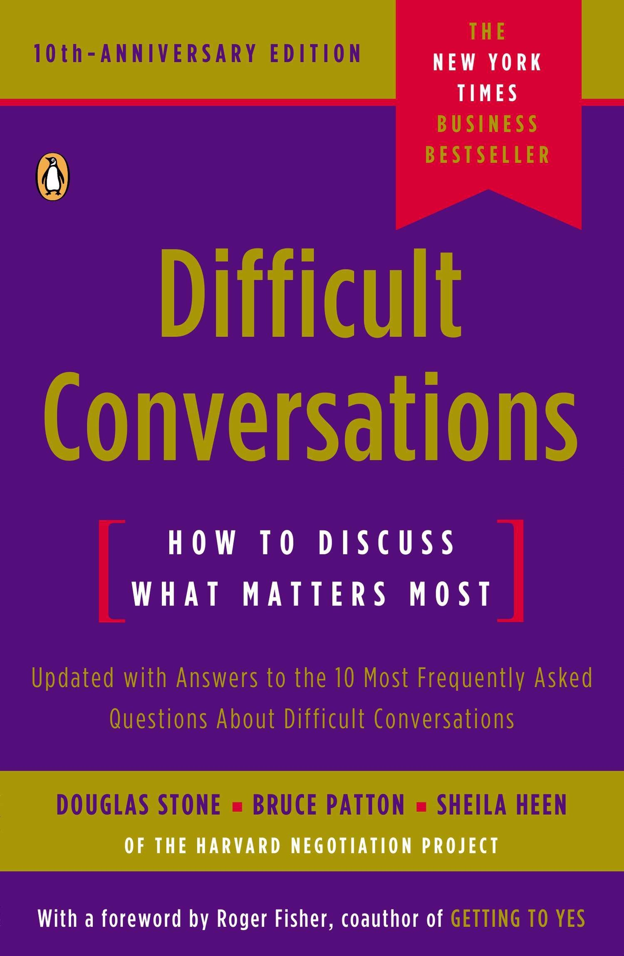

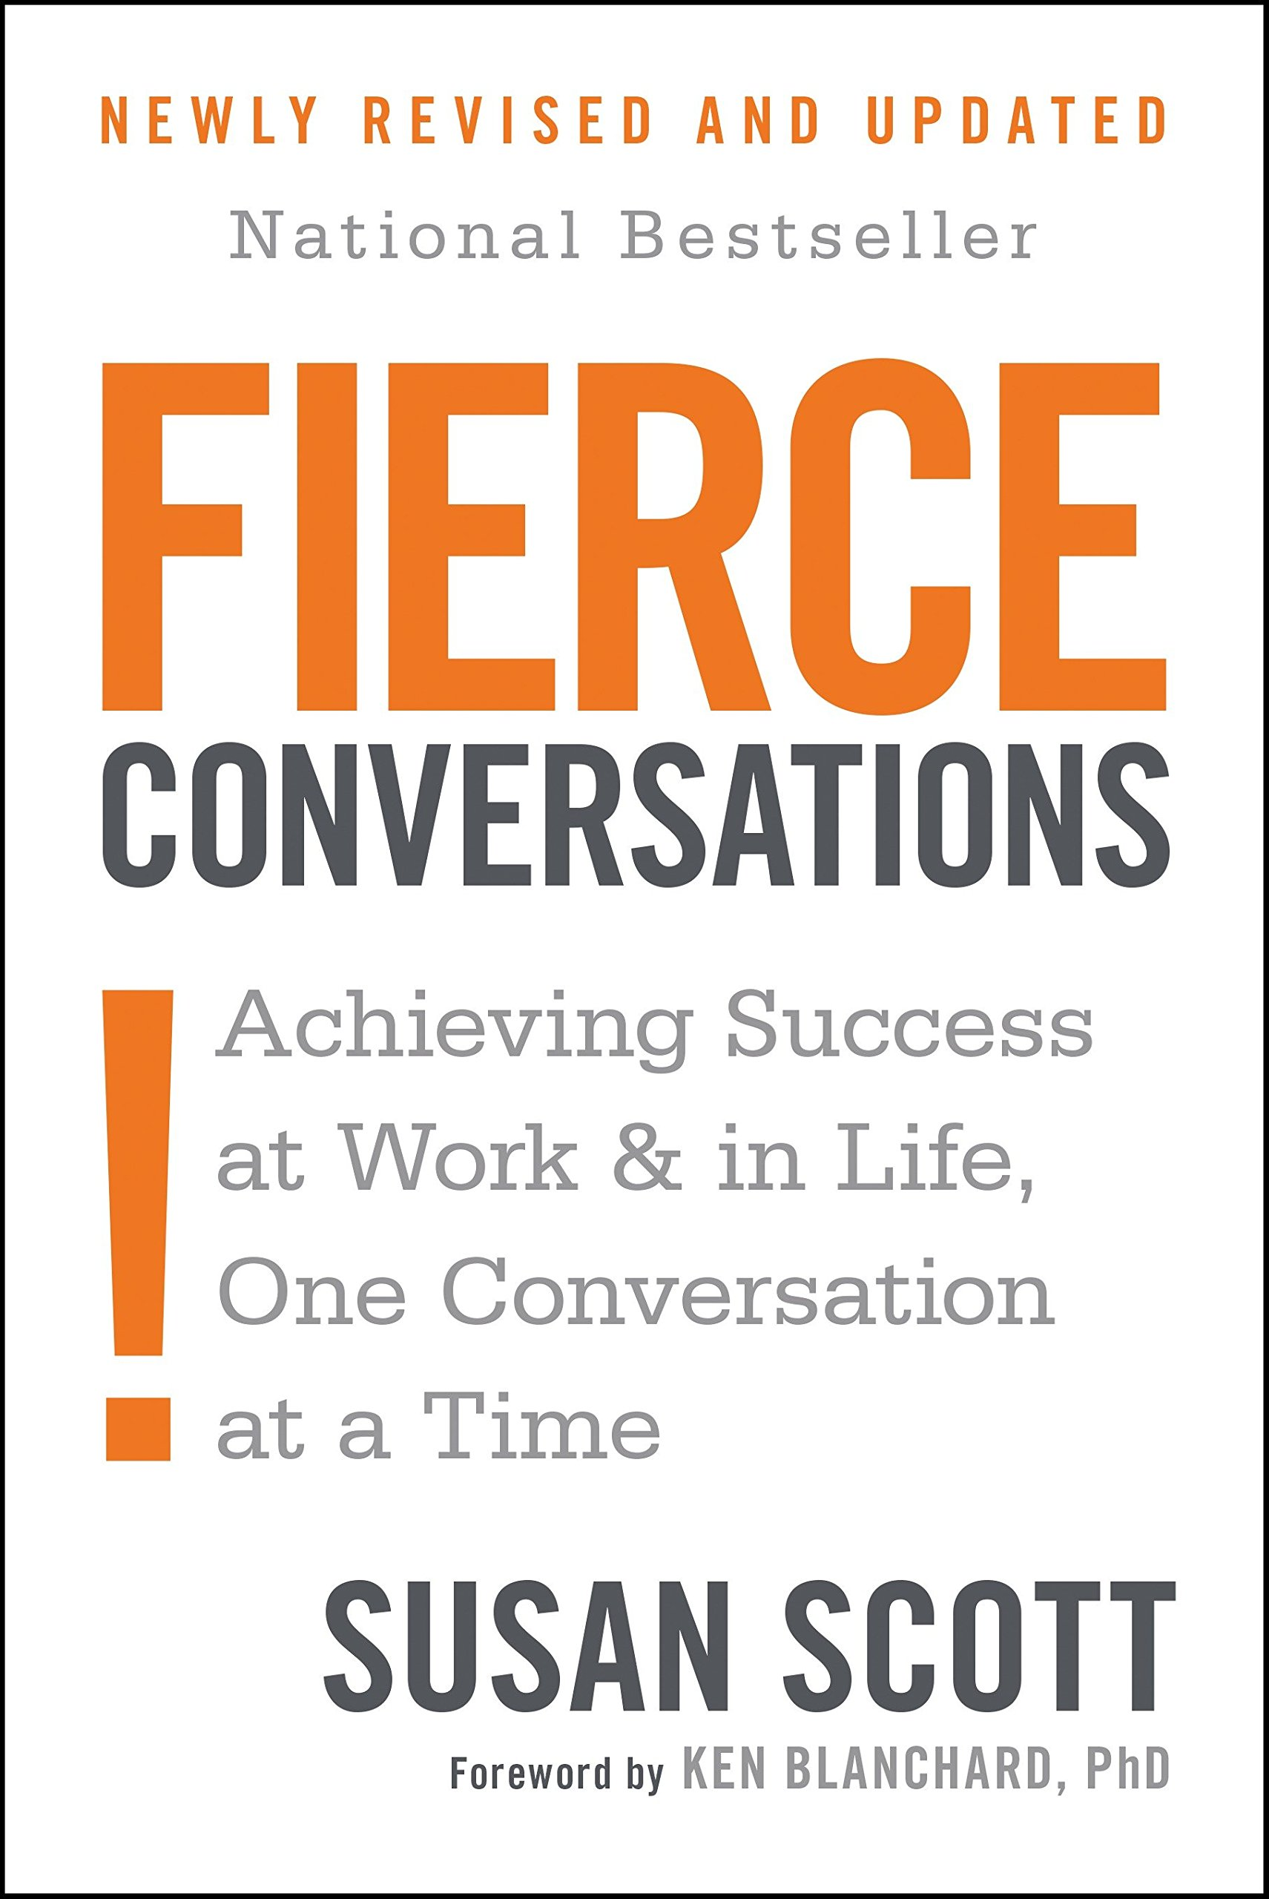
further reading
resources
Difficult Conversations: How to Discuss What Matters Most by D. Stone, B. Patton, S. Keen (1999).
Crucial Conversations: Tools for Talking When the Stakes are High by Patterson, Grenny, McMillan, and Switzler (2001).
Fierce Conversations: Achieving Success at Work and in Life One Conversation at a Time by Susan Scott (2004).

