Slide 1
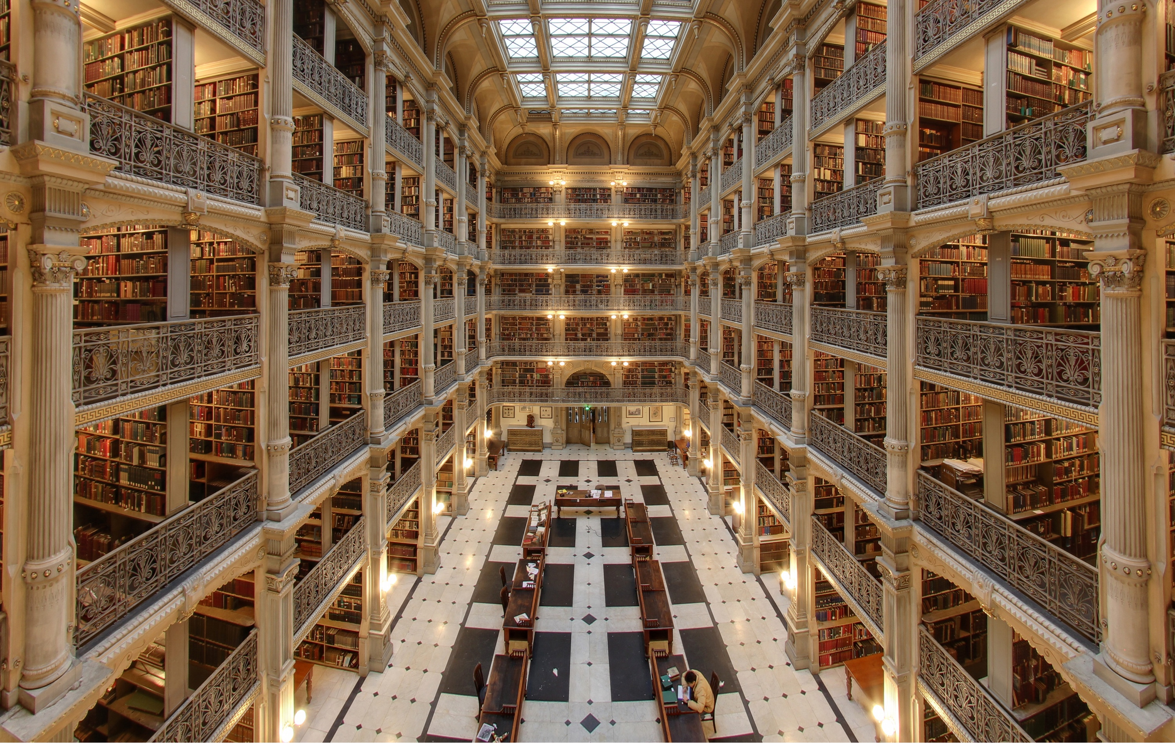
how to stay on top of the literature
how to catch the wave and enjoy the ride
Michael T McManus, PhD
University of California, San Francisco
Mentoring Workshop
July 29th, 2024
Notes:
George Peabody Library (Baltimore)

Slide 2
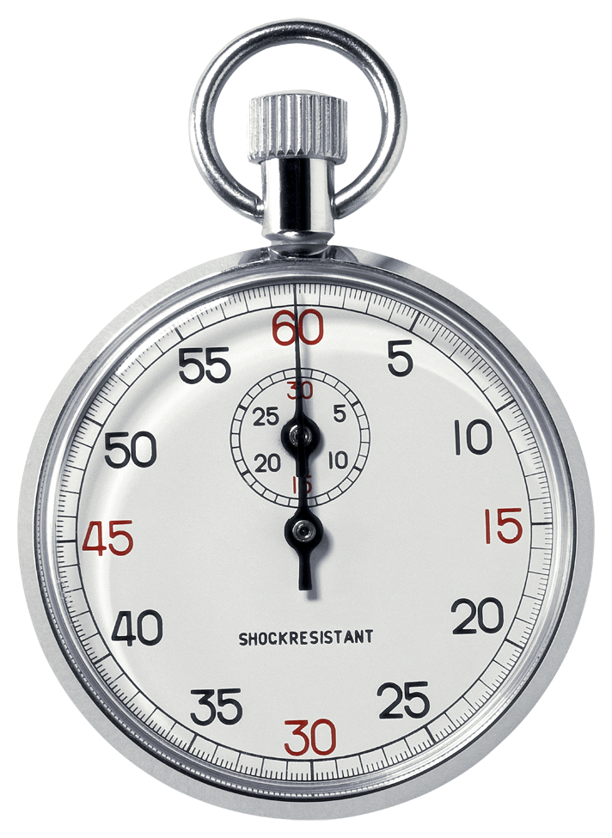
how to stay on top of the literature
making the time to build knowledge and ideas
where does the time go?
time is your most precious resource
Reading/Writing Papers
allocate your time appropriately
Various Meetings
Experiments

Slide 3
imagine reading and writing more papers
why bother?
“I’d rather focus on generating data needed to get my publications out the door first, rather than waste time reading the literature now”
imagine
The gut wrenching feeling when you come across a paper that impacts your work. Imagine the feeling when you discover that the paper is months or even years old.
The feeling when (on an interview seminar), a colleague asks how your work differs from another very similar research program. Imagine the feeling when you realize that you actually don’t know the work.
Discovering that your whole research approach is fundamentally flawed, or perhaps antiquated. Imagine the feeling when you find out that others have developed solutions to your approach… after you’ve spent months or years on your project.

Slide 4
reading and writing more papers
why bother?
“I’d rather focus on generating data needed to get my publications out the door first, rather than waste time reading the literature now”
Case Study
two students, nearly identical CVs, one gets a dream postdoc slot, the other doesn’t. How?
two postdocs, nearly identical CVs, both interview, one gets a job interview, the other doesn’t. Fair?
two techs, nearly identical CVs, one excels in the interview, the other doesn’t. Why?

Slide 5
reading and writing more papers
do you feel paralyzed?
you are not alone
Notes:
Start with an objective
Think of the resulting action, ie your goal.
Learn how to Sail.
Learning the tools to help navigate the sea of data will help you sail faster
Keep it regular
Digesting smaller amounts of data avoids consttipation

Slide 6
the data deluge
the most successful scientists see this as an opportunity

Slide 7
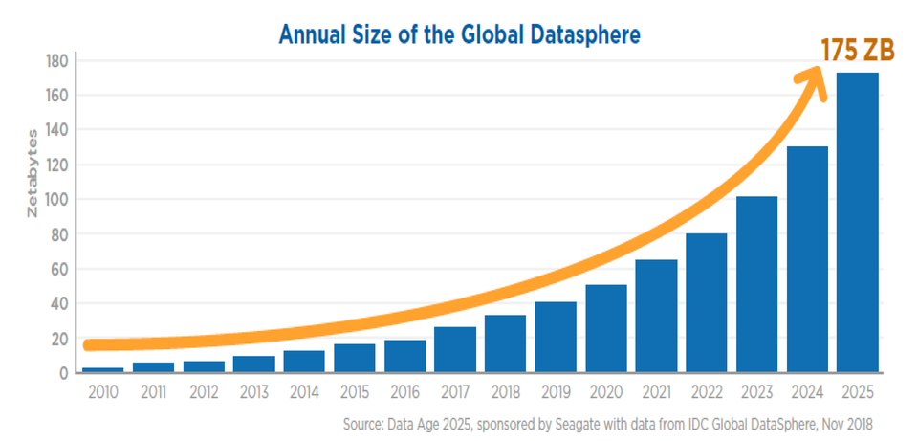
the data deluge
sound familiar?
“Genomic research makes it possible to look at biological phenomena on a scale not previously possible: all genes in a genome, all transcripts in a cell, all metabolic processes in a tissue. One feature that all of these approaches share is the production of massive quantities of data. GenBank, for example, now accommodates >10¹⁰ nucleotides of nucleic acid sequence data and continues to more than double in size every year. New technologies for assaying gene expression patterns, protein structure, protein-protein interactions, etc., will provide even more data. How to handle these data, make sense of them, and render them accessible to biologists working on a wide variety of problems is the challenge facing bioinformatics—an emerging field that seeks to integrate computer science with applications derived from molecular biology. We are swimming in a rapidly rising sea of data. . . how do we keep from drowning?”
—Roos (2001). Bioinformatics--Trying to Swim in a Sea of Data. Science. 291:1260

Slide 8
how to stay on top of the literature
discovery, analytics, reference libraries, and alerts
Discover the most relevant data.
Mining the world’s data to advance your science
Embracing analytics to decipher and distill data.
Analyzing data to identify key research, collaborations, funding sources, etc
Building a reference library to house your data.
Organizing your collected works to save time
Creating email alerts to stay on top of emerging data.
Once you have caught the wave, enjoy surfing it.

Slide 9
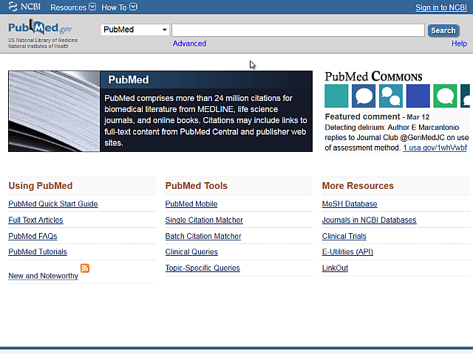
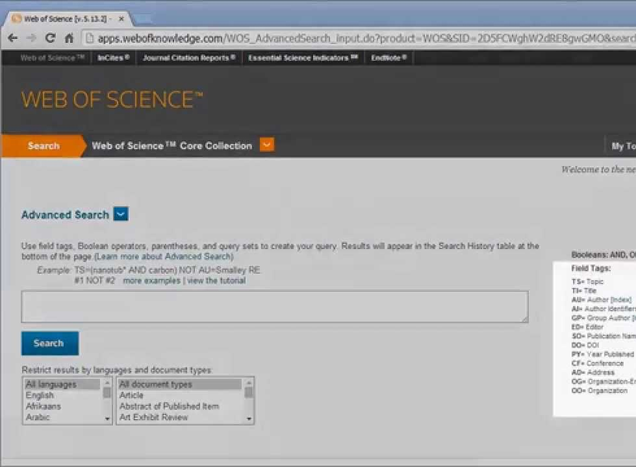
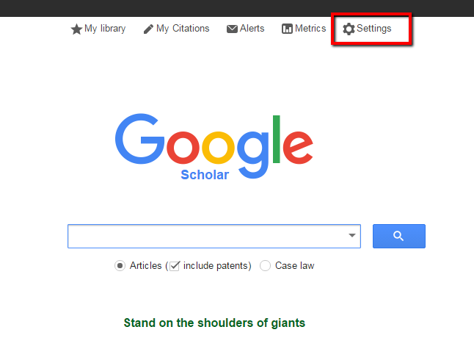
traditional engines
these are still excellent
Pubmed
Web of Science
Google Scholar
https://www.ncbi.nlm.nih.gov/pubmed/
https://webofknowledge.com/
https://scholar.google.com/

Slide 10
email alerts help you stay on top of emerging data
avoid these common mistakes
learn how to best use these powerful tools.
1: using the wrong keywords without Boolean operators
broad terms like ‘microRNA’ or ’CRISPR’ will drown you with results
2: focusing only on journal articles
journal articles are only a fraction of the available data
3: limiting searches to only subject keywords
citation alerts, authors, grants/fellowships, conferences, seminars, etc
4: ignoring your results
frequently missing your searches and feeds will give you a false sense of security

Slide 11
nextgen tools
when you need to find new papers, explore connections between research, manage citations and stay updated with the latest data
Undermind
Scite
Litmaps
Connected Papers
Quillbot
Jenni
SciSpace
Paperpile
EvidenceHunt
Elicit
Readwise
ChatGPT
SearchGPT
Iris.ai
ProQuest
Litmaps
Elicit
Connected Papers
ResearchRabbit
SciSpace
Sparrho
Scholarcy
Semantic Scholar
Consensus
Perplexity
Lens
growing list of others
A free tool for mining dissertations and theses
A free tool for mining scientific literature
A free tool for mining patent literature

Slide 12
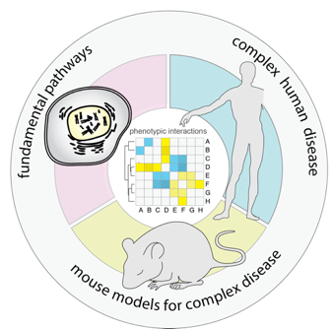
mining the scientific literature
when you need to find new papers, explore connections between research, and stay updated with the latest developments
McManus Lab
Neil Tay Tao Li
Dan Levy Katie Horvath
Yuhao Wang Stefan Oberlin
Gabriel Eades Imane Moutkine
Ruz Mosadeghi Natalia Moskal
Orry Elor Krishna Choudhary
Louis Sharp You?

