Slide 1
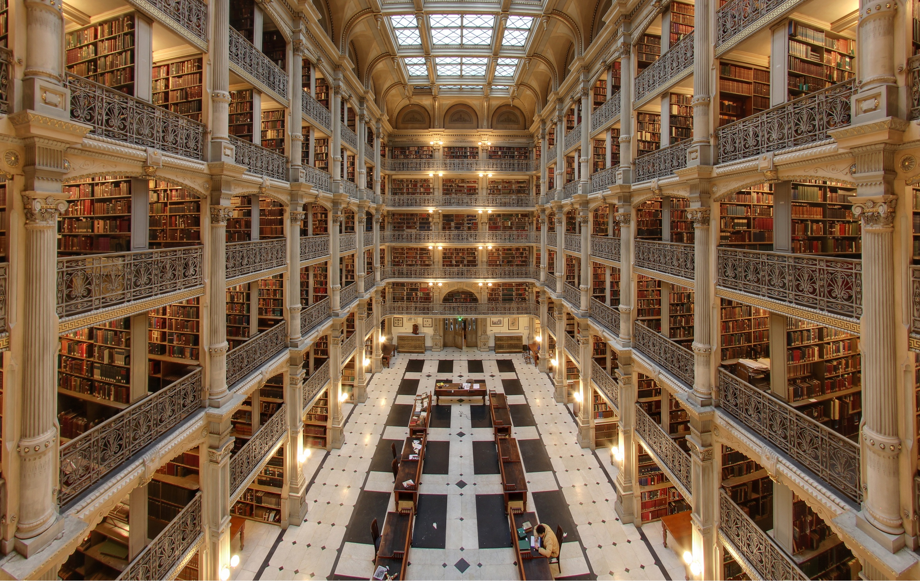
swimming in the literature
how to catch the wave and enjoy the ride
Michael T McManus, PhD
University of California, San Francisco
Mentoring Workshop
April 1th, 2025
Notes:
George Peabody Library (Baltimore)

Slide 2
how to stay on top of the literature
discovery, analytics, reference libraries, and alerts
Discover the most relevant data.
Mining the world’s data to advance your science
Embracing analytics to decipher and distill data.
Analyzing data to identify key research, collaborations, funding sources, etc
Building a reference library to house your data.
Organizing your collected works to save time
Creating email alerts to stay on top of emerging data.
Once you have caught the wave, enjoy surfing it.

Slide 3
imagine reading and writing more papers
why bother?
“I’d rather focus on generating data needed to get my publications out the door first, rather than waste time reading the literature now”
imagine
The gut wrenching feeling when you come across a paper that impacts your work. Imagine the feeling when you discover that the paper is months or even years old.
The feeling when (on an interview seminar), a colleague asks how your work differs from another very similar research program. Imagine the feeling when you realize that you actually don’t know the work.
Discovering that your whole research approach is fundamentally flawed, or perhaps antiquated. Imagine the feeling when you find out that others have developed solutions to your approach… after you’ve spent months or years on your project.

Slide 4
reading and writing more papers
why bother?
“I’d rather focus on generating data needed to get my publications out the door first, rather than waste time reading the literature now”
Case Study
two students, nearly identical CVs, one gets a dream postdoc slot, the other doesn’t. How?
two postdocs, nearly identical CVs, both interview, one gets a job interview, the other doesn’t. Fair?
two techs, nearly identical CVs, one excels in the interview, the other doesn’t. Why?

Slide 5
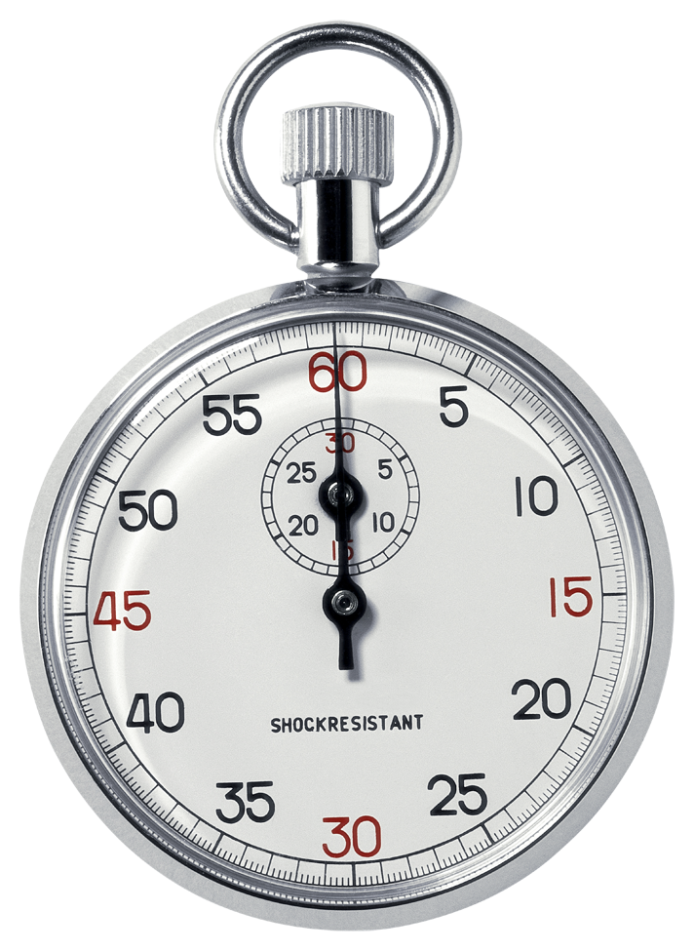
how to stay on top of the literature
making the time to build knowledge and ideas
where does the time go?
time is your most precious resource
Reading/Writing Papers
allocate your time appropriately
Various Meetings
Experiments

Slide 6
reading and writing more papers
do you feel paralyzed?
you are not alone
Notes:
Start with an objective
Think of the resulting action, ie your goal.
Learn how to Sail.
Learning the tools to help navigate the sea of data will help you sail faster
Keep it regular
Digesting smaller amounts of data avoids constipation

Slide 7
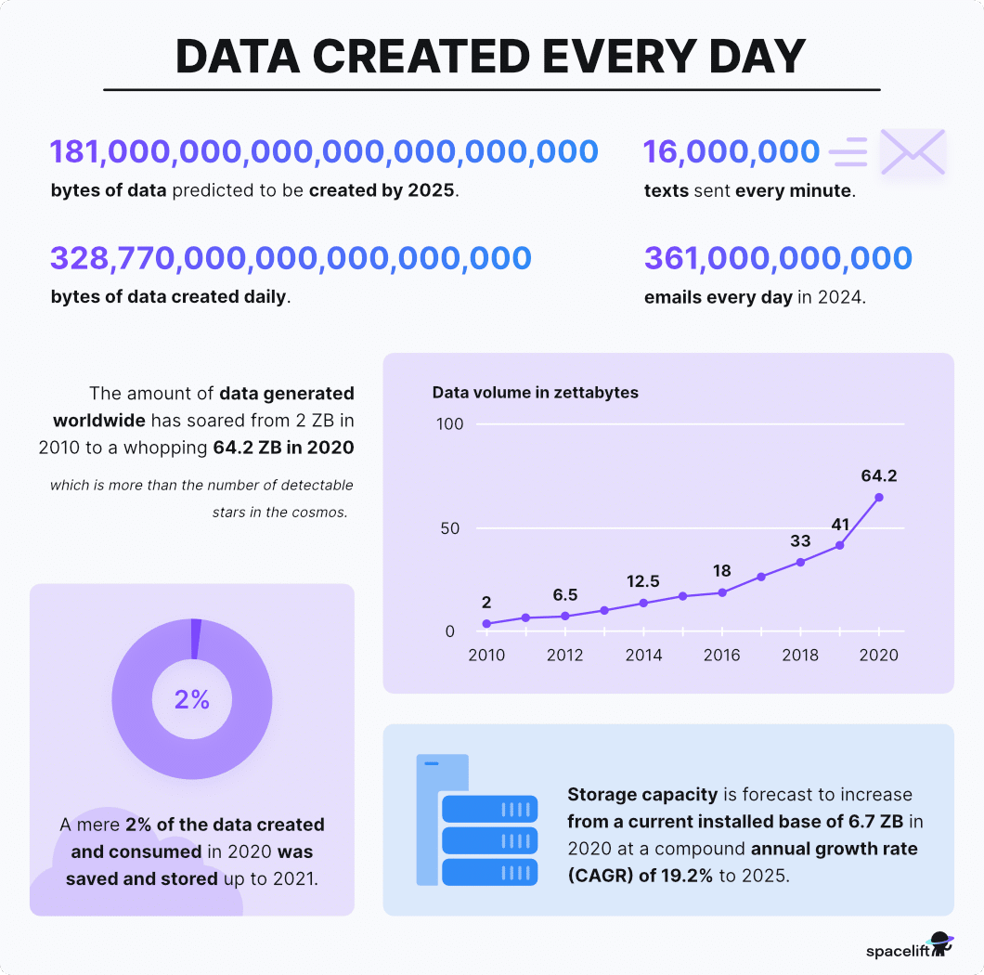
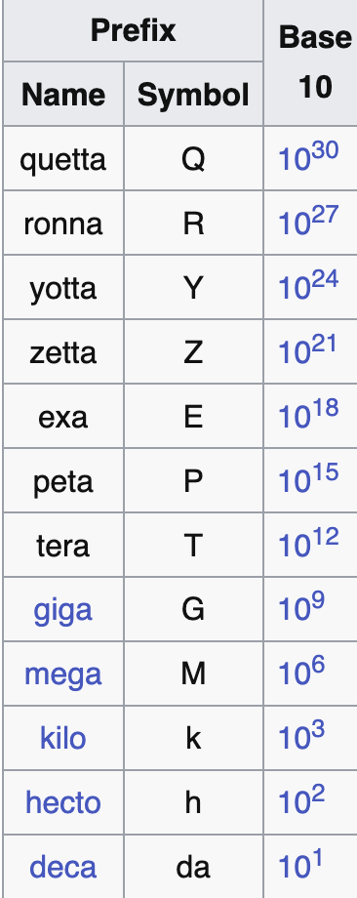
the data deluge
the most successful scientists see this as an opportunity

Slide 8
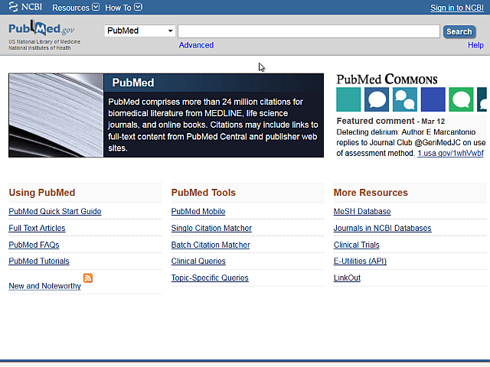
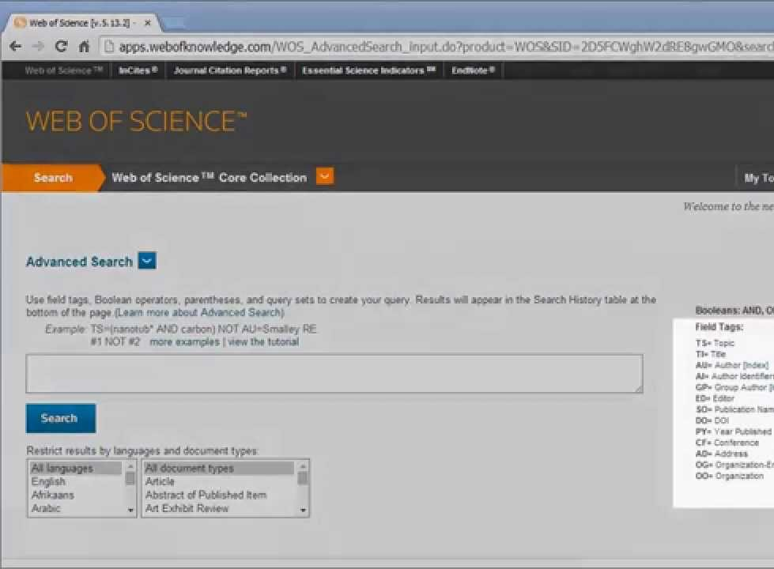
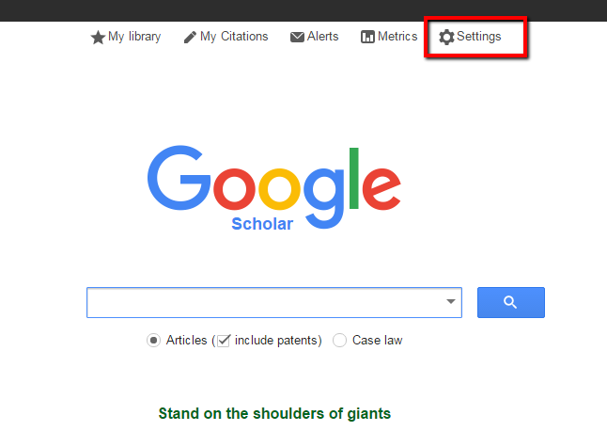
traditional engines
these are still good but…. for not much longer
Pubmed
Web of Science
Google Scholar
https://www.ncbi.nlm.nih.gov/pubmed/
https://webofknowledge.com/
https://scholar.google.com/

Slide 9
nextgen tools
when you need to find new papers, explore connections between research, manage citations and stay updated with the latest data
Undermind
SciSpace
OpenAlex
Perplexity
Scite
Elicit
NinjaAI
Consensus
ResearchRabbit
Jenni
NoteboookLM
ThesisAI
EvidenceHunt
Readwise
ChatGPT DR
Iris.ai
  ProQuest
  Litmaps
  Elicit
  Connected Papers
  Quillbot
  Julius AI
  Sparrho
  Scholarcy
  Semantic Scholar
  SearchGPT
  Litmaps
  Lens
  Gemini 2.5 DR
  Grok and Llama DR
  growing list of others
example: a free tool for mining dissertations and theses
example: a free tool for mining scientific literature
example: a free tool for mining patent literature

Slide 10
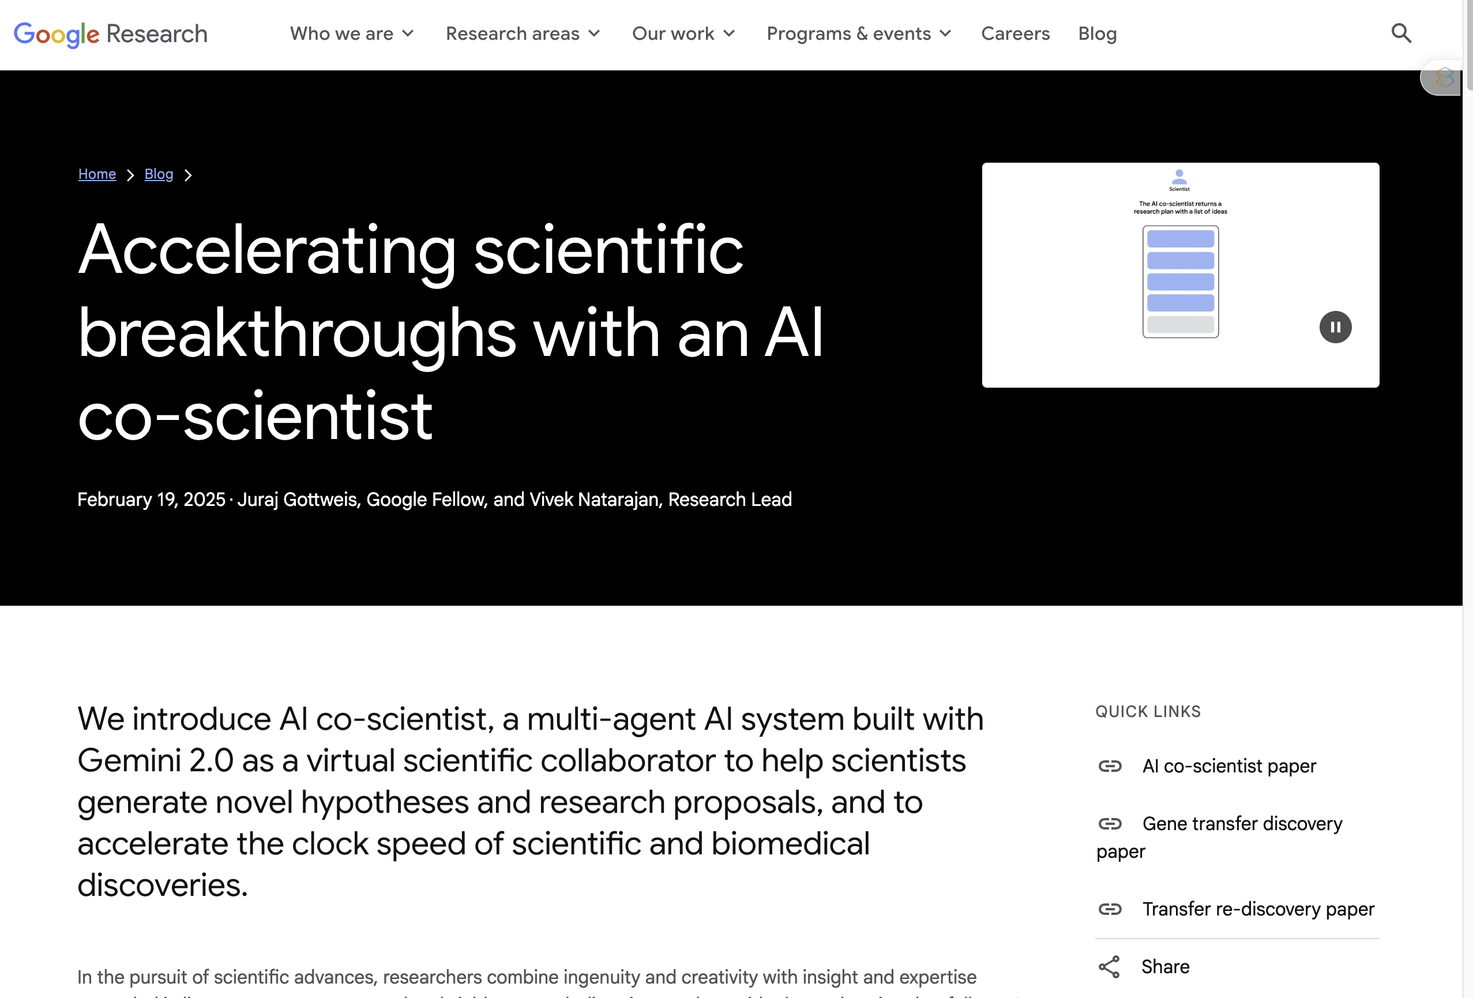
example: far beyond publication searches
multi-agent AI systems
https://storage.googleapis.com/coscientist_paper/ai_coscientist.pdf

Slide 11
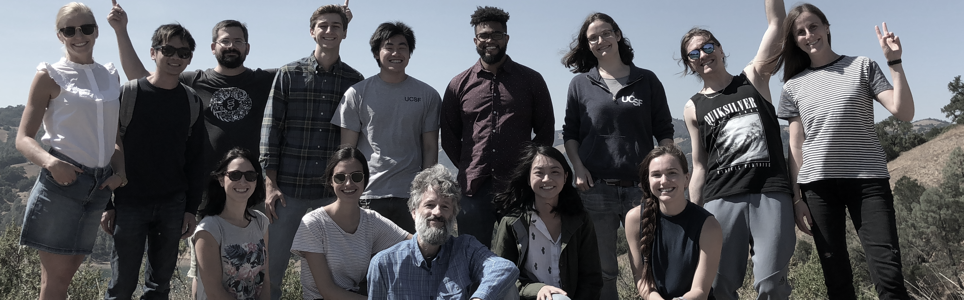
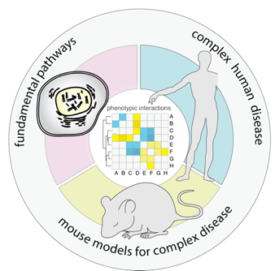
mining the scientific literature
when you need to find new papers, explore connections between research, and stay updated with the latest developments

