Slide 1
mentoring
past and future topics
Have fun while doing science
How To Stay On Top Of The Literature
How To Interview A Candidate
How To Prepare A Winning Poster
When, Where, And How To Publish
Imposter Syndrome
The Art Of Collaboration
Mentoring A Rotation Student
Effective Time Management
How To Give A Winning Elevator Pitch
Positive Psychology and Reinforcement

Slide 2
mentoring
past and future topics
Creating A Beautiful Figure
Scientific Career Choices
Choosing A Scientific Home
Difficult Conversations
Blow Them Away With Your Talk
Giving Solid Feedback
What Is Luck In Science
Diversity and Equality and Inherent Bias
Mid-Postdoc/Phd Crisis
Acing Your Interview
How To Create a Star Academic/Industry CV
Goal Setting and Motivation Strategies

Slide 3
mentoring
past and future topics
Using Your Environment To Advance Your Career
Networking Strategies
References: managing your discovered research
Reviewing Manuscripts
Staying Sane During Your Phd/Postdoc
The Mona Lisa Effect
Achieving Work-Life Balance
Writing Letters: One For Every Purpose
Reviewing Fellowships And Grants
Making an Impact Through Your Science
Writing A Winning Fellowship
Here and Now: Stress and Health

Slide 4
remember what you enjoy most
and do more of that…

Slide 5
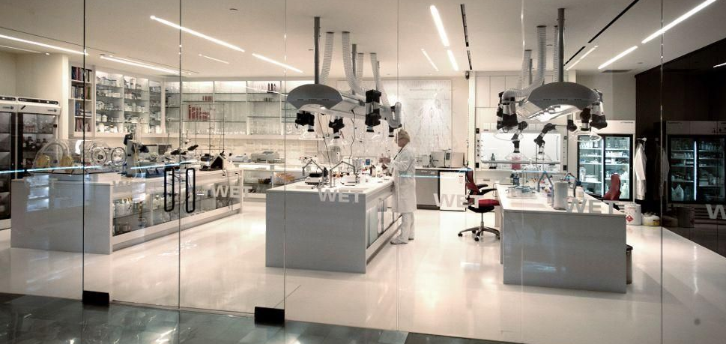
make a playground in the lab
never forget why you became a scientist
We can set up an exploratory budget or portioned time

Slide 6
make a goal to write every day or so
and write with a purpose in mind
We can organize team writing projects or develop writing workshops

Slide 7
make a goal to read every day or so
and write with a purpose in mind
We can organize team writing projects or develop writing workshops
Schedule regular meetings to discuss your reading

Slide 8
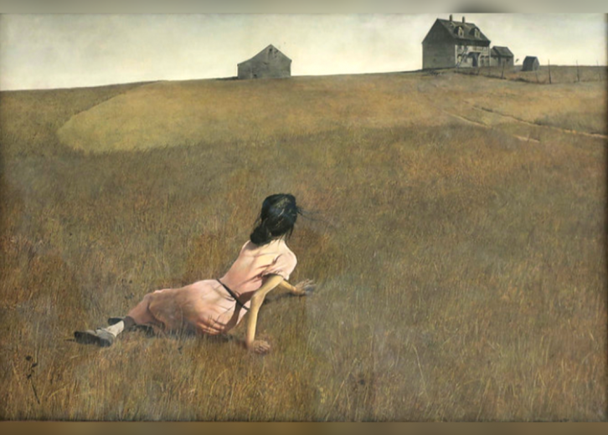
learn how to develop beautiful figures
“while drawing I discover what I really want to say”― Dario Fo
We can develop focused workshops to facilitate these skills
https://biorender.com/
http://mkweb.bcgsc.ca/pointsofsignificance/figures.mhtml
https://stock.adobe.com/

Slide 9
communicate with your collaborators frequently
never work alone
Let’s discuss how to address challenges in collaborative enterprises

Slide 10
build your network
and have fun while doing it
Let’s discuss ways to improve your networking

Slide 11
engage with the public
it’s more than a responsibility. it can be fun(ny).
As a group, we will make it easier for us to engage the community

Slide 12
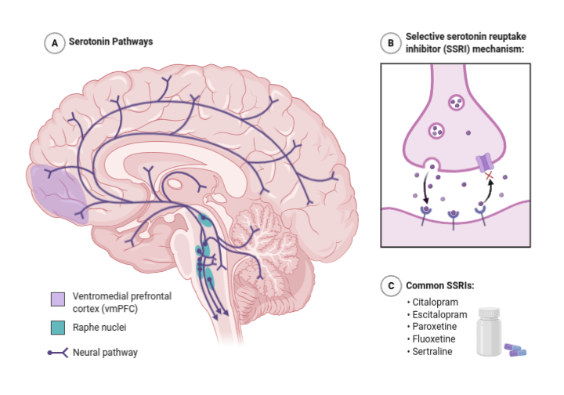
find balance
a healthy brain in a healthy body
Exercise, social interactions, hobbies, meditation, etc

Slide 13
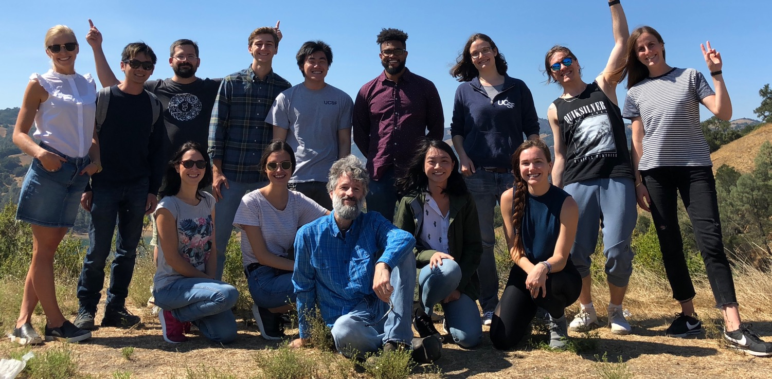
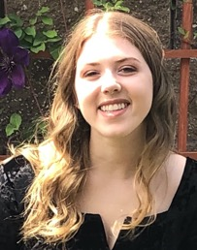
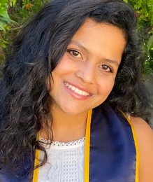
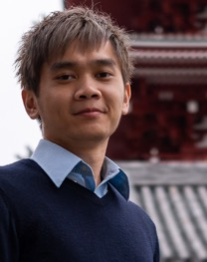
illuminating dark pathways
Systematic Functional Genomics Platforms to Solve Fundamentally Difficult Problems

