Slide 2
mentoring
future topics
Using Your Environment To Advance Your Career
Networking Strategies
Positive Psychology and Reinforcement
Reviewing Manuscripts
Staying Sane During Your Phd/Postdoc
The Mona Lisa Effect
Achieving Work-Life Balance
Writing Letters: One For Every Purpose
Reviewing Fellowships And Grants
Writing A Winning Fellowship

Slide 3
mentoring
future topics
Creating A Beautiful Figure
Scientific Career Choices
Choosing A Scientific Home
Difficult Conversations
Blow Them Away With Your Talk
Giving Solid Feedback
What Is Luck In Science
Mid-Postdoc/Phd Crisis
Acing Your Interview
How To Create a Star Academic/Industry CV

Slide 4
difficult conversations
what are some examples of difficult conversations?
Giving a negative performance review
Confiding personal issues
Giving the PI feedback
Talking about changes in career plans
Asking in-laws to stop interfering
Notes:
You need to know how to do this.

Slide 5

barriers to difficult conversations
fear of negative repercussions
fear of damaging relationship
fear of a bad reference letter
fear of ‘making things worse’
resentment, anger, and frustration
fear of legal consequences

Slide 6

conflict resolution
how do we engage in healthy conflict?
Conflict is inevitable. Without conflict, there can be no growth.
Healthy conflict is a respectful, debate-style conversation. Strong passion is A-OK, providing there is no personalization.
Unhealthy conflict is toxic. Toxic conversations often involve power play and can involve personalization and be unfocused.
Notes:
Healthy conflict is when those who are engaged in the process respect and appreciate the other’s point of view. This type of conflict usually manifests in a debate-style conversation where each person is presenting their case and the conversation goes back and forth. While passions may run high on the topic, there is no personalization of the conversation. At the end of the conflict both people know their relationship is still intact and may even be stronger.
Unhealthy conflict is toxic. It works its way into conversation or topics where it doesn’t belong. Sometimes it is conflict for conflict’s sake. Other times it presents as a power play where one person seeks to gain power over another or gain prestige in the eyes of the team or their boss. Unhealthy conflict is like school yard bullying…it can catch you off guard and tear you down before you know what is happening. It seeps into every day conversation and can make most interactions adversarial.

Slide 7

avoiding difficult conversations
here are the risks
No growth, no improvement
Problem gets worse
Resentment
Relationship erodes
Stress and health issues
Notes:
What will happen if you have this conversation? What will happen if you don’t?

Slide 8
conflict resolution
how do we engage in healthy conflict?
Set the Tone
Listen to the Person
Remain Calm
Provide Feedback
Express Empathy
Notes:
Stay focused on the goal of the conversation. What is the agenda? What are the immediate vs longer term objectives? Can you begin with the positives? What is the purpose? Establish a shared understanding before you begin.

Slide 9

conflict resolution
how do we engage in healthy conflict?
Set the Tone
Listen to the Person
Remain Calm
Provide Feedback
Express Empathy
Notes:
After establishing the goal of the conversation, ask questions. Listen. What are they saying? Some personalities are indirect… can you hear the words that they are ‘not saying’? What is their body language saying?

Slide 10
conflict resolution
how do we engage in healthy conflict?
Set the Tone
Listen to the Person
Remain Calm
Provide Feedback
Express Empathy
Notes:
Recognize their emotions, deal with anger quickly and reject any unacceptable behavior.
Consider cultural and personality differences. It’s OK for professional heated discussion, providing that it is not directed at the person.

Slide 11

conflict resolution
how do we engage in healthy conflict?
Set the Tone
Listen to the Person
Remain Calm
Provide Feedback
Express Empathy
Notes:
Feedback includes asking clarity questions to ensure a thorough understanding and awareness of the key points. When possible, paraphrasing and summarize. Feedback also involves providing constructive guidance.

Slide 12

Acknowledge their circumstances and feelings. Ask ‘how are you feeling?’ and show empathy. Not everyone is naturally empathic; think about what you would do in their shoes. Show sympathy when appropriate.
conflict resolution
how do we engage in healthy conflict?
Set the Tone
Listen to the Person
Remain Calm
Provide Feedback
Express Empathy
Notes:
Acknowledge their circumstances and feelings. Ask ‘how are you feeling?’ and show empathy. Not everyone is naturally empathic; think about what you would do in their shoes. Show sympathy when appropriate.

Slide 13
tips to difficult conversations
BEGIN with the END in mind
Always start with an agenda, the end goals, “If this is a successful conversation, then…”
I want to leave the conversation with zero confusion. Don’t be afraid to be direct, even blunt.
I want to leave the conversation having said/intimated that I care about the person.
I want to leave the conversation letting the person know that although it is over, the door is still open for further discussion.
I want to leave the conversation not “burning bridges.”

Slide 14
tips to difficult conversations
from a business perspective
Keep your goals realistic. You can't eliminate the stress, but you can reduce it. Some things simply can’t change easily.
Give bad news upfront. Tough messages should be simply & clearly stated in the first few sentences.
Adopt the "And Stance". Take control of the conversation by pre-empting distractions, objections & blame by using "and". "I know you worked all night, and I know you want to do well, and I know you are new, and I know I could have been clearer..." and, and, and.
Get out of the "blame frame." Each person involved in the situation has a different objective story. Your goal is not to judge right & wrong, it's to manage better outcomes.
Dowling, Harvard Business Review

Slide 15
more tips to difficult conversations
from a business perspective
Paraphrase. Create clarity & let people know you're genuinely listening, summarize what they're telling you.
Be prepared for bad reactions. Finger-pointing, denial, arguments & tears are all possible outcomes of tough conversations. You cannot control the other person's reactions, but anticipate & be ready.
Pretend it's 3 months or 10 years from now. Put the conversation in perspective by thinking about the future. Conversations that are hardest right now will seem less daunting.
Dowling, Harvard Business Review

Slide 16
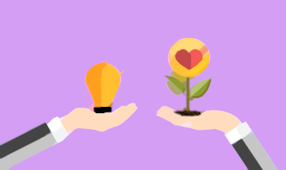
productive difficult conversations
here are the benefits
  build trust
  increased empathy and understanding
  comfort and creativity
  energized motivating climate
  desire to collaborate
  growth and opportunities

Slide 17

case study
imagine the following…
You are in the early stages of writing a publication (or dissertation proposal) and your advisor wants you to go in a different direction with your topic (that is more in alignment with your current research focus).
What is the issue here?
What are the costs and benefits of approaching this issue with your advisor?
What is your advisor’s position and interest, and what is yours?
What is your strategy?

Slide 18
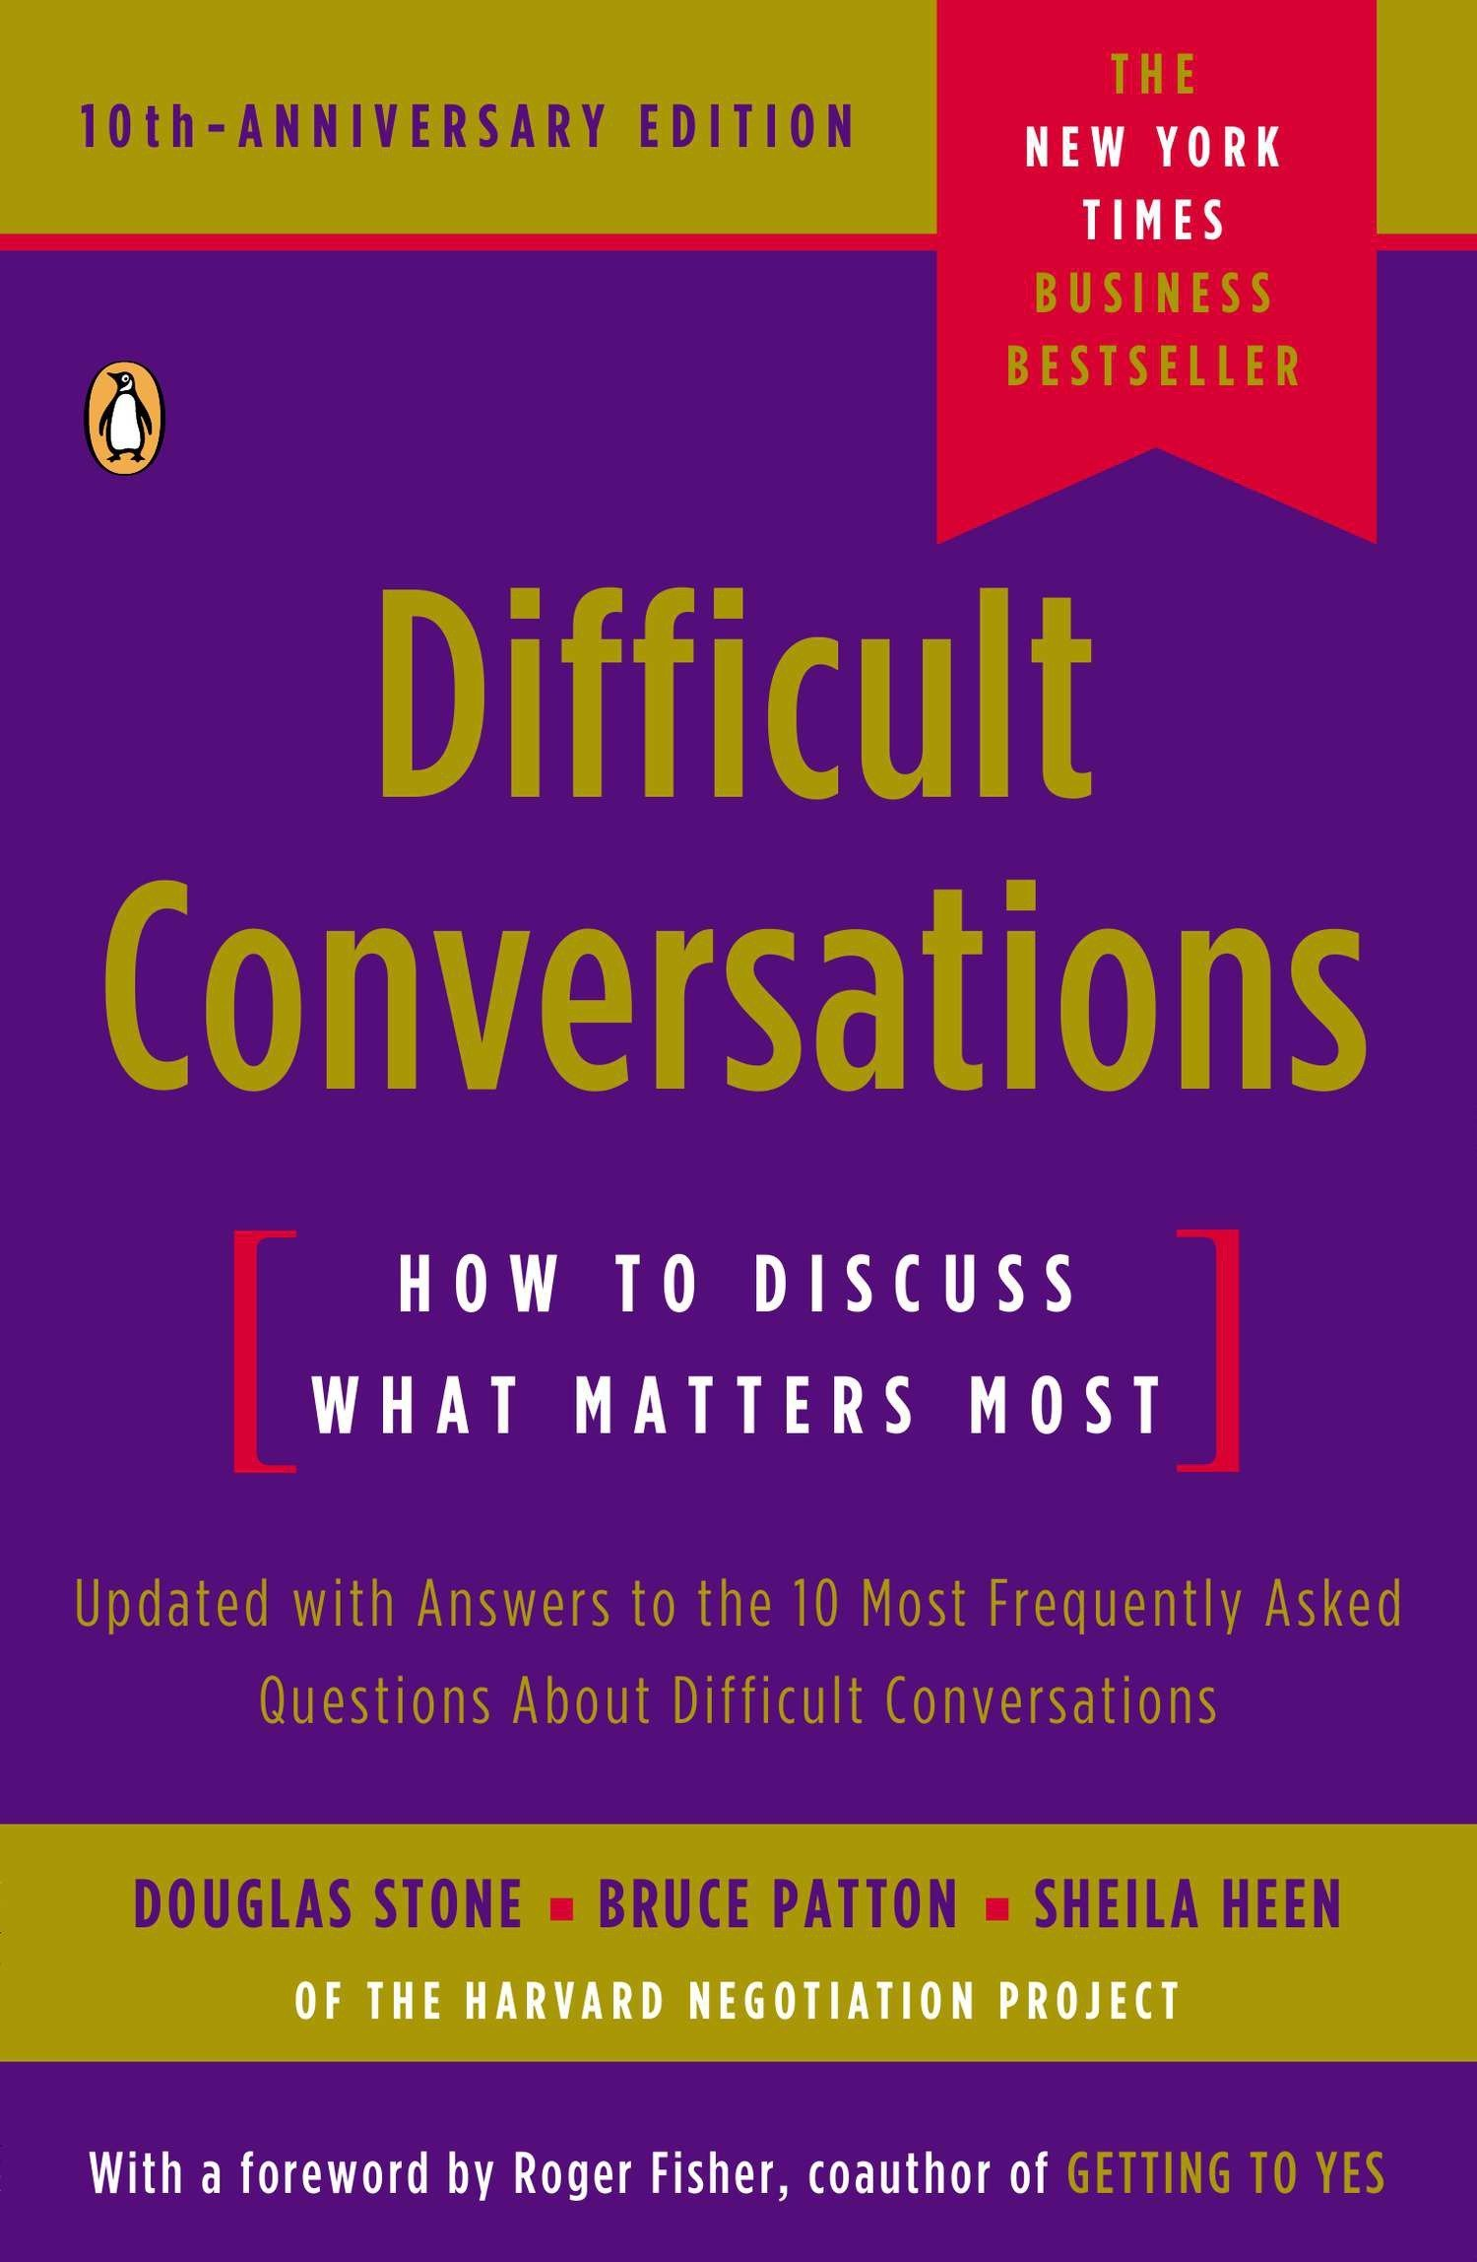

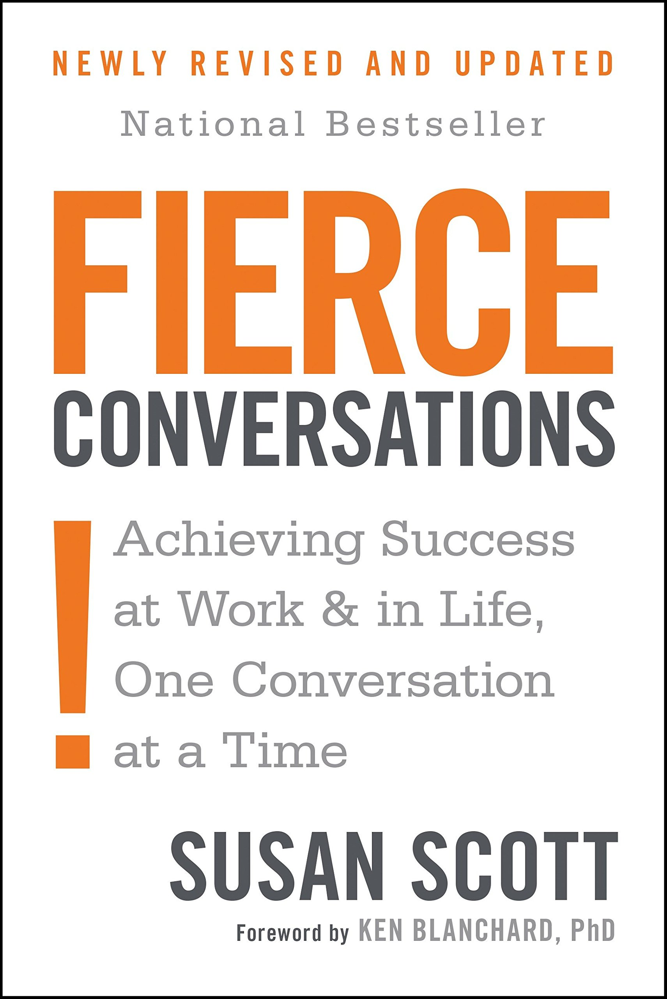
further reading
resources
Difficult Conversations: How to Discuss What Matters Most by D. Stone, B. Patton, S. Keen (1999).
Crucial Conversations: Tools for Talking When the Stakes are High by Patterson, Grenny, McMillan, and Switzler (2001).
Fierce Conversations: Achieving Success at Work and in Life One Conversation at a Time by Susan Scott (2004).

