Slide 1
mentoring
past and future topics
Creating A Beautiful Figure
Scientific Career Choices
Choosing A Scientific Home
Difficult Conversations
Blow Them Away With Your Talk
Giving Solid Feedback
What Is Luck In Science
Diversity and Equality and Inherent Bias
Mid-Postdoc/PhD Crisis
Acing Your Interview
How To Create a Star Academic/Industry CV
Here and Now: Stress and Health
Using Your Environment To Advance Your Career
Networking Strategies
References: managing your discovered research
Reviewing Manuscripts
Staying Sane During Your Phd/Postdoc
The Mona Lisa Effect
Leadership and Competency
Accountability
How To Stay On Top Of The Literature
How To Interview A Candidate
How To Prepare A Winning Poster
When, Where, And How To Publish
Imposter Syndrome
The Art Of Collaboration
Mentoring A Rotation Student
Effective Time Management
How To Give A Winning Elevator Pitch
Positive Psychology and Reinforcement
Achieving Work-Life Balance
Writing Letters: One For Every Purpose
Reviewing Fellowships And Grants
Making an Impact Through Your Science
Writing A Winning Fellowship

Slide 2
Pandemic, Diversity, and a Divided America
2020: a year that almost wasn’t
nonetheless, some things did go well:
We came together
We organized
We stayed safe
We were innovative
We adapted
We showed strength

Slide 3
formulating a strong team
key ingredients for any lab

Slide 4
leadership and competency
cultivating strong teams
in a strong lab, each person:
is a good collaborator
has a perspective and contributes it
has a sense of the “maze” they work within every day
understands how they contribute to the greater whole
are bonded by devotion, compassion, and concern for each other
works to improve themselves, personally and professionally

Slide 5
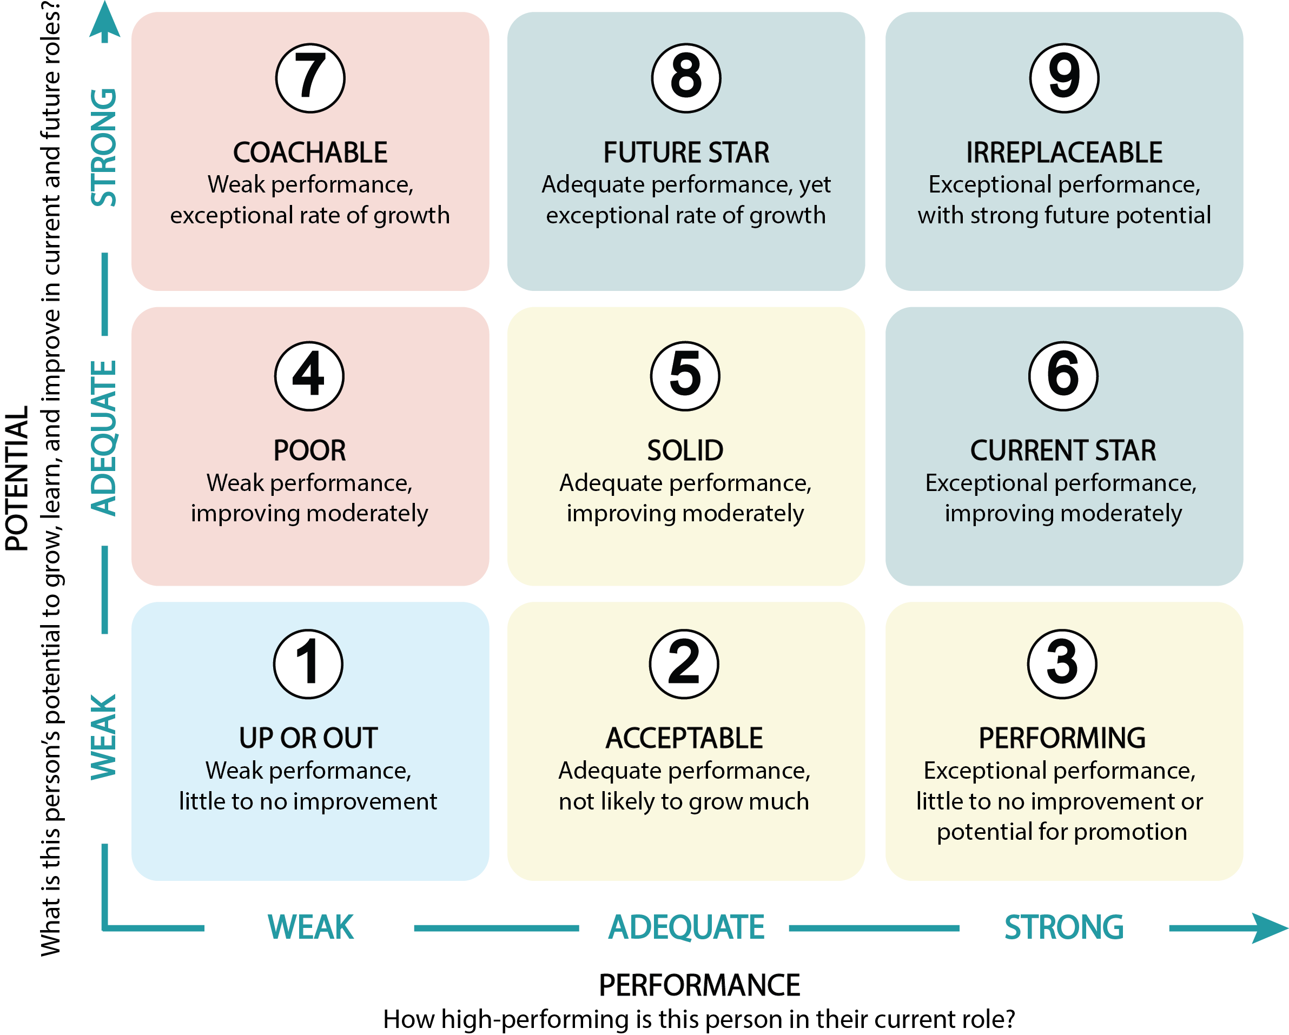
nine box grid
consider your competencies, performance, growth, and potential

Slide 6
core competencies
rate yourself now; how do you want to rate yourself in 2 years
Core Competencies
Research and Technical Skills
Academic Writing: Writing and publishing academic papers.
Experimental Design and Optimization: Designing robust and reproducible experiments, continuously optimizing protocols.
Data Analysis and Visualization: Proficiency in analyzing data, creating clear visualizations, and interpreting results.
Advanced Techniques: For example, utilizing advanced imaging, statistical methods, and bioinformatics tools for research.
Coding and Algorithm Development: Writing code for data analysis and developing algorithms for research applications.
AI and Machine Learning: Applying AI and machine learning tools to research problems (includes LLMs).
Laboratory Skills: Mastery of lab techniques, equipment maintenance, and automation.
Ethical Research Practices: Adhering to ethical guidelines in data management, animal use, and human subjects research.
Regulatory Compliance: Ensuring compliance with all relevant institutional policies, laws, and regulations.

Slide 7
core competencies
rate yourself now; how do you want to rate yourself in 2 years
Core Competencies
Communication and Collaboration
Communication Skills: Proficiency in writing, presenting research findings, and engaging with diverse audiences.
Collaborative Tools and Software: Proficiency with collaborative research tools and software.
Teamwork and Interpersonal Skills: Ability to work effectively in teams, manage conflicts, and foster a positive lab culture.
Cross-Disciplinary and Global Collaboration: Collaborating across disciplines and with national/international teams.

Slide 8
core competencies
rate yourself now; how do you want to rate yourself in 2 years
Core Competencies
Project Management and Funding
Project Management: Managing time, resources, and projects effectively.
Fellowship/Grant Writing and Management: Skills in writing grant proposals, managing budgets, and ensuring compliance.
Resource Management: Efficiently allocating and managing lab resources and supplies.

Slide 9
core competencies
rate yourself now; how do you want to rate yourself in 2 years
Core Competencies
Professional Development
Continuous Learning: Commitment to lifelong learning and staying updated with the latest research.
Mentorship and Leadership: Providing and seeking career mentorship, leading research teams. Includes teaching.
Networking and Community Building: Building professional networks and fostering a sense of community within the lab.

Slide 10
core competencies
rate yourself now; how do you want to rate yourself in 2 years
Core Competencies
Innovation and Technology
Technology Integration and Adaptation: Integrating new technologies and methodologies into research.
Digital Literacy: Proficiency in digital tools and platforms used in research.
Innovation and Entrepreneurship: Implementing innovative ideas and exploring opportunities for commercialization.

Slide 11
core competencies
rate yourself now; how do you want to rate yourself in 2 years
Core Competencies
Miscellaneous
Public Engagement and Outreach: Communicating scientific concepts to the public and engaging in outreach activities.
Science Communication: Writing for lay audiences and engaging with media.
Policy and Advocacy: Understanding science policy, advocating for research funding and policy changes.

Slide 12
Large Number of Competencies
your mileage will vary
+200
different competencies
which ones apply to you?
of the competencies that apply to you, rank yourself (1-10)
Past
Present
future
although this list may not be comprehensive, it might be useful to identify your goals and growth opportunities

Slide 13
Research and Technical Skills
Experimental Design and Techniques
Advanced Imaging Techniques: Utilizing advanced imaging techniques for research.
Advanced Statistical Methods: Applying advanced statistical methods to complex data sets.
Algorithm Development: Developing algorithms for data analysis and research applications.
Bioinformatics: Utilizing bioinformatics tools and techniques for data analysis.
Coding and Scripting: Proficiency in coding or scripting for data analysis and automation.
Experimental Design: Ability to design robust and reproducible experiments.
Experimental Optimization: Continuously optimizing experimental protocols for better results.
Experiment Automation: Automating repetitive experimental tasks.
Experiment Customization: Customizing experiments to suit specific research needs or conditions.
Experiment Replication: Ensuring that experiments can be reliably replicated.
Experimental Troubleshooting: Ability to identify and resolve issues in experiments.
Field Research Logistics: Managing the logistics of conducting field research.
Fieldwork Skills: Competence in conducting field research, if applicable.
Machine Learning: Applying machine learning techniques to research problems.
Time Series Analysis: Analyzing time-dependent data effectively.
Translational Research: Bridging the gap between translational research and laboratory findings and clinical applications.

Slide 14
Research and Technical Skills
Data Management and Analysis
AI and Data Analysis: Using artificial intelligence tools for data analysis.
Data Analysis: Proficiency in analyzing and interpreting data.
Data Archiving: Properly archiving data for future research and reference.
Data Backup: Implementing and maintaining data backup systems.
Data Ethics: Applying ethical considerations to data collection, analysis, and sharing.
Data Integration: Integrating data from multiple sources effectively.
Data Mining: Extracting useful information from large datasets.
Data Privacy: Ensuring the privacy and security of sensitive research data.
Data Security: Implementing and maintaining data security measures.
Data Visualization: Creating clear and informative data visualizations.
Database Management: Managing and organizing research databases.
Digital Data Management: Efficiently managing digital data and utilizing cloud storage solutions.
Documentation Compliance: Ensuring all documentation meets regulatory and institutional standards.
Documentation Practices: Maintaining thorough and accurate documentation of all research activities.
Documentation Standards: Ensuring all research documentation meets high standards of accuracy and completeness.
Digital Archiving: Archiving digital data and research materials securely.
Record Keeping: Maintaining detailed and accurate lab notebooks and records.
Reproducible Research: Ensuring research methods and results are reproducible.

Slide 15
Research and Technical Skills
Communication and Collaboration
Academic Writing: Writing and publishing academic papers.
Communication Skills: Proficiency in writing and presenting research findings.
Critical Reading: Ability to critically read and assess scientific papers.
Critical Thinking: Ability to critically evaluate scientific literature and experimental results.
Digital Communication: Utilizing digital platforms to communicate research findings effectively.
Journal Club Participation: Actively participating in and contributing to journal club discussions.
Knowledge Translation: Translating complex scientific knowledge into practical applications or policies.
Literature Review: Ability to conduct thorough and comprehensive literature reviews.
Media Communication: Communicating research findings to the media effectively and responsibly.
Media Engagement: Engaging with media to communicate research findings.
Presentation Design: Designing visually appealing and effective presentation materials.
Presentation Feedback: Giving and receiving constructive feedback on presentations.
Presentation Skills: Mastering public speaking and presentation skills for scientific conferences.
Presentation Software: Proficiency with software for creating scientific presentations (e.g., PowerPoint, Keynote).
Public Engagement: Ability to communicate scientific concepts to the public or non-specialists.
Science Communication: Communicating scientific concepts clearly to non-specialists.
Scientific Blogging: Writing and managing a scientific blog.
Scientific Writing: Skill in writing scientific papers and reports.
Science Writing for Lay Audiences: Writing about scientific topics in a way that is accessible to non-specialists.
Social Media Engagement: Using social media to engage with the scientific community.
Writing Reviews: Writing comprehensive reviews of the literature.

Slide 16
Research and Technical Skills
Teamwork and Collaboration
Adaptability to Change: Adapting to new research directions or funding priorities.
Adaptation to Technology: Quickly adapting to new technologies and methodologies.
Collaboration: Ability to work effectively in a team.
Collaboration Tools: Proficiency with collaborative tools and platforms (e.g., shared drives, project management software).
Collaborative Grant Management: Managing joint grant projects with multiple collaborators and institutions.
Collaborative Grant Writing: Collaborating with others to write and submit joint grant proposals.
Collaborative Research Tools: Proficiency with collaborative research tools and software.
Collaborative Software: Using collaborative software for joint research projects.
Collaborative Writing: Collaborating on writing projects with multiple authors.
Conflict Management: Managing and resolving conflicts within the research team.
Conflict Mediation: Mediating conflicts within the research team to maintain a positive working environment.
Conflict of Interest Management: Identifying and managing conflicts of interest in research.
Conflict Resolution Skills: Resolving conflicts within the research team constructively.
Continuous Improvement: Applying continuous improvement principles to enhance research processes.
Continuous Learning: Commitment to continuous learning and staying updated with the latest research.
Cross-Cultural Communication: Effectively communicating with international collaborators.
Cross-Cultural Competence: Demonstrating competence in working with international and cross-cultural teams.
Cross-Disciplinary Collaboration: Working effectively with researchers from other disciplines.
Cross-Disciplinary Training: Pursuing training opportunities in disciplines related to your research..

Slide 17
Research and Technical Skills
Teamwork and Collaboration (continued)
Cross-Functional Collaboration: Working with offices, such as development, to advance research goals.
Interdepartmental Coordination: Coordinating efforts and resources across different departments.
Interdisciplinary Collaboration: Collaborating effectively across different scientific disciplines.
Interdisciplinary Knowledge: Understanding of related fields and integrating knowledge across disciplines.
Interdisciplinary Problem Solving: Solving research problems using knowledge from multiple disciplines.
Interpersonal Communication: Enhancing interpersonal communication within the lab.
Interpersonal Dynamics: Navigating interpersonal dynamics within the lab effectively.
Interpersonal Skills: Building strong working relationships with colleagues and collaborators.
Global Collaboration: Collaborating with international research teams and understanding global research standards.
Mentoring Undergraduates: Effectively mentoring and supervising undergraduate students.
Mentorship: Ability to mentor and train junior students or lab members.
Networking Events: Effectively participating in networking events and conferences.
Networking Skills: Actively building a professional network within the scientific community.
Networking: Building professional relationships and collaborations.
Open Science Practices: Adopting open science practices to share data and results.
Remote Collaboration: Skills in collaborating effectively with remote teams.
Research Networking: Networking with researchers in other institutions and disciplines.
Stakeholder Engagement: Engaging with stakeholders, including funders, industry partners, and the community.

Slide 18
Research and Technical Skills
Project and Resource Management
Budget Management: Managing research project budgets effectively.
Grant Budgeting: Skills in creating and managing grant budgets.
Grant Compliance: Ensuring compliance with grant requirements and reporting.
Grant Management: Overseeing the budget and reporting for funded research projects.
Project Dissemination: Effective dissemination of research findings through various channels (e.g., conferences, workshops).
Project Evaluation: Evaluating the success and impact of research projects.
Project Management: Ability to manage time, resources, and projects effectively.
Proposal Writing: Writing successful research proposals and funding applications.
Protocol Development: Creating and optimizing experimental protocols.
Resource Allocation Strategy: Developing strategies for the efficient allocation of lab resources.
Resource Allocation: Efficiently allocating resources for research projects.
Resource Management: Efficiently managing lab resources, including supplies and equipment.
Risk Management: Identifying and mitigating risks in research projects.
Strategic Planning: Engaging in strategic planning for research projects and career development.
Strategic Thinking: Applying strategic thinking to plan and execute research projects.

Slide 19
Research and Technical Skills
Funding (Fellowships and Grants etc)
Collaborative Grant Management: Managing joint grant projects with multiple collaborators and institutions.
Collaborative Grant Writing: Collaborating with others to write and submit joint grant proposals.
Funding Acquisition: Identifying and pursuing funding opportunities.
Funding Diversification: Diversifying funding sources to ensure financial stability of research projects.
Funding Opportunities Identification: Identifying and pursuing new funding opportunities.
Funding Proposal Review: Reviewing and critiquing funding proposals.
Grant Budgeting: Skills in creating and managing grant budgets.
Grant Compliance: Ensuring compliance with grant requirements and reporting.
Grant Management: Overseeing the budget and reporting for funded research projects.
Grant Writing: Skills in writing grant proposals and securing funding.

Slide 20
Professional Development and Ethics
Continuous Learning and Mentorship
Career Mentorship: Seeking and providing career mentorship.
Continuous Improvement: Applying continuous improvement principles to enhance research processes.
Continuous Learning: Commitment to continuous learning and staying updated with the latest research.
Critical Feedback: Giving and receiving constructive feedback.
Life-Long Learning: Committing to life-long learning and professional development.
Mentoring Undergraduates: Effectively mentoring and supervising undergraduate students.
Mentorship: Ability to mentor and train junior students or lab members.
Professional Certification: Obtaining professional certifications relevant to your research field.
Professional Development Planning: Creating and following a professional development plan.
Professional Development: Actively seeking opportunities for professional growth.

Slide 21
Professional Development and Ethics
Ethics and Compliance
Biosecurity: Understanding and implementing biosecurity measures in the lab.
Conflict of Interest Management: Identifying and managing conflicts of interest in research.
Data Ethics: Applying ethical considerations to data collection, analysis, and sharing.
Ethical AI Use: Understanding ethical considerations in using AI and machine learning in research.
Ethical Conduct: Understanding and adherence to ethical guidelines in research.
Ethical Data Management: Ensuring ethical management and sharing of research data.
Ethical Data Sharing: Sharing data ethically and in accordance with open science principles.
Ethical Dilemmas: Navigating and resolving ethical dilemmas in research.
Ethical Publication: Understanding the ethics of authorship and publication.
Ethical Reporting: Reporting research findings ethically and transparently.
Ethical Review: Conducting ethical reviews of research proposals.
Ethical Reviewing: Participating in ethical review boards or committees.
Ethical Use of Animals: Conducting research with animals ethically and in compliance with regulations.
Ethics Training: Participating in and applying ethics training programs.
Human Subjects Research: Conducting research involving human subjects ethically and compliantly.

Slide 22
Professional Development and Ethics
Ethics and Compliance (continued)
Intellectual Property Law: Understanding intellectual property law and its implications for research.
Intellectual Property Management: Understanding the management of intellectual property in research.
Intellectual Property Strategy: Developing strategies to protect intellectual property and innovations.
Legal Compliance: Ensuring all research activities comply with relevant laws and regulations.
Professional Ethics: Adhering to professional ethics in all aspects of research and collaboration.
Publication Ethics: Understanding and adhering to publication ethics and standards.
Regulatory Affairs Knowledge: Understanding regulatory affairs and ensuring compliance in research.
Regulatory Compliance: Knowledge of regulatory requirements and ensuring compliance.
Research Governance: Understanding and participating in the governance structures of research institutions.
Research Integrity: Upholding the highest standards of research integrity and honesty.
Scientific Ethics: Deep understanding of scientific integrity and ethical issues.
Scientific Integrity: Upholding the highest standards of scientific integrity and honesty.

Slide 23
Innovation and Technology
Technology and Innovation Management
Adaptation to Technology: Quickly adapting to new technologies and methodologies.
Digital Literacy: Proficiency in digital tools and platforms used in research.
Digital Transformation: Leading digital transformation initiatives within the lab.
Emerging Technologies: Staying abreast of and integrating emerging technologies into research practices.
Innovation Implementation: Implementing innovative research techniques and technologies.
Innovation Management: Managing and implementing innovative ideas in research.
Innovation: Creativity in developing new methods or approaches to research problems.
Technology Assessment: Assessing and integrating new technologies into the research workflow.
Technology Integration: Integrating new technologies and methodologies into research.
Technology Literacy: Staying current with the latest technological advancements in the field.
Technology Transfer: Understanding the process of technology transfer and commercialization.

Slide 24
Innovation and Technology
Digital and Automation Skills
AI and Data Analysis: Using artificial intelligence tools for data analysis.
Coding and Scripting: Proficiency in coding or scripting for data analysis and automation.
Digital Communication: Utilizing digital platforms to communicate research findings effectively.
Digital Data Management: Efficiently managing digital data and utilizing cloud storage solutions.
Digital Literacy: Proficiency in digital tools and platforms used in research.
Experiment Automation: Automating repetitive experimental tasks.
Remote Collaboration: Skills in collaborating effectively with remote teams.
Remote Data Collection: Conducting data collection remotely or in virtual environments.
Remote Experimentation: Conducting experiments and data collection remotely.
Remote Lab Management: Managing laboratory operations remotely when necessary.
Virtual Collaboration Tools: Using virtual collaboration tools effectively for remote research activities.
Virtual Reality for Research: Applying virtual reality tools to enhance research and data visualization.

Slide 25
Laboratory Management and Safety
Lab Operations and Management
Budget Management: Managing research project budgets effectively.
Lab Animal Handling: Proper handling and care of laboratory animals, if applicable.
Lab Culture Development: Contributing to a positive and productive lab culture.
Lab Equipment Maintenance: Regular maintenance and calibration of lab equipment.
Lab Instrument Calibration: Calibrating and maintaining lab instruments to ensure accurate results.
Lab Meeting Facilitation: Effectively facilitating lab meetings and discussions.
Lab Organization: Keeping the lab organized and efficient.
Lab Waste Management: Implementing effective waste management practices in the lab.
Laboratory Automation: Utilizing automation technologies to improve lab efficiency.
Laboratory Design: Designing and organizing laboratory space for optimal workflow.
Laboratory Outreach: Engaging in outreach activities to promote the laboratory’s work to the broader community.
Laboratory Sustainability Practices: Implementing sustainable practices in the laboratory.

Slide 26
Laboratory Management and Safety
Health, Safety, and Compliance
Biosecurity: Understanding and implementing biosecurity measures in the lab.
Crisis Management in Research: Effectively managing crises that arise during research projects.
Crisis Management: Handling crises or unexpected issues in research projects.
Emergency Response: Knowing how to respond to emergencies in the lab.
Health and Safety Audits: Conducting health and safety audits to ensure lab compliance.
Health and Safety Training: Completing and applying health and safety training.
Safety Awareness: Knowledge and practice of laboratory safety protocols.

Slide 27
Professional Skills and Outreach
Personal and Professional Skills
Adaptability to Change: Adapting to new research directions or funding priorities.
Adaptability: Flexibility to adapt to changing research conditions and priorities.
Adaptation to Technology: Quickly adapting to new technologies and methodologies.
Adaptive Learning: Adapting to new learning environments and methodologies quickly.
Conflict Management: Managing and resolving conflicts within the research team.
Conflict Mediation: Mediating conflicts within the research team to maintain a positive working environment.
Conflict Resolution Skills: Resolving conflicts within the research team constructively.
Critical Feedback: Giving and receiving constructive feedback.
Critical Thinking: Ability to critically evaluate scientific literature and experimental results.
Effective Note-Taking: Keeping detailed and effective notes during experiments.
Independence: Capability to work independently and take initiative.
Leadership: Taking on leadership roles within the lab or research projects.
Multitasking: Managing multiple research projects and responsibilities simultaneously.
Negotiation Skills: Negotiating collaborations, funding, and resources.
Personal Branding: Building a personal brand within the scientific community.
Precision and Accuracy: Ensuring high standards of precision and accuracy in experiments.
Resilience: Ability to cope with setbacks and persist through challenges.
Strategic Planning: Engaging in strategic planning for research projects and career development.
Strategic Thinking: Applying strategic thinking to plan and execute research projects.
Stress Management: Managing stress and maintaining work-life balance.
Time Management: Efficient management of time to balance research, coursework, and other responsibilities.

Slide 28
Professional Skills and Outreach
Outreach and Engagement
Community Building: Fostering a sense of community within the lab.
Educational Outreach: Engaging in outreach activities to educate the public or schools about scientific research.
Public Engagement: Ability to communicate scientific concepts to the public or non-specialists.
Public Policy Influence: Understanding how research can influence public policy.
Science Advocacy: Advocating for science funding and policy at local, national, or international levels.
Science Diplomacy: Engaging in science diplomacy to foster international research collaboration.
Scientific Outreach: Participating in scientific outreach and community engagement.
Workshop Attendance: Actively attending workshops and seminars to continuously update knowledge and skills.
Workshop Facilitation: Designing and facilitating workshops and training sessions.

Slide 29
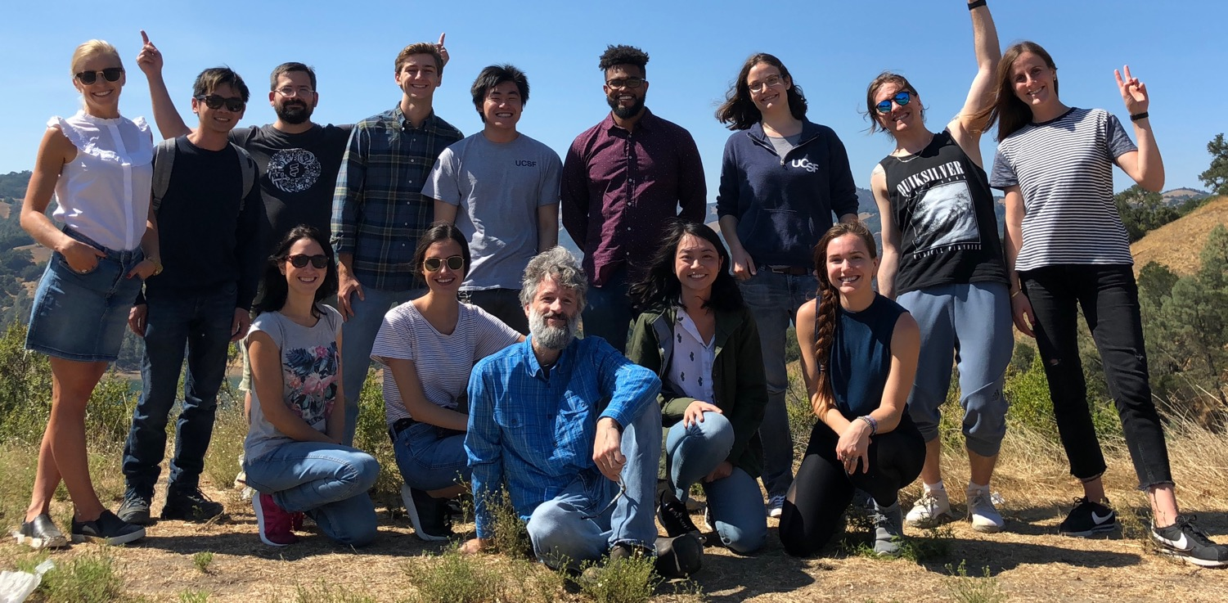
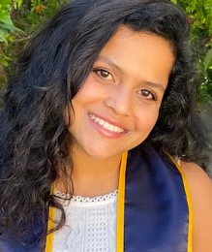
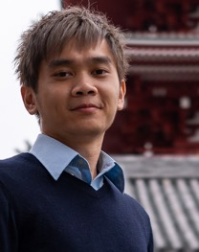
illuminating dark pathways
Systematic Functional Genomics Platforms to Solve Fundamentally Difficult Problems

