Slide 1


Slide 2
the art
of
COLLABORATION

Slide 3
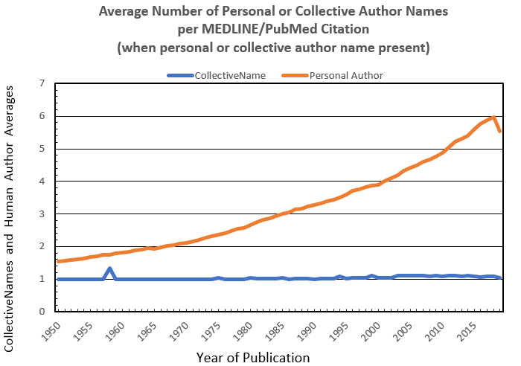
evidence of collaboration
it takes a village to do good science
https://www.nlm.nih.gov/bsd/authors1.html
Notes:
*The data presented on this Web page were extracted from the 2019 Statistical Reports on MEDLINE®/PubMed® Baseline Data (choose the Baseline Including OLDMEDLINE Records Excel option), which include detailed statistics on all data elements in the baseline database. The baseline contains all completed records in PubMed at the end of the NLM 2019 production year, which occurred in January, after the global updating for the new year of MeSH (Medical Subject Headings). Note that very few citations from 1966-2000 contain collective author data (see #3, below).

Slide 4
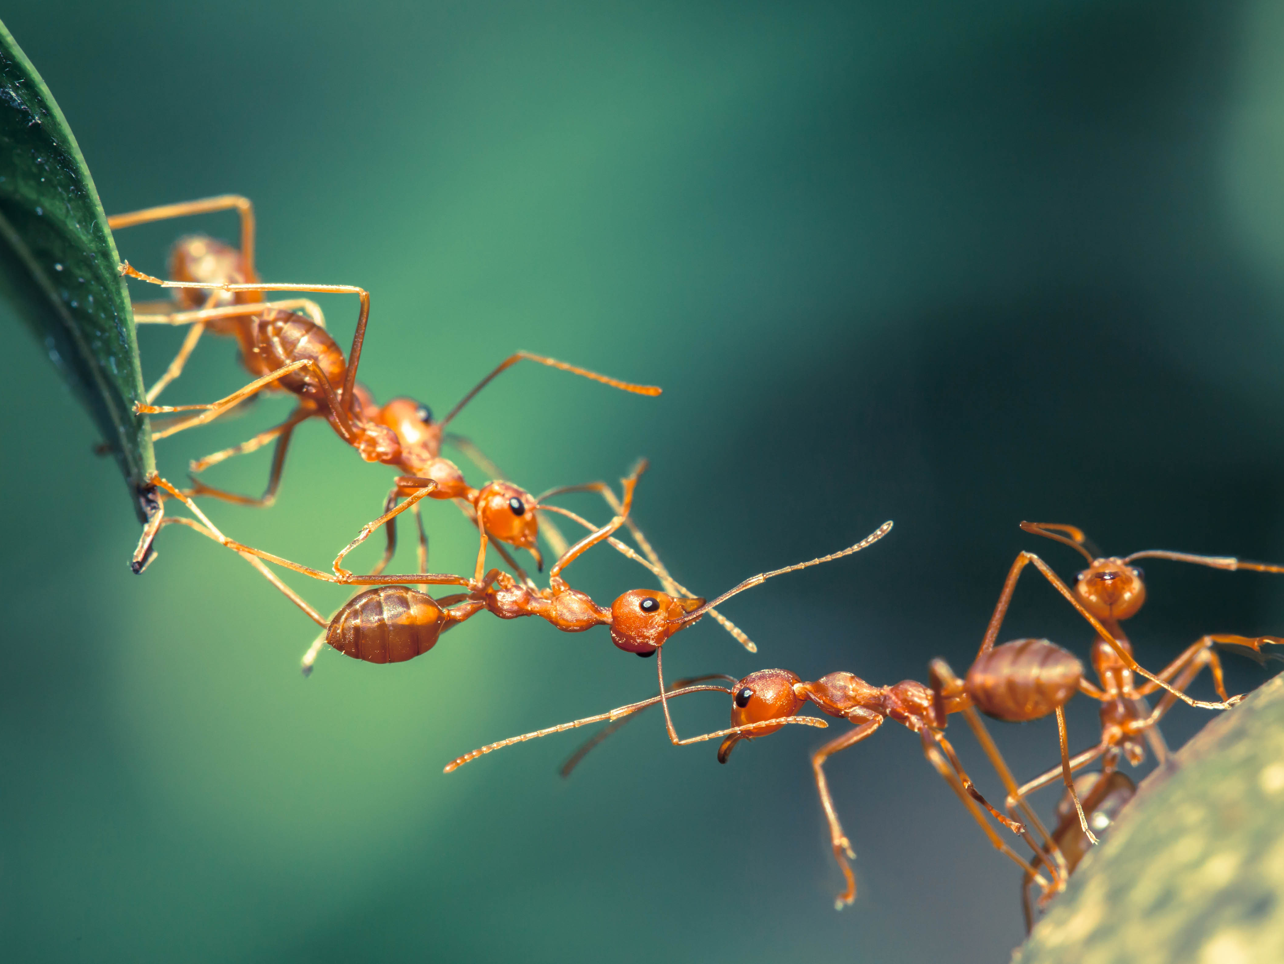
elements of effective collaboration
fundamental principles
build trust
establish shared goals
break down a problem to bite-size units
communicate effectively
take advantage of specialized expertise
resolve conflict when it arises

Slide 5
vision
a shared goal
Notes:
Any effective collaboration begins with a vision of the grander goal.
Take an ant colony, for example. An ant colony is a complex network of underground chambers in which ants live.
Depending on the species, ant colonies can range anywhere in size of less than 2 square inches hosting 100 ants to more than 500 square feet housing up to 7 million ants. The largest colonies extend hundreds of square miles.
What is a vision? What is yours? Write it down.
Effectively communicating your vision is essential in any collaboration. Develop your pitch, keeping it palpable and exciting. Outline the steps to get there. Delegate tasks. Guide your expedition. Meet often.
How will you execute your vision? Websites. Publications. Conferences. Seminars and posters.

Slide 6
teamwork that focuses on one problem at a time
contribution
Notes:
To achieve a grander vision, ants must work together. Building a huge colony takes millions of smaller seemingly impossible achievements.
Ants are known to overcome challenging obstacles by working together as a group. Whether using their jaws and claws to link together to form bridges or arranging their bodies into a waterproof raft to survive a flood, ants have an uncanny ability to quickly identify a problem and organize themselves to solve it.
As a team we often encounter problems that seem unsolvable. However if the team has a collaborative mindset, it will maximize their opportunity for success.
Here are some self-reflective thought strategies to gauge how collaborative you are:
Are you willing to work with others with an open mind to new ideas or approaches?
Do you know and trust the members of your team?
Are you willing to help a struggling team member for the success of the team?
Practice being an individual leader in these areas. Others will follow.
Are you aware of each team member’s role and the benefit they bring? Specialized expertise.

Slide 7
epigenetic castes
specialization
Bonasio R et al. Genome-wide and caste-specific DNA methylomes of the ants Camponotus floridanus and Harpegnathos saltator. Curr Biol 9;22(19):1755-64.
Notes:
To help organize the chaos within these colonies, each ant is responsible for specific tasks, whether food gathering, building nests, guarding the colony, or reproduction. These instinctual social rules in which ants organize themselves help ensure the colony’s survival.
Applied to a team setting, division of labor is about role clarity and how your contributions align with the goals set by the team to ensure its success.
As an individual on a team, it is important you take time to self-reflect, understand your weaknesses, invest in your strengths, and leverage your talents towards the success of the team.
As a manager of a team, it is important you understand the strengths of each member, place them in positions to be successful, and clearly communicate their role within the team so there is a consistent understanding of the division of labor.
Doing these things will put you on a fast track to operational efficiency.

Slide 8
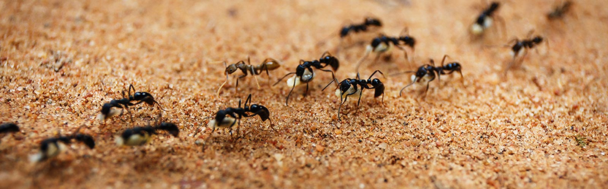
communication
specialization
Notes:
Ants release roughly ten to twenty different pheromones from glands found all over their bodies. These pheromones are used as a means of communication with other ants within the colony.
This “chemical language” is used to summon ants to defend the colony, find the location of a food source, or warn others of potential danger. In short, understanding these pheromones is critical to the colony’s survival.
In a team environment, defining a “chemical language” can be challenging given unique personalities, different communication styles, technology, and being part of a distributed team. However, an easy mitigation strategy is to define clear standards and processes for your team to follow.
There is also a social aspect to this. Like any relationship, you need to nurture and build personal connections. Strengthen the bond within your team:
Encourage in-person meetings or if using web conference software, ensure everyone has their video camera on
Be open minded: practice positive intent, active listening and empathy
Get the team together for events outside of work (i.e., happy hour, quarterly team activities)
Defining a “chemical language” specific to your organization may help reduce existing communication challenges. What best practices will you define as part of your team culture?
The art of email communication.

Slide 9
conflict resolution
specialization
Notes:
Ant societies are remarkably complex and exhibit extremely high levels of cooperation. However, just like human societies, ant colonies also encounter conflict where a few outliers diverge from the status quo.
For example, the reproductive division of labor is typically reserved for the queen of the colony. In some ant species, the worker ants have the ability to lay male eggs and do so illicitly in an attempt to overthrow the queen.
Internal conflict will always arise no matter how cohesive the team is. However, when managed correctly, conflict can be used as a channeling mechanism to encourage growth and innovation.
Use the tips below to successfully manage team conflict:
Align on team processes and standards to ensure operational consistency
Encourage fact-based decision-making to remove emotion and personal attachment
Remove the “I” from the equation. Challenge the cost benefit by identifying what is right for the team
Provide real-time feedback addressing issues up-front instead of allowing resentment to build

Slide 10
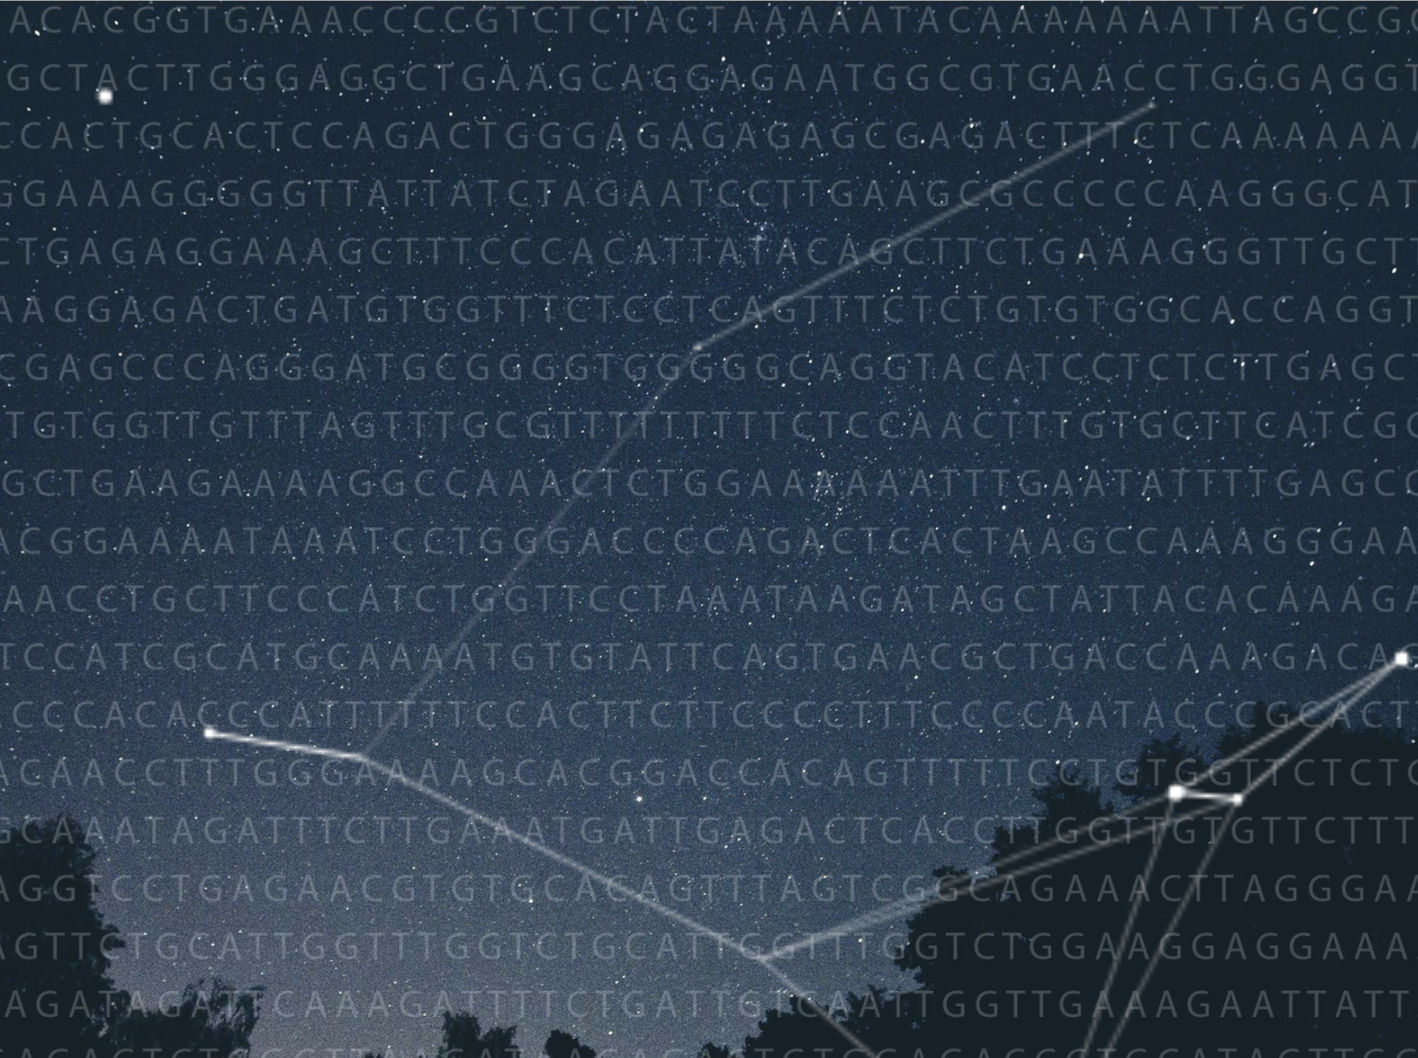
our collaboration
our lab

