Slide 1

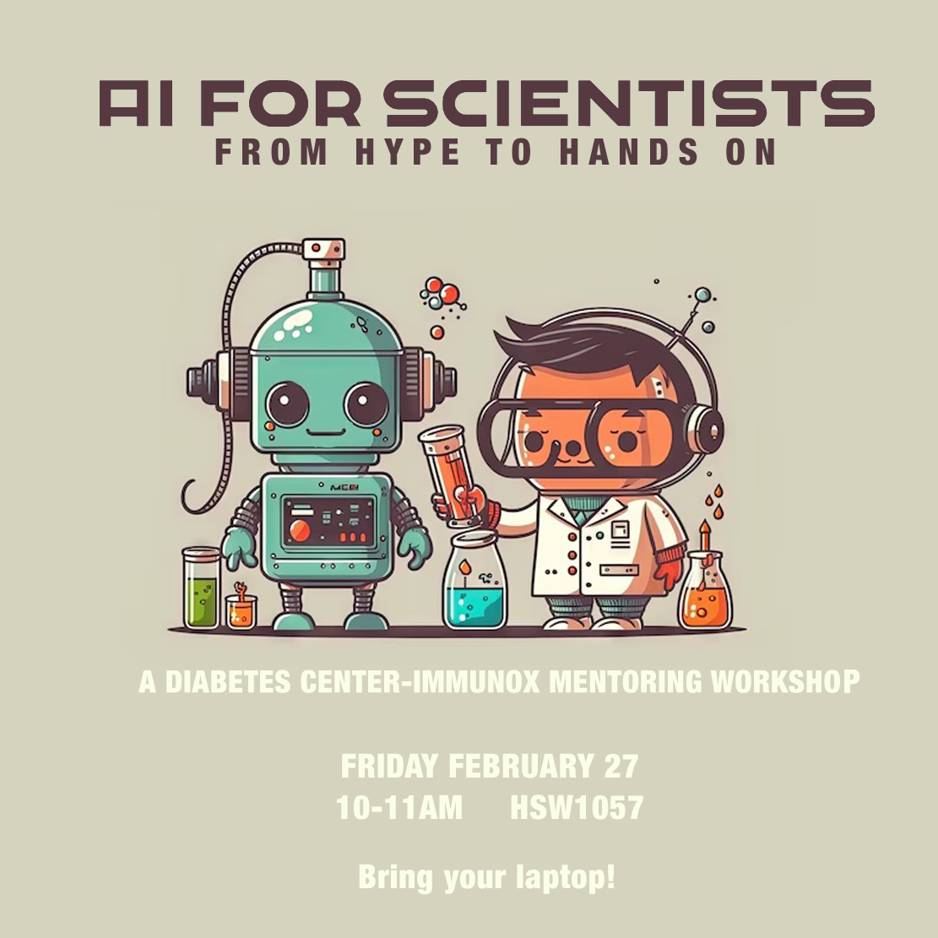
UCSF Michael McManus, PhD

Slide 2
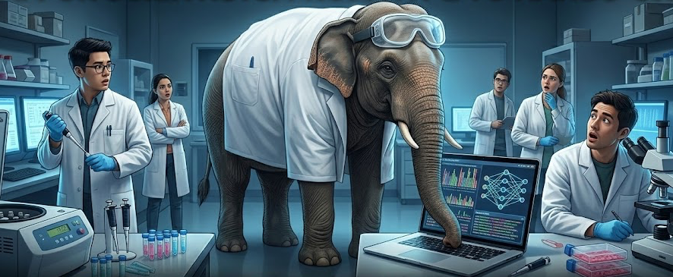
the AI elephant in the lab
how will AI affect your career?
UCSF AI Workshop

Slide 3
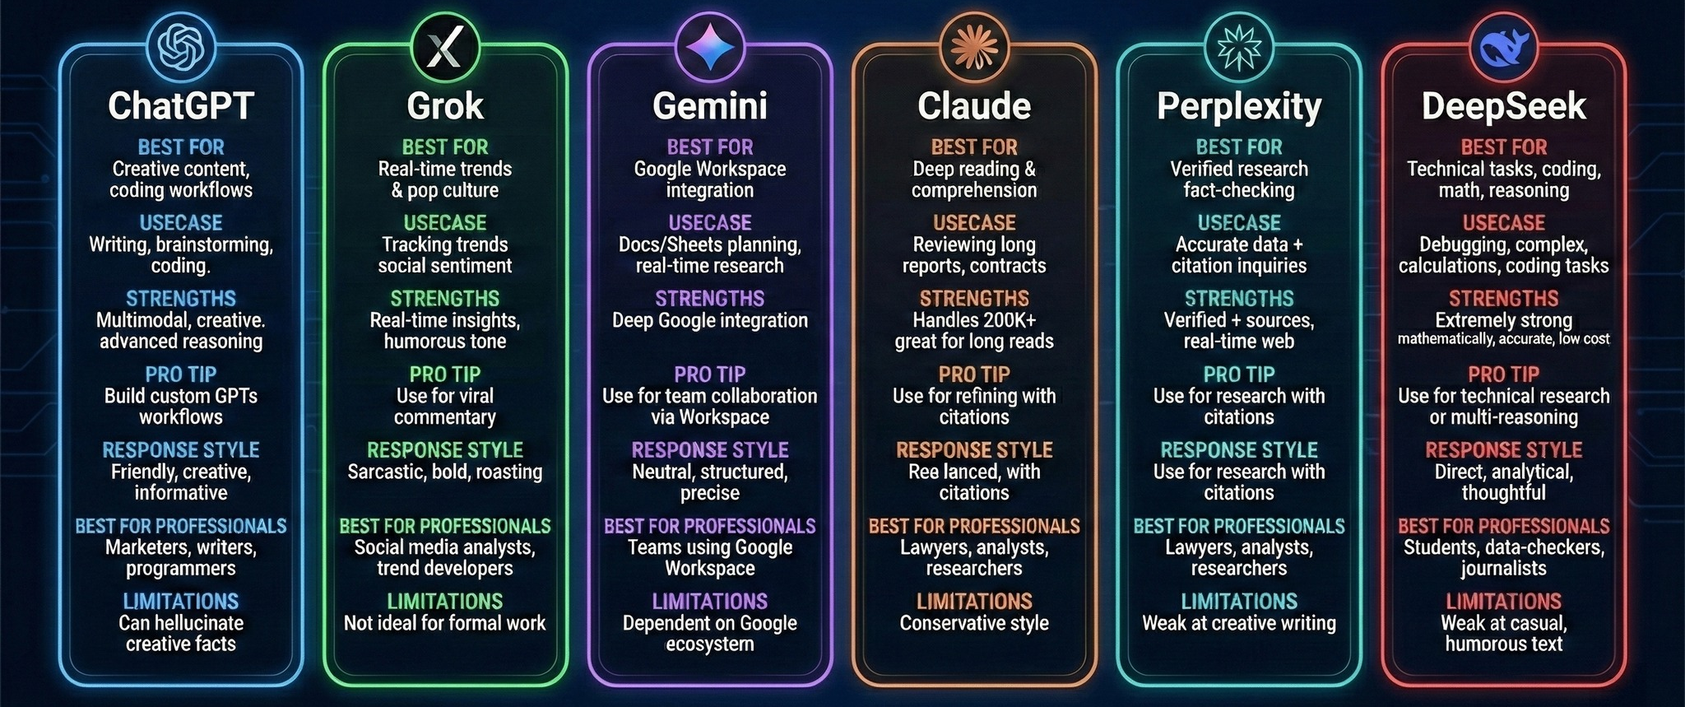
transformer large language models
a continuing competitive explosion of tools
UCSF AI Workshop

Slide 4
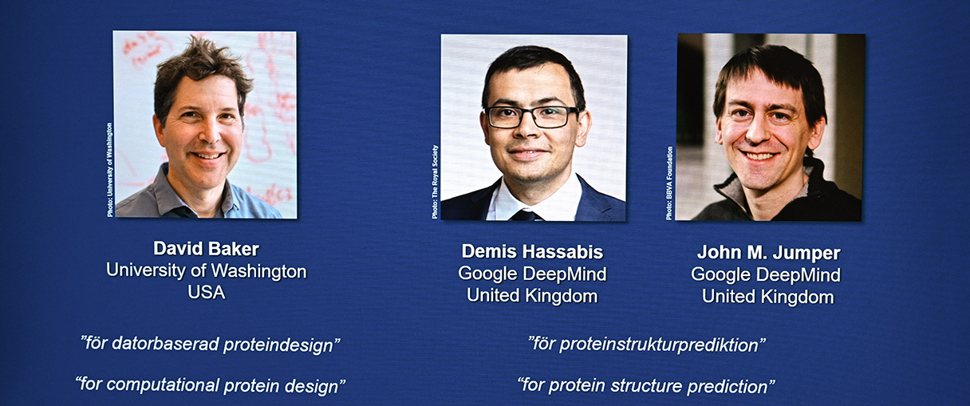
Nobel prize for chemistry 2024
powerful example of what AI has changed
UCSF AI Workshop

Slide 5
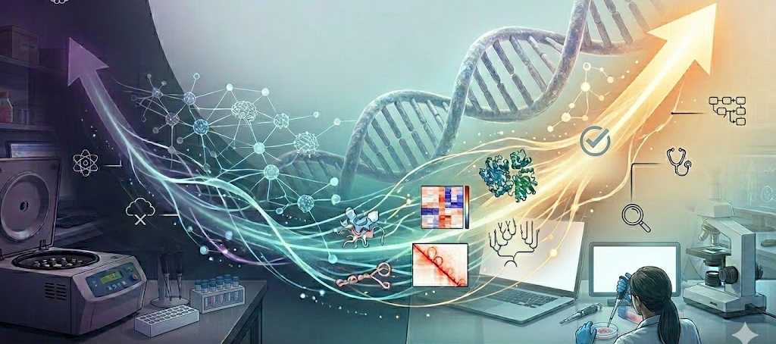
foundational genomics
beyond protein– whole genome logic
Evo2 (Arc Institute)
A massive "DNA Language Model" trained on the entire Tree of Life (microbes to humans). Unlike predictive models, Evo2 is generative; it can "write" new genetic code and has successfully designed functional CRISPR systems from scratch.
AlphaGenome (Google DeepMind)
Published in Nature (Jan 2026), this is a "Sequence-to-Function" specialist. It predicts exactly how a DNA mutation will affect 6,000+ molecular signals—including splicing, expression, and chromatin loops—with base-pair precision.
UCSF AI Workshop

Slide 6

the Genesis MIssion
where the US government is investing
UCSF AI Workshop

Slide 7
the Genesis Mission
a new type of federal agent
“This order launches the “Genesis Mission” as a dedicated, coordinated national effort to unleash a new age of AI‑accelerated innovation and discovery that can solve the most challenging problems of this century. The Genesis Mission will build an integrated AI platform to harness Federal scientific datasets — the world’s largest collection of such datasets, developed over decades of Federal investments — to train scientific foundation models and create AI agents to test new hypotheses, automate research workflows, and accelerate scientific breakthroughs.”
https://www.whitehouse.gov/presidential-actions/2025/11/launching-the-genesis-mission/
UCSF AI Workshop

Slide 8
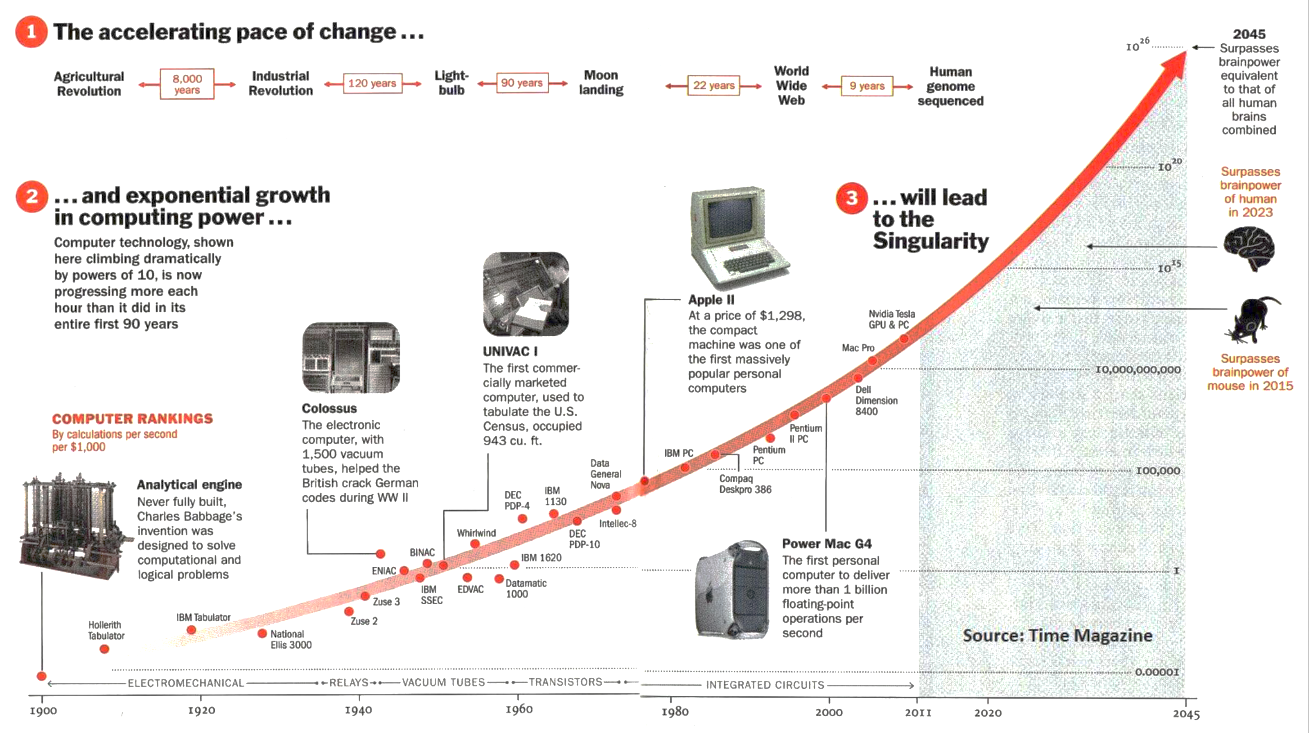
TIME
Pethokoukis
2023

Slide 9

hallucinations
based on the probabilistic nature of models
Chain of thought (CoT)
Model Context Protocol (MCP)
Agentic Retrieval Augmented Generation (RAG)
UCSF AI Workshop

Slide 10
why AI?
popular applications for academic scientists
The 24/7 Literature Scout
Synthesize 100+ papers in the time it takes to read one abstract
Adversarial Review
Use AI to find the holes in your logic before Reviewer 2 finds them
Democratized Bioinformatics
If you can describe the logic, you can generate the pipeline-- no CS degree required
The End of the "Blank Page" Problem
Never start a grant, abstract, or lab notebook entry script from zero again
The Modern Lab Skillset
In 2026, "AI fluency" is as fundamental as pipetting or PCR
UCSF AI Workshop

Slide 11
swimming in the literature
when you need to find new papers, explore connections between research, manage citations and stay updated with the latest data
Undermind
SciSpace
OpenAlex
Perplexity
Scite
Elicit
NinjaAI
Consensus
ResearchRabbit
Jenni
NoteboookLM
  Semantic Scholar
  ProQuest
  Litmaps
  Elicit
  Connected Papers
  Quillbot
  Julius AI
  Sparrho
  Scholarcy
  Iris.ai
  SearchGPT
ThesisAI
EvidenceHunt
Readwise
ChatGPT DR
Litmaps
Lens
Gemini 2.5 DR
Grok DR
Llama DR
Claude DR
growing list of others

Slide 12
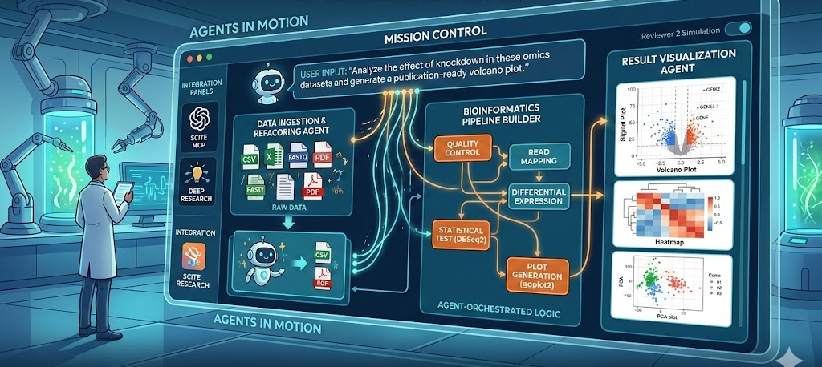
vibe coding and agents
coding is essentially dead – and menial computer tasks are too
UCSF AI Workshop

Slide 13
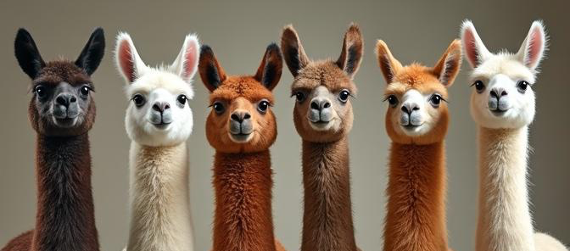
local models
Ollama and LM Studio
Ollama
https://ollama.com/
LM Studio
https://lmstudio.ai/
UCSF AI Workshop

Slide 14
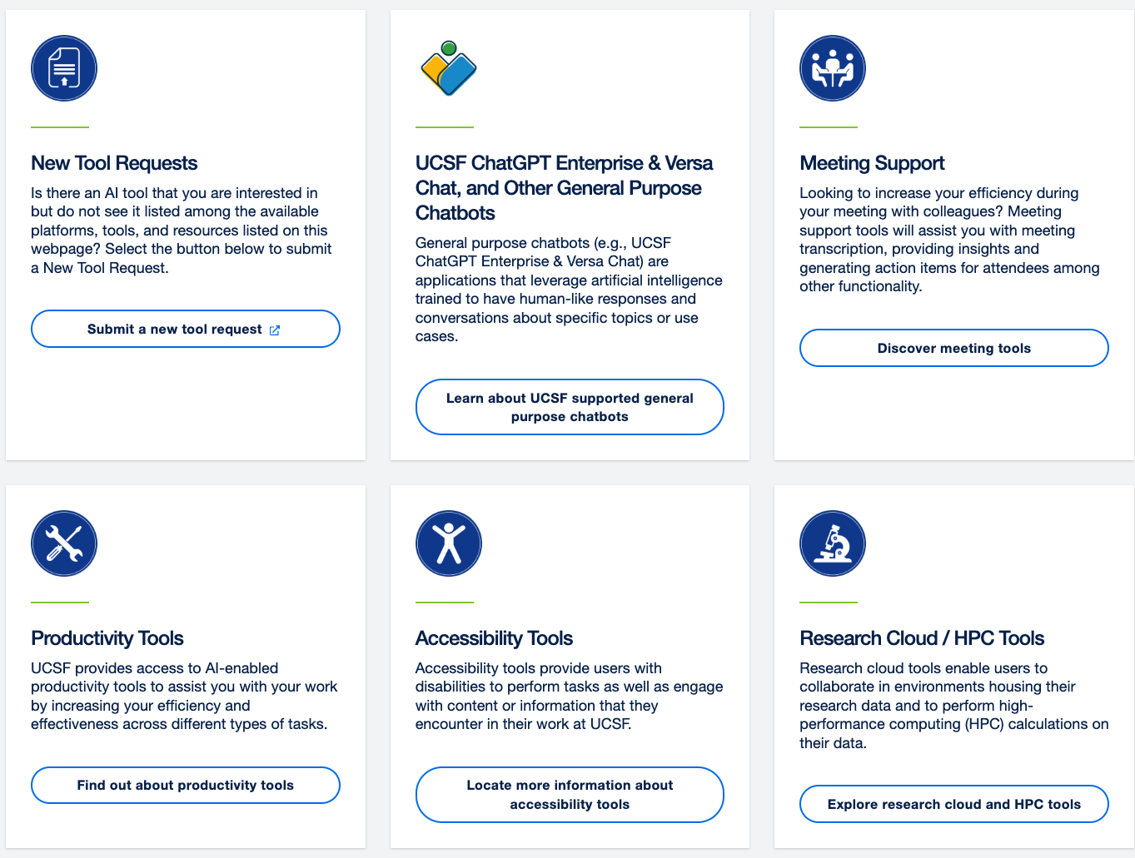
AI at UCSF
Ready to get started with AI at UCSF?
Platforms, Tools, and Resources
https://ai.ucsf.edu/platforms-tools-and-resources
UCSF AI Workshop

