Slide 1
WHERE
WHEN
HOW
TO
PUBLISH

Slide 2
slides from a chalk talk
these were mostly assembled by lab members
Interesting read on time-to-publication.
https://www.nature.com/news/does-it-take-too-long-to-publish-research-1.19320
Secrets from an insider…. these are pretty good.
https://www.elsevier.com/connect/5-secrets-to-surviving-and-progressing-in-a-phd-program
Want to learn more? A link that contains many relevant articles.
https://smartsciencecareer.com/

Slide 3
what to publish? think about multiple opportunities
Primary research papers
The most common type of publication for scientists that is used to communicate primary research to the academic community.
Reviews
Another commonly used format for scientists to summarize and review the of progress made in a particular field or area of research. A review typically also contains the author’s perspectives and take on the field.
Perspectives, commentaries, and opinions
A format that enables scientists to communicate their perspectives and opinions on various topics, including but not limited to areas of research and social and political issues that may affect science.
News articles
News articles are used to communicate scientific research to the general public and are written without field-specific jargons and technicalities.
Blog posts, magazine articles, etc.
Other forms of publications include blog posts, magazine articles, and other social media posts. These are typically aimed at large diverse audiences and can often be used to serve a wide range of purposes, from scientific education to research dissemination.

Slide 4
when to publish? be realistic about your timeline
In biology, it takes on average 3 years to publish a scientific paper (from idea conception to acceptance to the journal). This is best case scenario.
We know based on stats that a typical Phd 5-6 years to graduate. A postdoc takes about 3-5 years to complete training.
This means you have to start planning your paper as soon as you get into the lab ☺

Slide 5
when to publish? practical tips
Start thinking about how your project is transformed into a publication early.
Assemble your data into publication quality figures in the same software you will use for the paper (e.g. Illustrator).
This will help you plan the flow of the paper and clearly see which data is missing. The earlier you start this- the sooner you will publish!

Slide 6
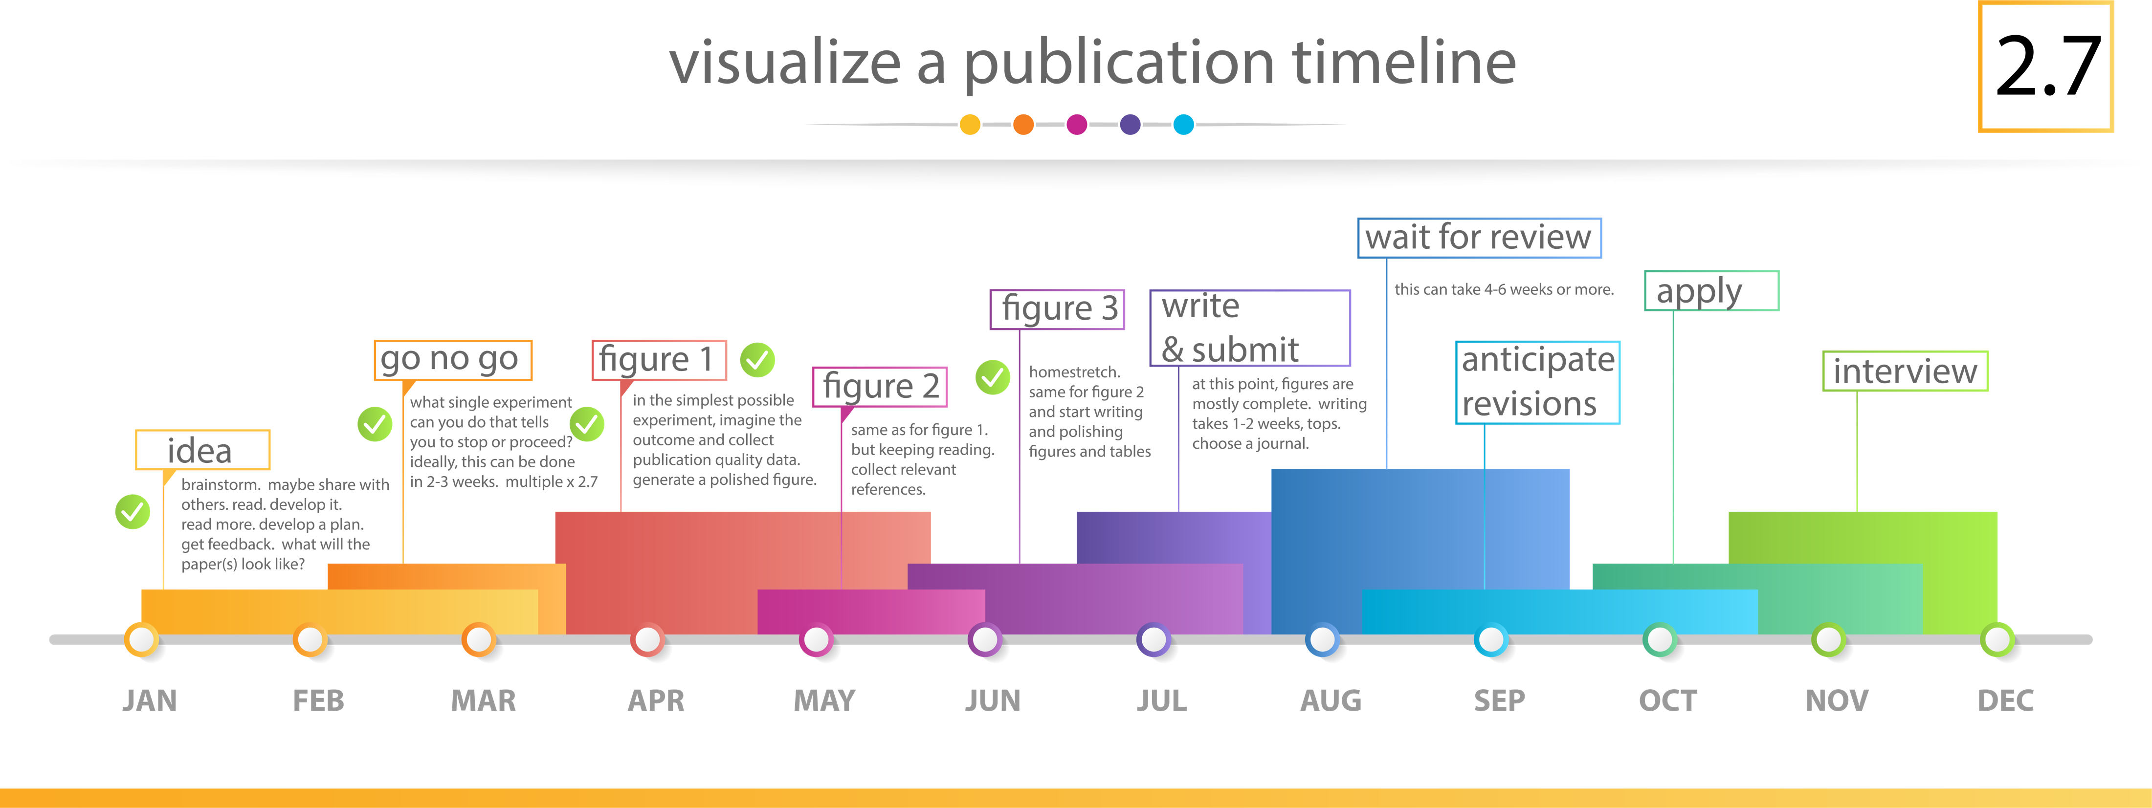
set a realistic timeline on paper it may take a year, but multiple by 2.7

