Slide 1
mentoring
past and future topics
Creating A Beautiful Figure
Scientific Career Choices
Choosing A Scientific Home
Difficult Conversations
Blow Them Away With Your Talk
Giving Solid Feedback
What Is Luck In Science
Diversity and Equality and Inherent Bias
Mid-Postdoc/PhD Crisis
Acing Your Interview
How To Create a Star Academic/Industry CV
Here and Now: Stress and Health
Using Your Environment To Advance Your Career
Networking Strategies
References: managing your discovered research
Reviewing Manuscripts
Staying Sane During Your Phd/Postdoc
The Mona Lisa Effect
Leadership and Competency
Accountability
How To Stay On Top Of The Literature
How To Interview A Candidate
How To Prepare A Winning Poster
When, Where, And How To Publish
Imposter Syndrome
The Art Of Collaboration
Mentoring A Rotation Student
Effective Time Management
How To Give A Winning Elevator Pitch
Positive Psychology and Reinforcement
Achieving Work-Life Balance
Writing Letters: One For Every Purpose
Reviewing Fellowships And Grants
Making an Impact Through Your Science
Writing A Winning Fellowship

Slide 2
Pandemic, Diversity, and a Divided America
2020: a year that almost wasn’t
nonetheless, some things did go well:
We came together
We organized
We stayed safe
We were innovative
We adapted
We showed strength

Slide 3
formulating a strong team
key ingredients for any lab

Slide 4
leadership and competency
cultivating strong teams
in a strong lab, each person:
is a good collaborator
has a perspective and contributes it
has a sense of the “maze” they work within every day
understands how they contribute to the greater whole
are bonded by devotion, compassion, and concern for each other
works to improve themselves, personally and professionally

Slide 5
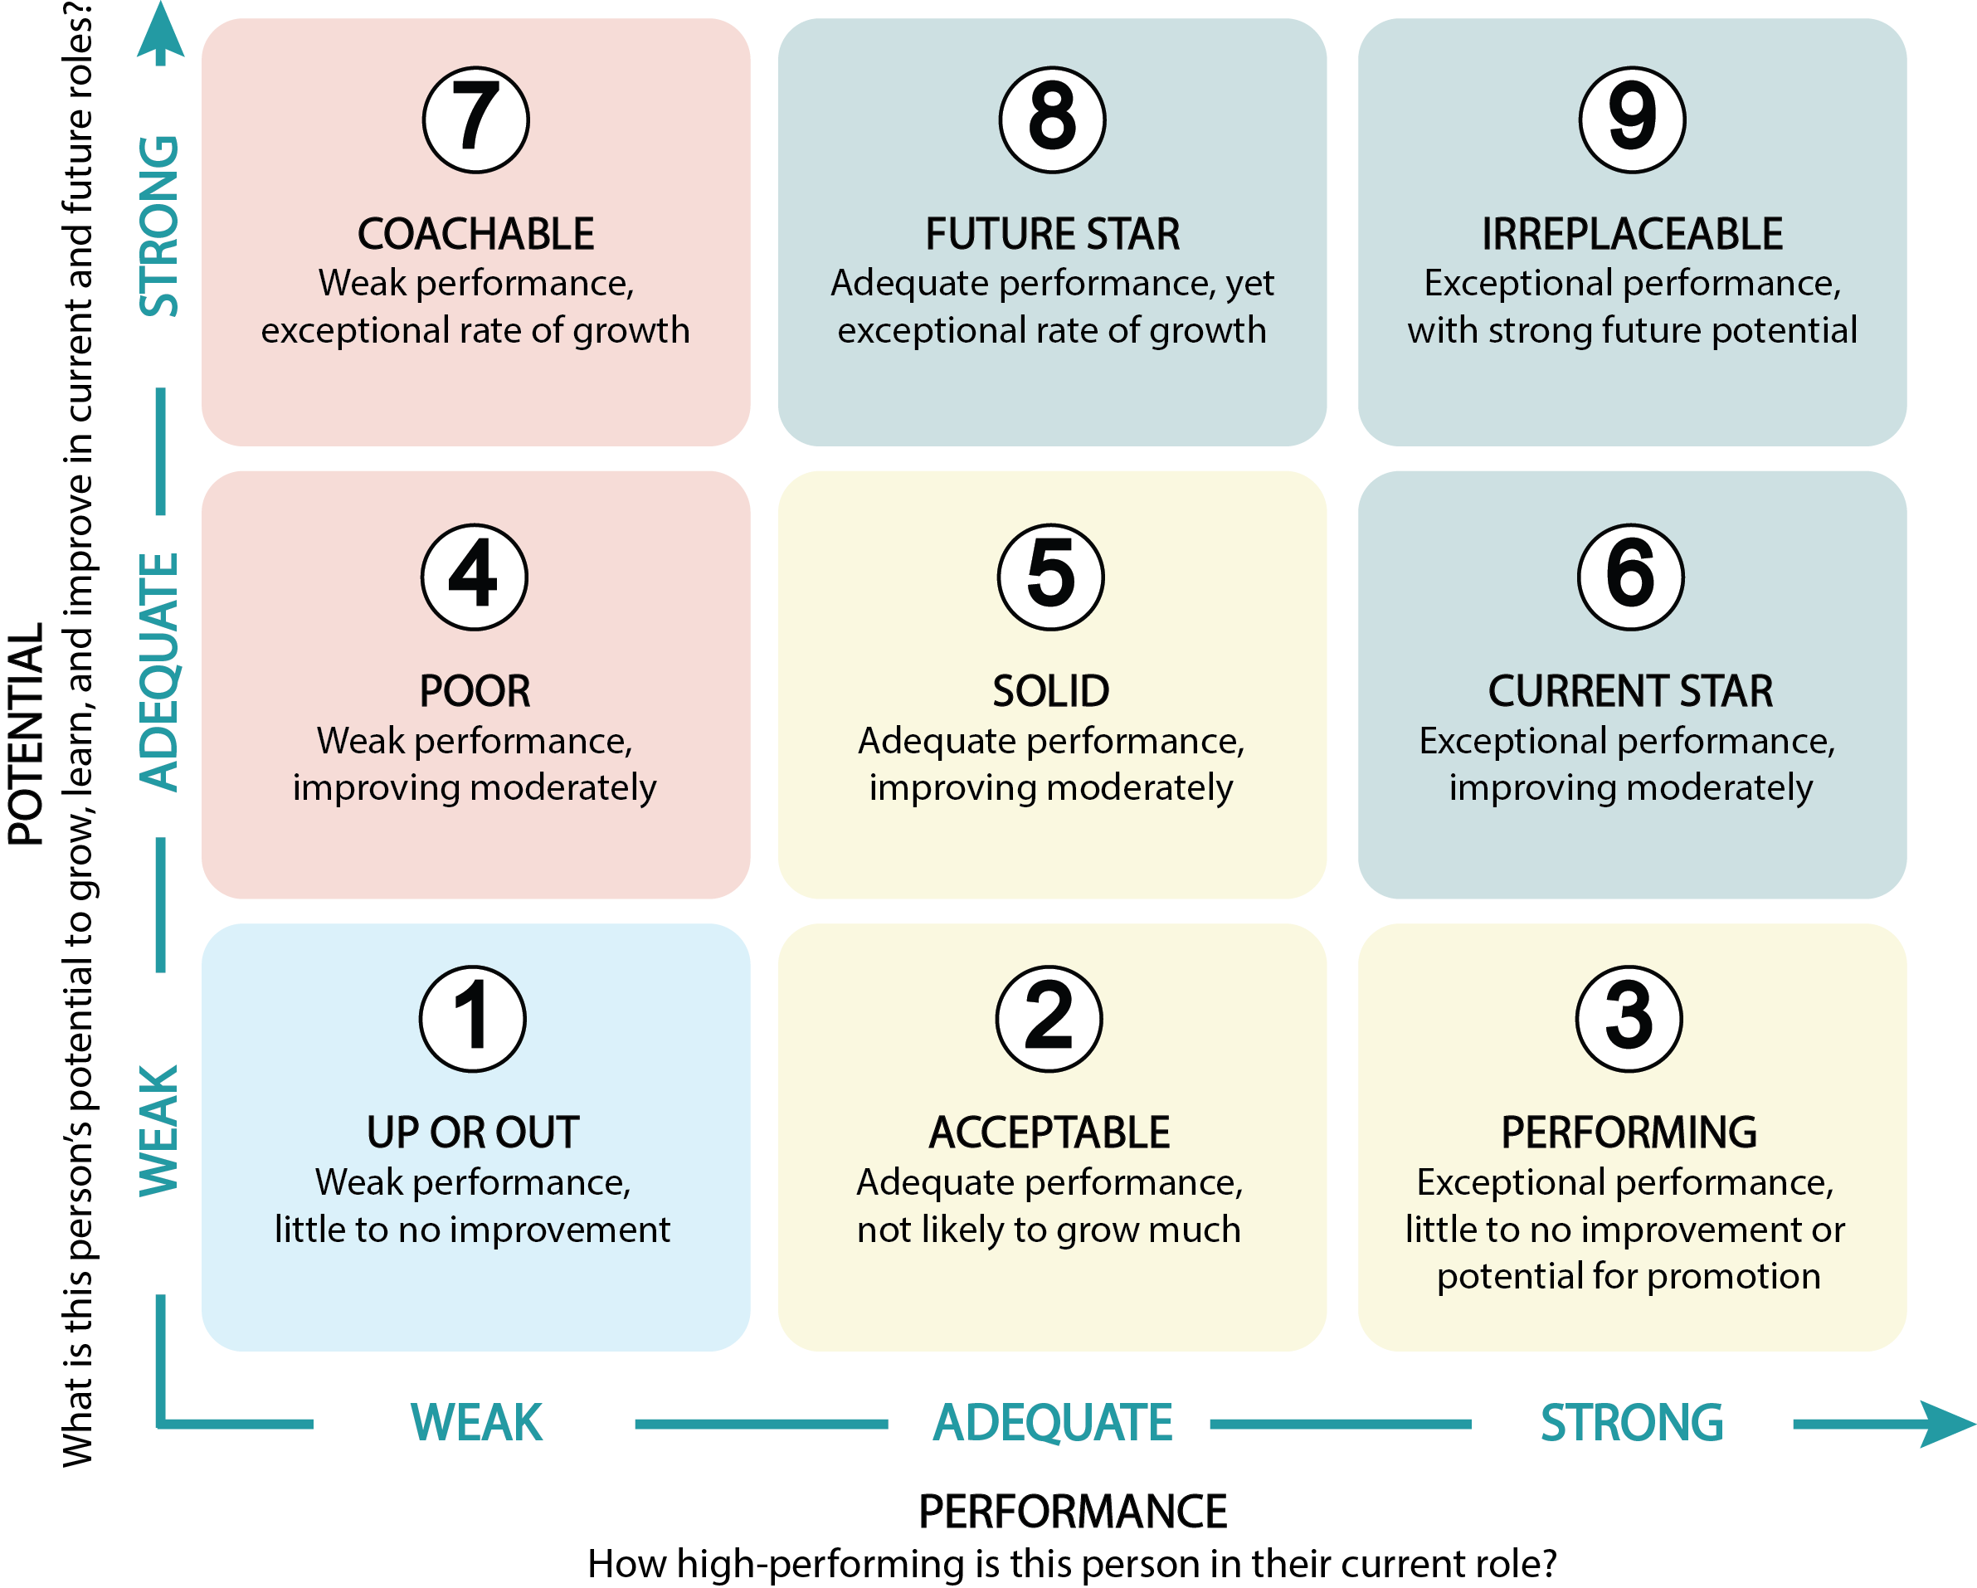
nine box grid
checking yourself

Slide 6
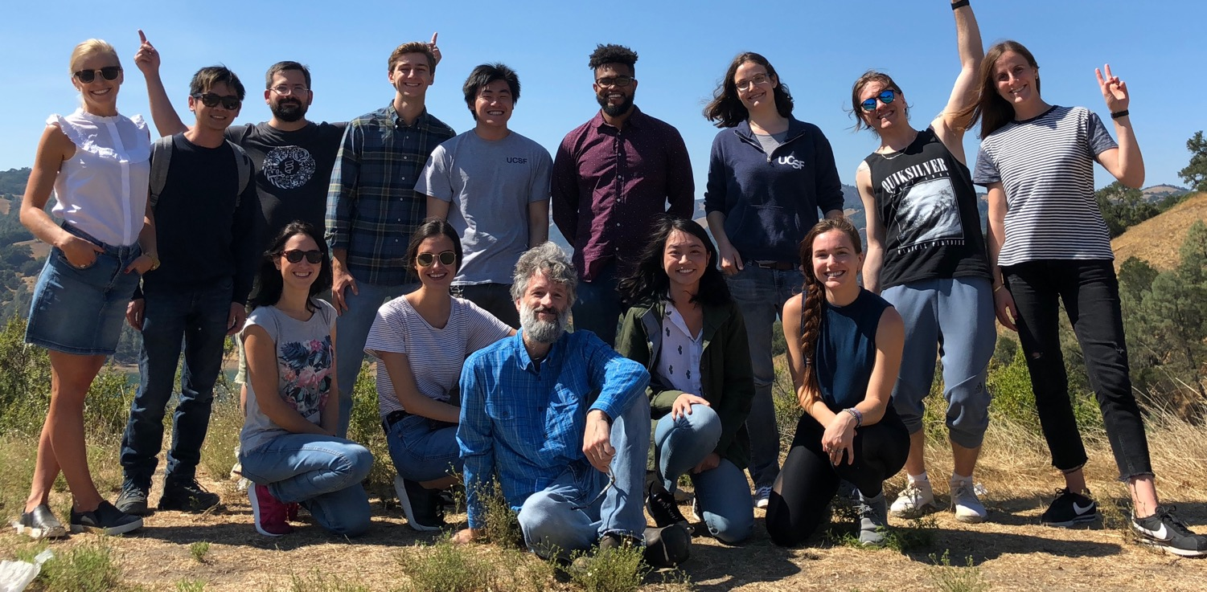
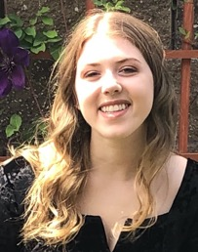
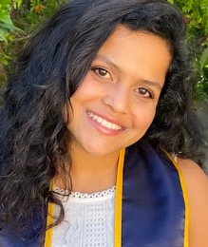
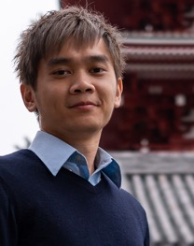
illuminating dark pathways
Systematic Functional Genomics Platforms to Solve Fundamentally Difficult Problems

