Slide 1
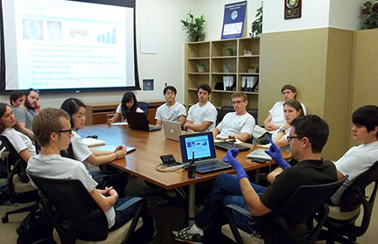
presenting a journal club paper
Preface to this document
Welcome to the McManus Lab! During your training here, you will have the opportunity to present at lab meetings, journal clubs, seminars, and conferences.
Treat each presentation as an opportunity to improve upon your teaching skills; excellent written and oral communication skills are valuable assets to your professional toolkit. The emphasis of this document is on planning a clear and informative lecture for your colleagues and offers a compendium of helpful pointers.
Practice and fine tune your teaching skills, a great lecture can open doors and make a significant impact in promoting science to the community.

Slide 2
your presentation is a teaching experience
prepare in advance
do your homework ahead of time
every presentation should have a solid (i.e. ~15-20 minute) introduction
demonstrate enthusiasm and a little humor
when appropriate, use adjectives that convey the excitement
extraordinary, ridiculous, amazing, terribly flawed, awesome, incredible ;-)
making the best possible images and slides
follow the 1:1:1 rule
one slide, one idea, one minute
read the ‘tons of terrific teaching tips’
useful points to improve yourself and the lecture experience
do your best and experiment to develop your style

Slide 3
morphology of a solid presentation
use a formula
make it easy for your self and the audience
example:
caveats
future
impact
implications
paper title
outline
why I picked the paper
title
conclusions
walk-away-points
introduction
results and discussion

Slide 4
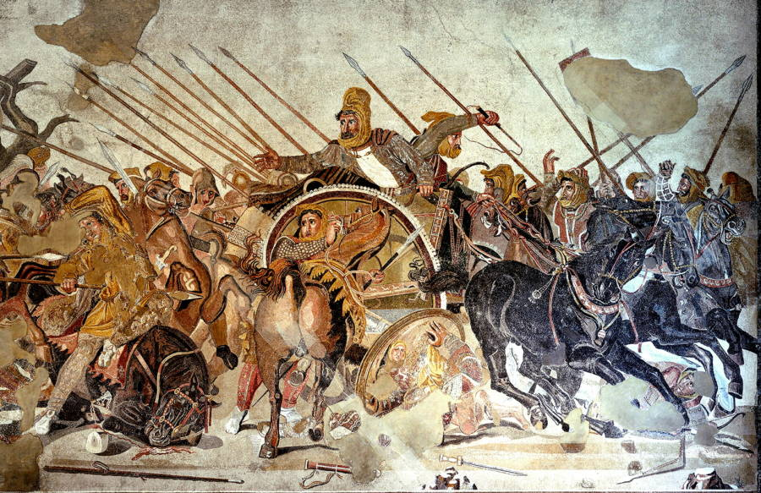
WAR
points:
a striking image will alert the audience
your title slide can set a tone
your can set your theme
phage
bacteria
immunity

Slide 5
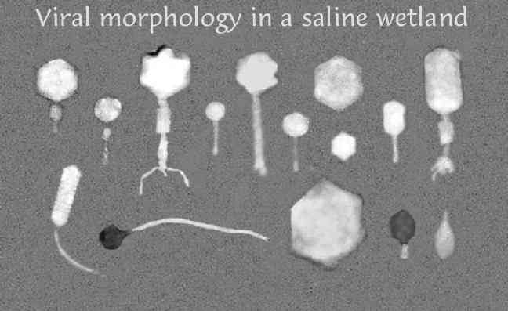
up to 9×10⁸ virions per milliliter
can be found in microbial mats
points:
use simple slides
use analogies
use large fonts use images
Notes:
THEY HAVE THE NUMBERS
Phages are estimated to be the most widely distributed and diverse entities in the biosphere.
Phages are ubiquitous and can be found in all reservoirs populated by bacterial hosts, such as soil or the intestines of animals.
One of the densest natural sources for phages and other viruses is sea water, where up to 9×108 virions per milliliter have been found in microbial mats at the surface,[3] and up to 70% of marine bacteria may be infected by phages.[4]
They have been used for over 60 years as an alternative to antibiotics in the former Soviet Union and Eastern Europe.[5] They are seen as a possible therapy against multi drug resistant strains of many bacteria.[6]

Slide 6
Figure 1
great figure for a publication
terrible figure for a presentation
Deveau et al, 2010. Annual Reviews Microbiology. 64:475-93

Slide 7
The ebb and flow of the battle
animation is better but still—
this is a busy slide
Deveau et al, 2010. Annual Reviews Microbiology. 64:475-93

Slide 8
layout of the CRISPR allele
instead, create simpler slides:
It takes the same amount of time
to present the same material distributed
to multiple slides
space below can be used for:
brief points
illustrations
or leave it blank!
Deveau et al, 2010. Annual Reviews Microbiology. 64:475-93

Slide 9
tips for fielding questions
don’t make it personal
when presenting data, no need to be defensive
all data have caveats and can be criticized
deflect questions that you don’t know the answer
no one is an expert on everything
engage the group, realize that we are all students
Q&A and discussion is high value
prepare your lecture to reserve time for Q&A
if one person has a specific Q, chances are that others have the same Q

