Slide 1
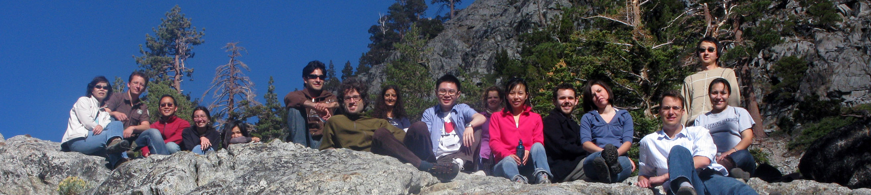
recruiting a new postdoc
to the McManus Lab
It takes time to recruit a postdoc having the perfect ‘fit’. We interview many more than we make offers. We’re appropriately picky.
Some postdocs might be mainly attracted by our research area, the great UCSF reputation, and San Francisco’s desirable geographic area. Our applicants are interested in the work that we have published. We are a well-established lab.
Most postdocs are attracted to established labs because these usually are reliable launching pads for their careers. Our lab is well-known in our research area.

Slide 2
communicating the big picture
what do I talk about during my interview?
Talk about your project in terms of impact. Your excitement about your project will excite and interest applicants. Keep in mind that discussing your unpublished data and ideas during a job interview is considered public disclosure and can compromise patentability.
Communicate our lab culture. How does our lab differ from their PhD lab? Communication, collaboration, and cooperation are valued concepts in our lab, and they can be selling points in our recruitment.
Convey our commitment to mentoring. This means that people in the lab are really supportive in helping each other out- and the PI is very available.
Reassure that we have a history of stable funding. New postdocs are often appointed under a grant and then move to a fellowship within a year. Because of this, keep in mind there is often flexibility on research projects.

Slide 3
key elements of the most successful candidates
We seek someone who has a passion for science and a strong work ethic. Enthusiasm, a can-do attitude, and the willingness to go the extra mile are critical attributes. “Drive” is the number one essential element!
Consider the “chemistry.” First and foremost, pay attention to your intuitive reaction to the person. Look for a person who is interested in, and able to get along with others. Communication skills are key.
Ascertain whether the applicant is a good fit. Keep in mind that we are building our team and need people with the skills and personalities to get things done. Look for people who have a track record of productivity and have demonstrated an ability to learn new skills. Think “no fear”.
Check the applicant’s career plans. Ambition and forethought. Knowing what the applicant wants to be doing in 5 or 10 years can give you insight into his or her scientific maturity and creativity, as well as his or her commitment to a specific research area.
Other pluses may include: creativity, experience, teaching ability, knowledge base.

Slide 4
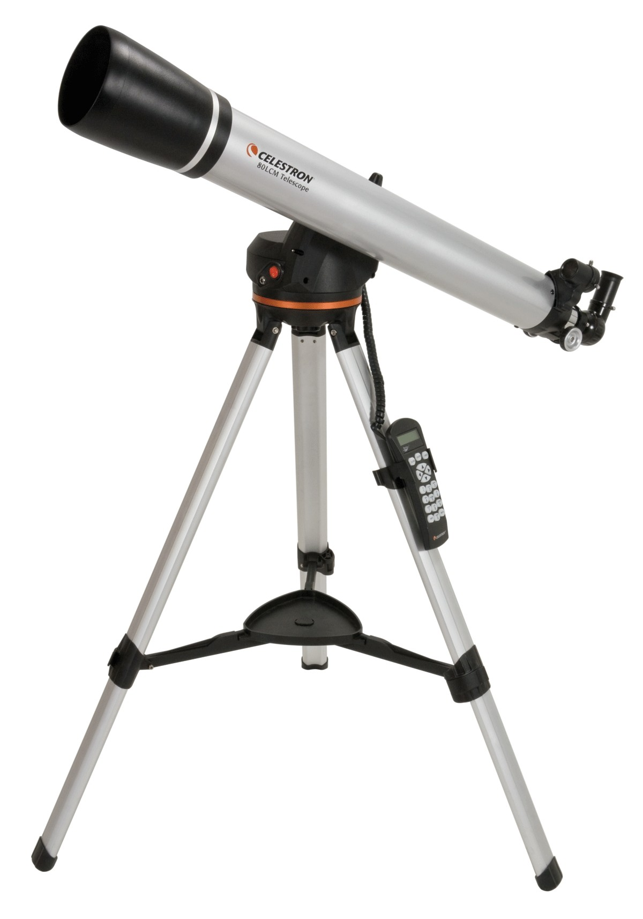
don’t worry about
If you aren’t especially excited in their work, consider whether this is your personal perspective or whether this is simply the theme of their lab. Maybe they were assigned the project by the PI? Don’t blame your disinterest on the candidate.
Keep in mind people often change fields for their postdoc. Don’t worry about someone coming from a physics, chemistry, or other biology background. Switching fields can be considered a huge asset!
Don’t get hung-up on minor mistakes. Everyone is human and interviews are never perfect!
Stay focused on the key elements that we look for in a great candidate: drive, determination, passion for science, and a strong work ethic.

Slide 5
legal topics to avoid
the following points are essential no-no topics for managers, recruiters,
and those involved in the hiring process
Most illegal or ill-conceived questions deal with race, color, national origin, sex, religion, disability, or age.
You should not ask about sexual orientation, marital status, marriage plans, pregnancy or plans for having children, the number and ages of dependent children, child-care arrangements, or other non-work-related matters. If they bring these topics up, you can converse, but try to stay on track on the relevant questions.
Remember that job-related questions are the only appropriate means by which to determine skills and qualifications.

Slide 6
red flags
rare but possible red flags may include:
Unwillingness to take responsibility for something that has gone wrong.
Complaining about an adviser and coworkers.
Delaying answering questions, challenging your questions, deflection, or avoiding answering them all together (humor and sarcasm can be subtle tools to avoid answering questions.)
Unless you have been rude, responding to an interview question with anger is never appropriate.
Incongruence between what you hear and what you see (e.g., downcast eyes and slouching are not signs of an eager, assertive candidate).
Trying to control the interview and otherwise behaving inappropriately.

Slide 7
key points of the interview
Don’t make the applicant feel uncomfortable
Keep in mind the topics to avoid
Listen carefully- and let the applicant do most of the talking
Give the applicant plenty of opportunities to ask questions
Maintain objectivity- don’t judge the applicant by comparing to yourself
Don’t rely too heavily on first impressions

Slide 8
recommended reading
content in this slide deck was adapted from:
“Making the Right Moves”
A Practical Guide to Scientific Management
for New Postdocs and New Faculty
Burroughs Wellcome Fund
Howard Hughes Medical Institute
SAMPLE interview questions follow. Of course you will have your own.
Keep in mind that an interview should not feel like a drill-down test,
but simply a pleasant conversation.

Slide 9
experience and skills
sample
questions
keep in mind we don’t usually recruit postdocs to obtain their skill sets-
If they are driven, they will learn what they need to know
What were your most significant accomplishments?
Tell me the part you played in conducting a specific project or implementing a new approach or technology in your lab.
I see you have worked with [insert specific technology or technique here]. Tell me about its features and benefits.
How did you prepare for this interview? What did you take away from [insert specific papers here]?

Slide 10
commitment and initiative
sample
questions
Why do you want to work in the McManus lab?
Where do you see yourself in five years?
What kinds of projects do you want to do? Why?
Tell me how you stay current in your field.
Describe a time when you were in charge of a project and what you feel you accomplished.
Tell me about a project or situation that required you to take initiative.
What motivates you at work?

Slide 11
working and learning styles
sample
questions
Would you rather work on several projects at a time or on one project?
Do you learn better from books, hands-on experience, or other people?
Tell me about a project that required you to work as part of a team. What was the outcome of the team’s efforts?
How would you feel about leaving a project for a few hours to help some- one else?
If you encountered a problem in the lab, would you ask someone for help or would you try to deal with it yourself?

Slide 12
time management
sample
questions
How do you prioritize your work?
Do you work after hours or on a weekend?
What happens when you have two priorities competing for your time?
How do you organize your notebooks and lab reagents?
What are some examples of your multi-tasking ability?
How many different projects did you work on as a PhD? Did you or your PI prioritize them?

Slide 13
decision making and problem solving
sample
questions
What is your biggest challenge in your current job? How are you dealing with it?
Tell me about a time when you made a decision that resulted in unintended (or unexpected) consequences (either good or bad).
Give me an example of a situation where you found it necessary to gather other opinions before you made a decision.
What’s the most creative thing you’ve ever done in the lab?

Slide 14
interpersonal skills
sample
questions
How important is it to you to be liked by your colleagues and why?
If you heard through the grapevine that someone didn’t care for you, what would you do, if anything?
Tell me about a situation in which your work was criticized. How did you rectify the situation?
Describe a scientist whom you like and respect. What do you like about this person?

