Slide 1
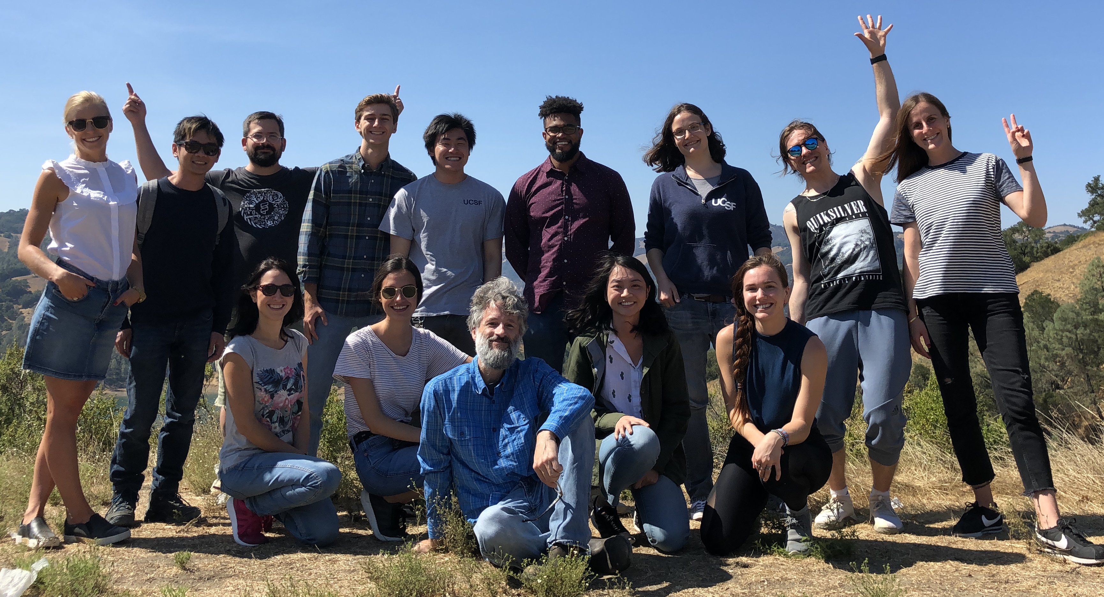
illuminating the dark matter of the genome
all of us. together. again.
Michael T. McManus, PhD
Professor, Stella Coates Endowed Chair
University of California, San Francisco
Imposter You are Not
February 14, 2019

Slide 2

Imposter Syndrome
most of us probably experience a bit of it
A syndrome where sufferers are unable to internalize their accomplishments.
Regardless of what level of success they may have achieved or what external proof they get, they remain convinced internally that they do not deserve the success and are really frauds.
Proofs of success are dismissed as luck, timing, or ability to deceive others.
This syndrome is typically associated with academics (70%).

Slide 3
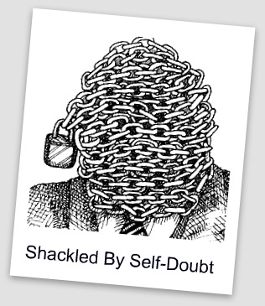
why is this so prevalent
one major determinant is human psychology
Self-doubt and negative feedback weigh heavily on the mind, but praise barely registers.
People tend to attribute their failures to a stable, inner core of ineptness.
While discounting successes as accidental…
Why.

Slide 4
imposter syndrome
more prevalent in academia
This is because of our distorted take on science!
  We are often taught that Science deals with objective things and absolute truths and think that doing science is the same.
  When we find that our own discoveries have a big element of randomness we feel that we were just lucky.
  It can seem like people around us discovered things in a logical way since that is the way papers and seminars are presented.

Slide 5
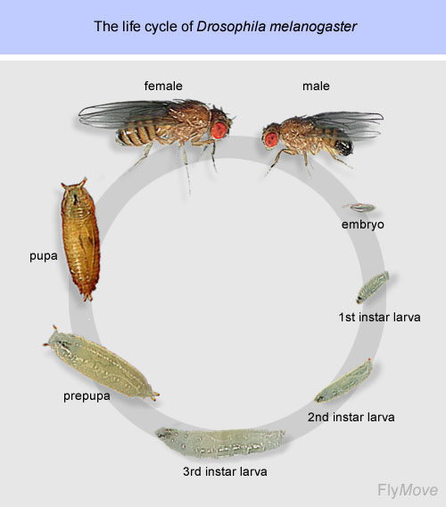
stages in science
how do you prepare?
an academic
PI
PostDoc (After....)
Start undergraduate school
B.A
PostDoc
(before you publish)
M.SC
Ph.D

Slide 6
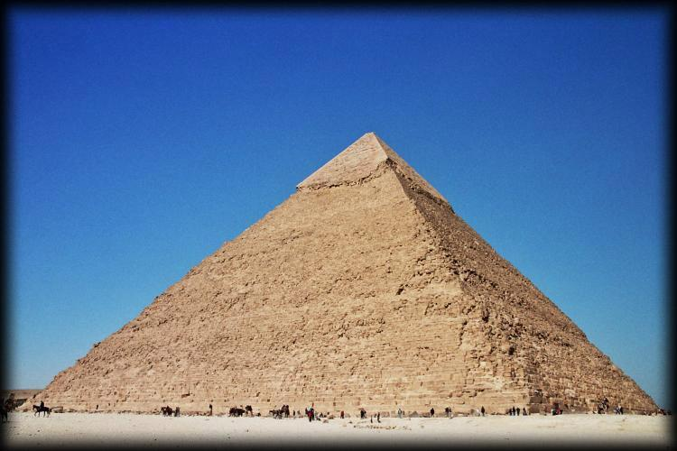
pyramid effect
our peer group gets better and better…

Slide 7
imposter syndrome
pretty much sucks
It can make you less inclined to compete for advanced positions (such as postdocs or faculty positions).
It can instill a fear to pursue new ideas and to take scientific risks.
It can make you reticent about offering potentially valuable insights, ideas, opinions and solutions to problems for fear of being wrong or exposing your “ignorance.”
It can prevent you from asking questions… hence block your learning and advancement

Slide 8
imposter syndrome
pretty much sucks
It can make you prone to procrastination. This often causes delays in graduation of students.
It can cause stress-related problems leading to disease. M.Sc and PhD students are under VERY high risk for psychological stress
It makes you more likely to see constructive criticism as proof of your ineptitude, rather than using it to improve skills and knowledge.

Slide 9
imposter syndrome
what to do?

Slide 10
imposter syndrome
what to do?
Break the silence.
Knowing there’s a name for these feelings and that you are not alone can be tremendously freeing.

Slide 11
imposter syndrome
what to do?
1. Break the silence. Knowing there’s a name for these feelings and that you are not alone can be tremendously freeing.
2. Separate feelings from fact. Realize that just because you may feel stupid, doesn’t mean you are.
3. Recognize it. Instead of taking your self-doubt as a sign of your ineptness, recognize that it might be a normal response to being a beginner – which you will often be in an academic environment..
4. Accentuate the positive. Forgive yourself when the inevitable mistake happens.
5. Develop a new response to failure and mistake making. Henry Ford once said, “Failure is only the opportunity to begin again more intelligently.”

Slide 12
imposter syndrome
what to do?
6. Right the rules. Recognize that you have just as much right as the next person to be wrong, have an off-day (or day off….), or ask for assistance.
7. Develop a new script in your head. When you start a new job don’t think: “Wait till they find out I have no idea what I’m doing,” try thinking, “Everyone who starts something new feels off-base in the beginning. I may not know all the answers but I’m smart enough to find them out.”
8. Visualize success. Spend time beforehand picturing yourself making a successful presentation or calmly posing your question in class.
9. Fake it ‘til you make it. Instead of considering “winging it” as proof of your ineptness learn to view it as a skill.
10. Reward yourself. Break the cycle of continually seeking and then dismissing validation outside of yourself by learning to pat YOURSELF on the back.

Slide 13
reward ourselves
celebrate!
We often feel like we get very few moments of happiness in science (people often say it’s a “thankless” job) but it is only because of the way WE choose to view it.
For example – when you get a good PCR to work – you will never stop to celebrate (it seems SO trivial to have a PCR work – anyone can do it – right?) but when you have run it for 10 times without success you will SURE beat yourself up about it…
SO – learn how to give equal weight to your failures and successes.

Slide 14

reward ourselves
celebrate!
We never celebrate when we send a paper/grant/PhD proposal out because we fear it still might get rejected or criticized.
By the time news of the submission comes back you can only feel relief.
If you learn to measure yourself and celebrate your OWN finish lines you will increase your own self assessment skills.

Slide 15
imposter syndrome
where to learn more
Dr. Valerie Young
webpage: http://impostorsyndrome.com/
John Gradem
webpbage: http://www.johngraden.com/impsyn.html
Pauline Clance
webpbage: http://www.paulineroseclance.com
Maya Schuldiner
http://mayaschuldiner.wixsite.com/schuldinerlab

Slide 16
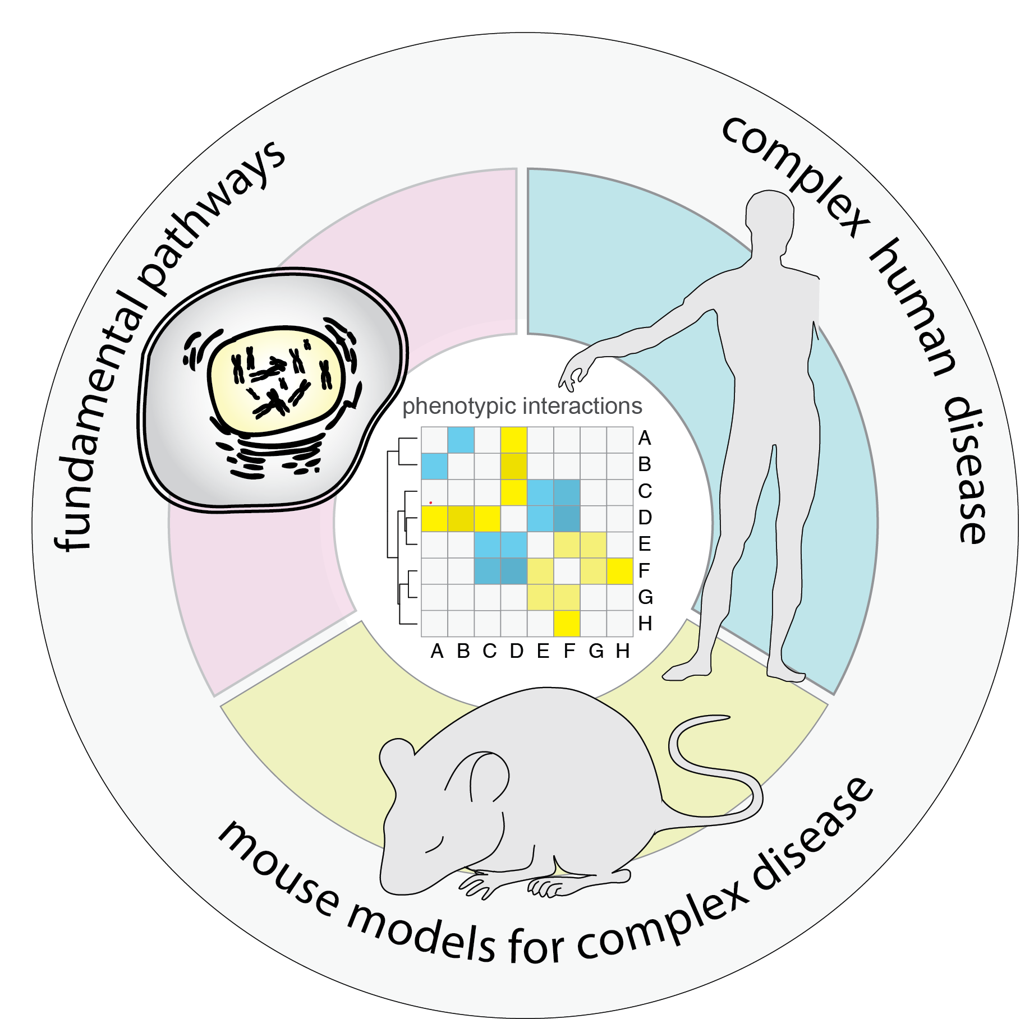


illuminating the dark matter of the genome
McManus Lab at University of California, San Francisco

