Slide 1
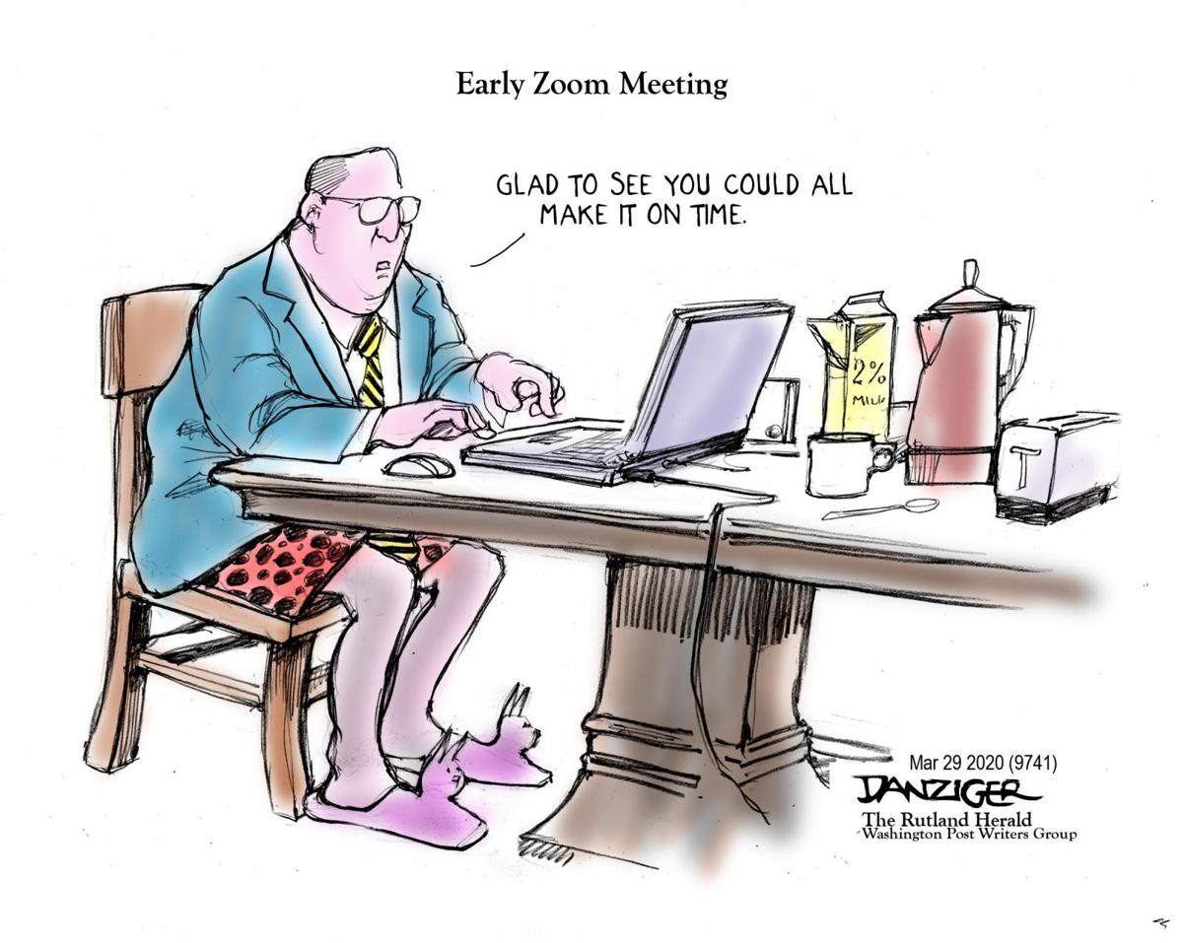
10 minutes after?
Nope. Just 5 minutes after. We’re improving!
Here and Now
Michael T McManus, PhD
Professor, UCSF
Stella Coates Endowed Chair

Slide 2
mentoring
past and future topics
Here and Now: Stress and Health
How To Stay On Top Of The Literature
How To Interview A Candidate
How To Prepare A Winning Poster
When, Where, And How To Publish
Imposter Syndrome
The Art Of Collaboration
Mentoring A Rotation Student
Effective Time Management
How To Give A Winning Elevator Pitch
Positive Psychology and Reinforcement

Slide 3
mentoring
past and future topics
Creating A Beautiful Figure
Scientific Career Choices
Choosing A Scientific Home
Difficult Conversations
Blow Them Away With Your Talk
Giving Solid Feedback
What Is Luck In Science
Mid-Postdoc/Phd Crisis
Acing Your Interview
How To Create a Star Academic/Industry CV

Slide 4
mentoring
past and future topics
Using Your Environment To Advance Your Career
Networking Strategies
References: managing your discovered research
Reviewing Manuscripts
Staying Sane During Your Phd/Postdoc
The Mona Lisa Effect
Achieving Work-Life Balance
Writing Letters: One For Every Purpose
Reviewing Fellowships And Grants
Making an Impact Through Your Science
Writing A Winning Fellowship

Slide 5
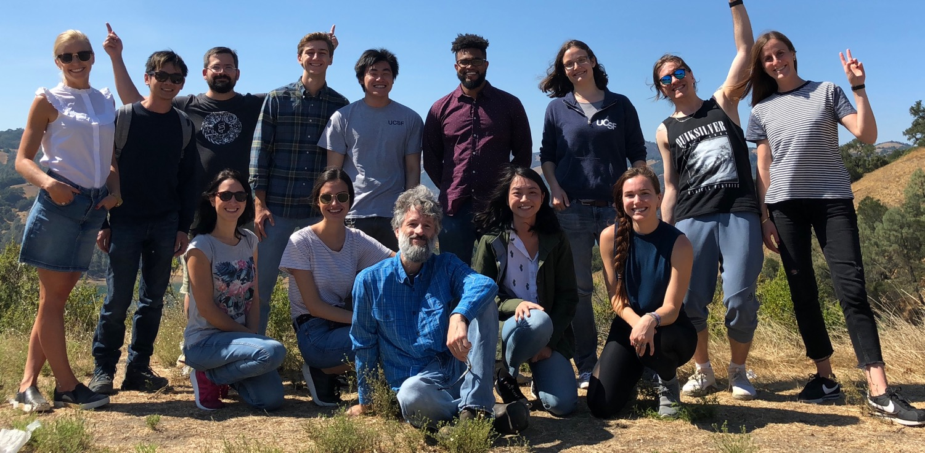
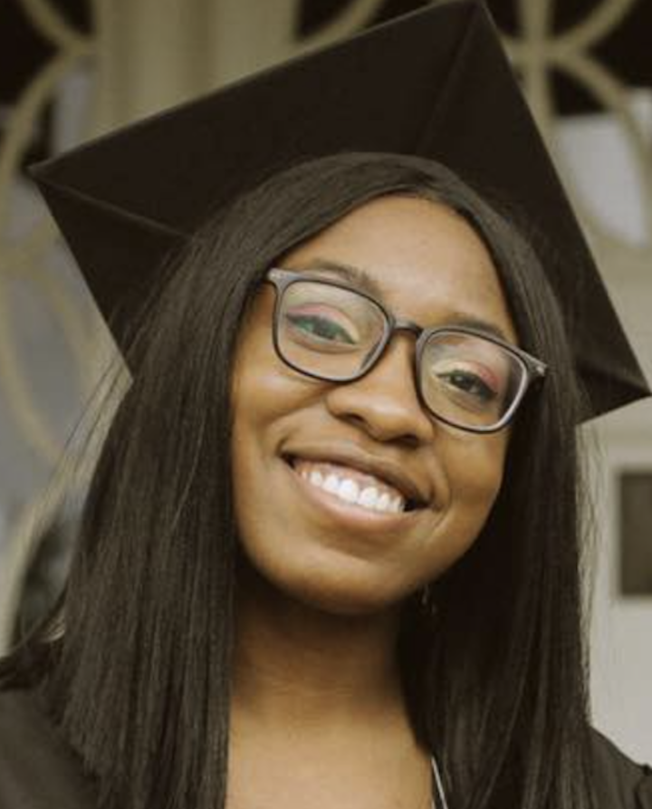
illuminating dark pathways
Systematic Functional Genomics Platforms to Solve Fundamentally Difficult Problems
Michael T McManus
Professor, Stella Coates Endowed Chair
University of California, San Francisco
Notes:
I also want to give an up-front acknowledgement of the folks in the lab who are working hard to advance basic science. I may refer to them during my presentation but

Slide 6
The Pandemic
SARS-CoV-2
Notes:
I know a lot of us have been stressed and horrified with racial divide prompted by police brutality and veritable murder of our citizens.
I hope all of you had the opportunity to attend last Friday’s town hall. It was incredibly touching to hear the stories and experiences. I am proud to be part of a community that is working together to make a difference.
Proud to say we have PRIDE. Professionalism, Respect, Integrity, Diversity and Excellence
I wanted to dedicate this lecture to the members of our community who fight on the front lines– not just for COVID19, but for all of us who promote Diversity and Equality.

Slide 7
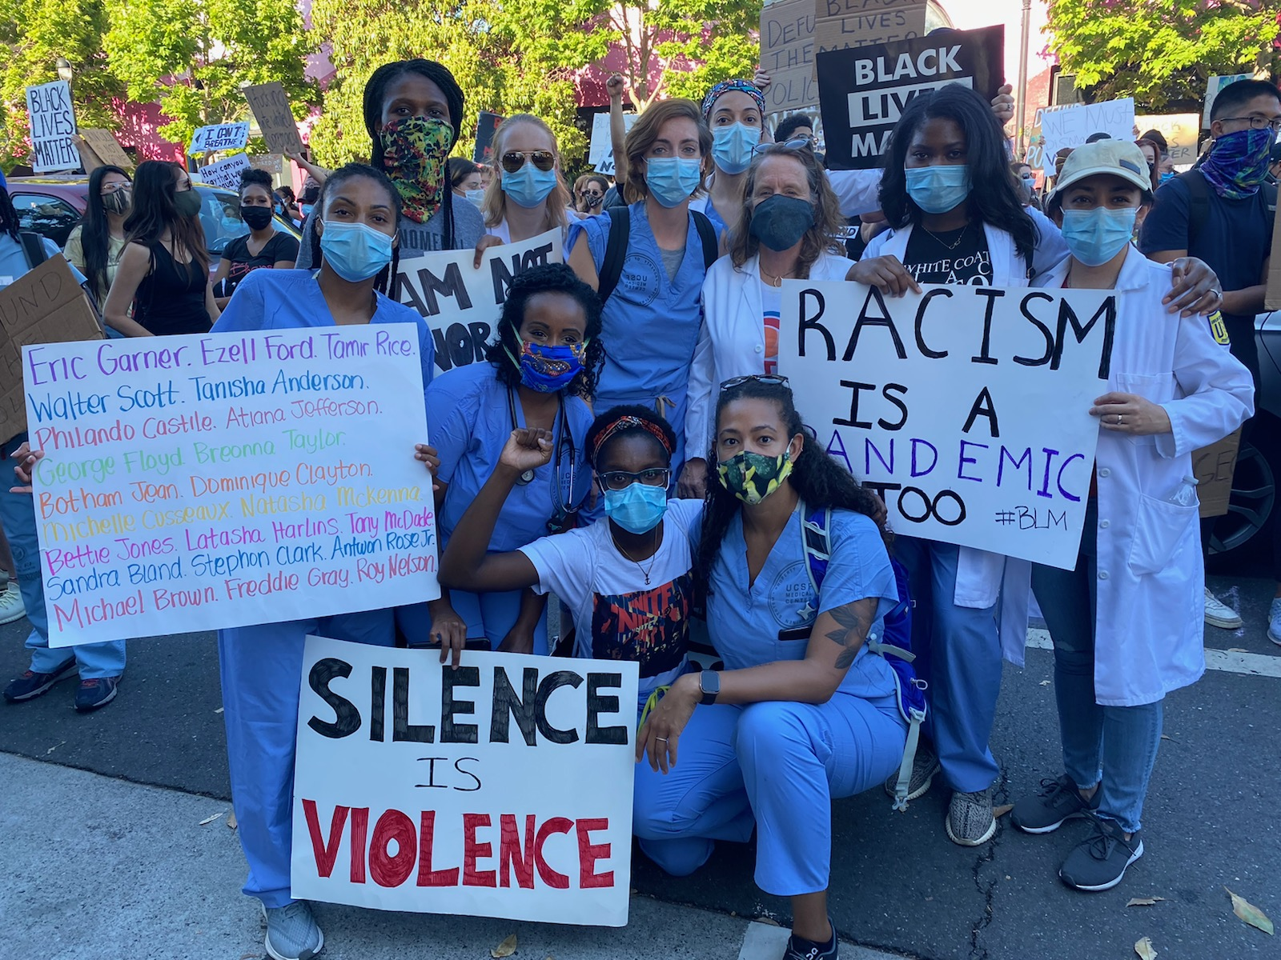
working together to promote PRIDE
proud to be part of UCSF
'Racism is a pandemic too': UCSF health care workers join San Francisco protest for George Floyd [ABC7News]
Notes:
I know a lot of us have been stressed and horrified with racial divide prompted by police brutality and veritable murder of our citizens.
I hope all of you had the opportunity to attend last Friday’s town hall. It was incredibly touching to hear the stories and experiences. I am proud to be part of a community that is working together to make a difference.
Proud to say we have PRIDE. Professionalism, Respect, Integrity, Diversity and Excellence
I wanted to dedicate this lecture to the members of our community who fight on the front lines– not just for COVID19, but for all of us who promote Diversity and Equality.

Slide 10
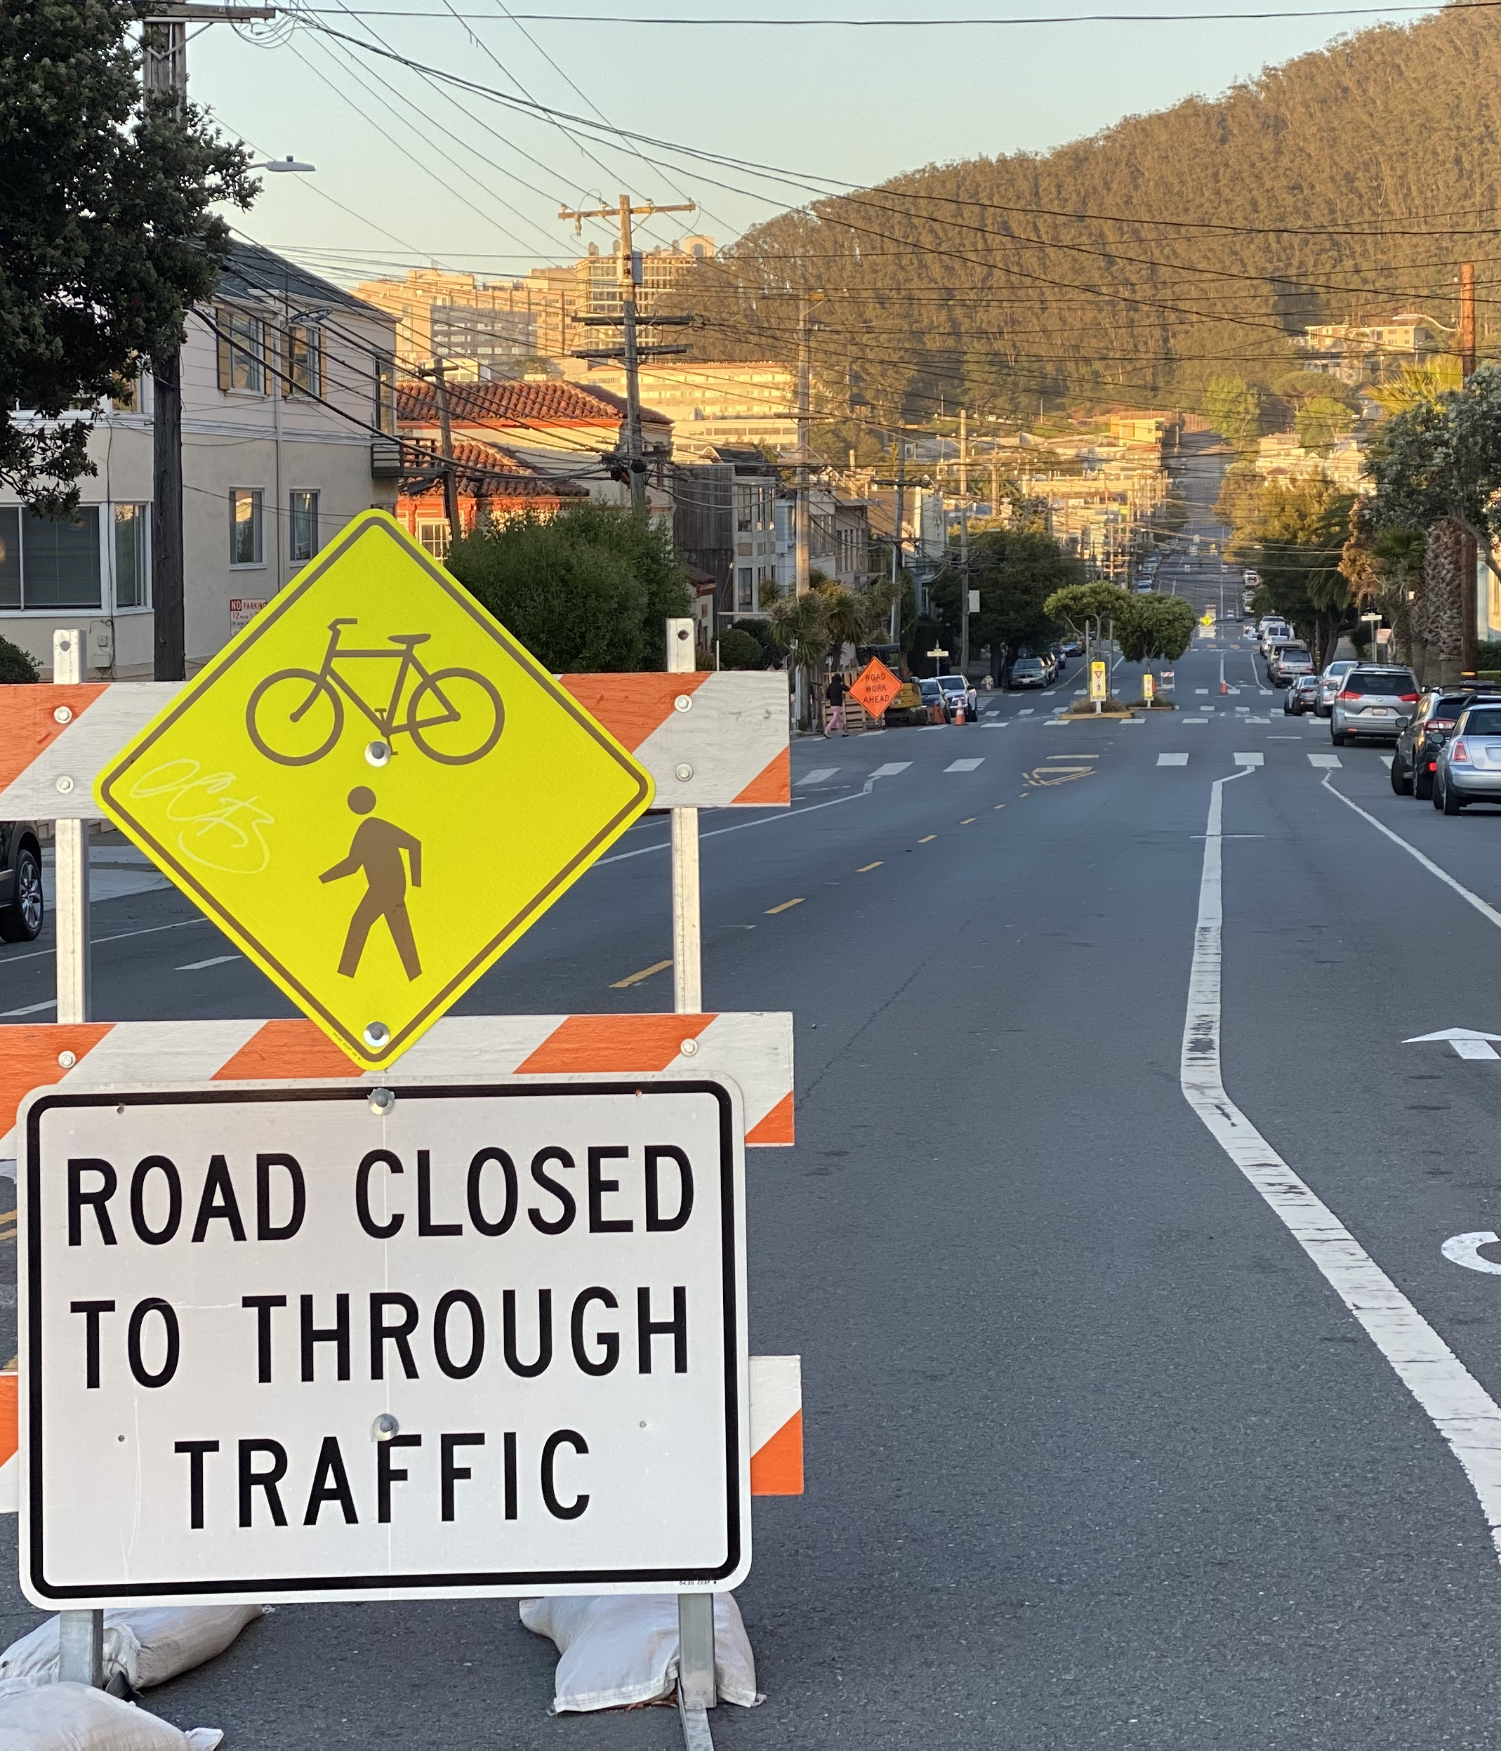
moment of repose
Open Discussion on Stress and Health
Kirkham Street Closure

Slide 12
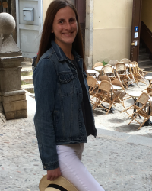
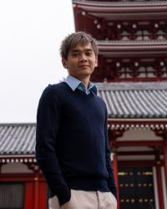
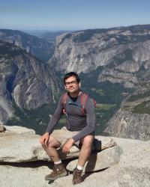
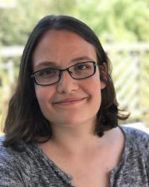
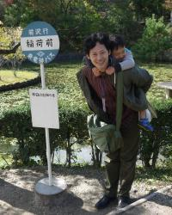
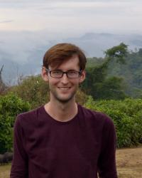
proposed VR teams
our postdoc leaders will help keep us together
Juntaro Matsuzaki
Olga Gulyaeva
Neil Tay
Gabriel Eades
Hannah Gruner
Stefan Oberlin
AltspaceVR
ENGAGE
Spatial
Rec Room
MeetinVr
VRChat

Slide 13
