Slide 1
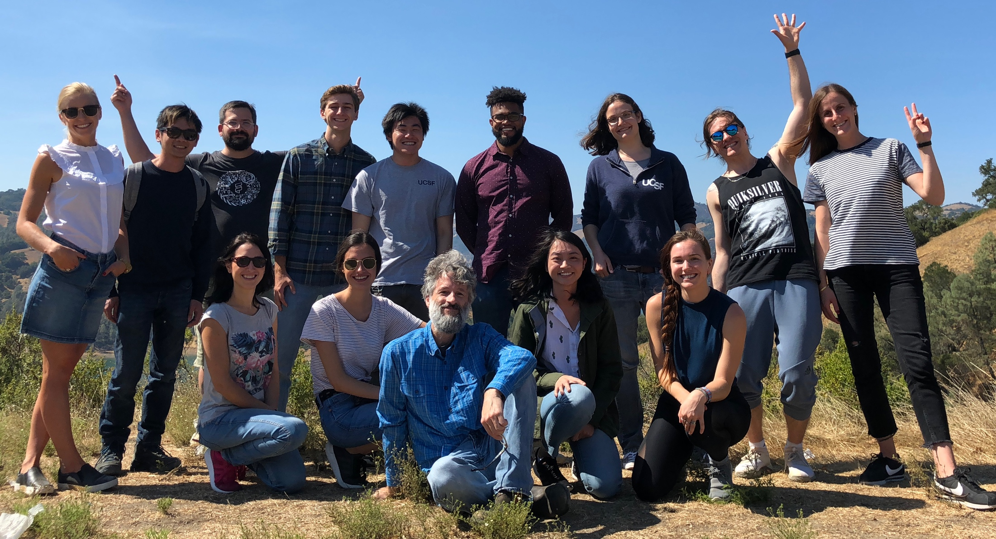
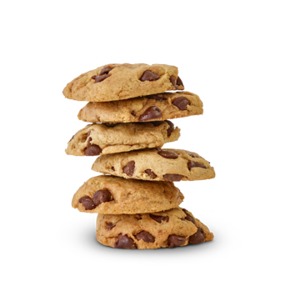
illuminating the dark matter of the genome
Systematic Functional Genomics Platforms to Solve Fundamentally Difficult Problems
Michael T. McManus, PhD
Professor, Stella Coates Endowed Chair
University of California, San Francisco
Equinor
November 6, 2019

Slide 2

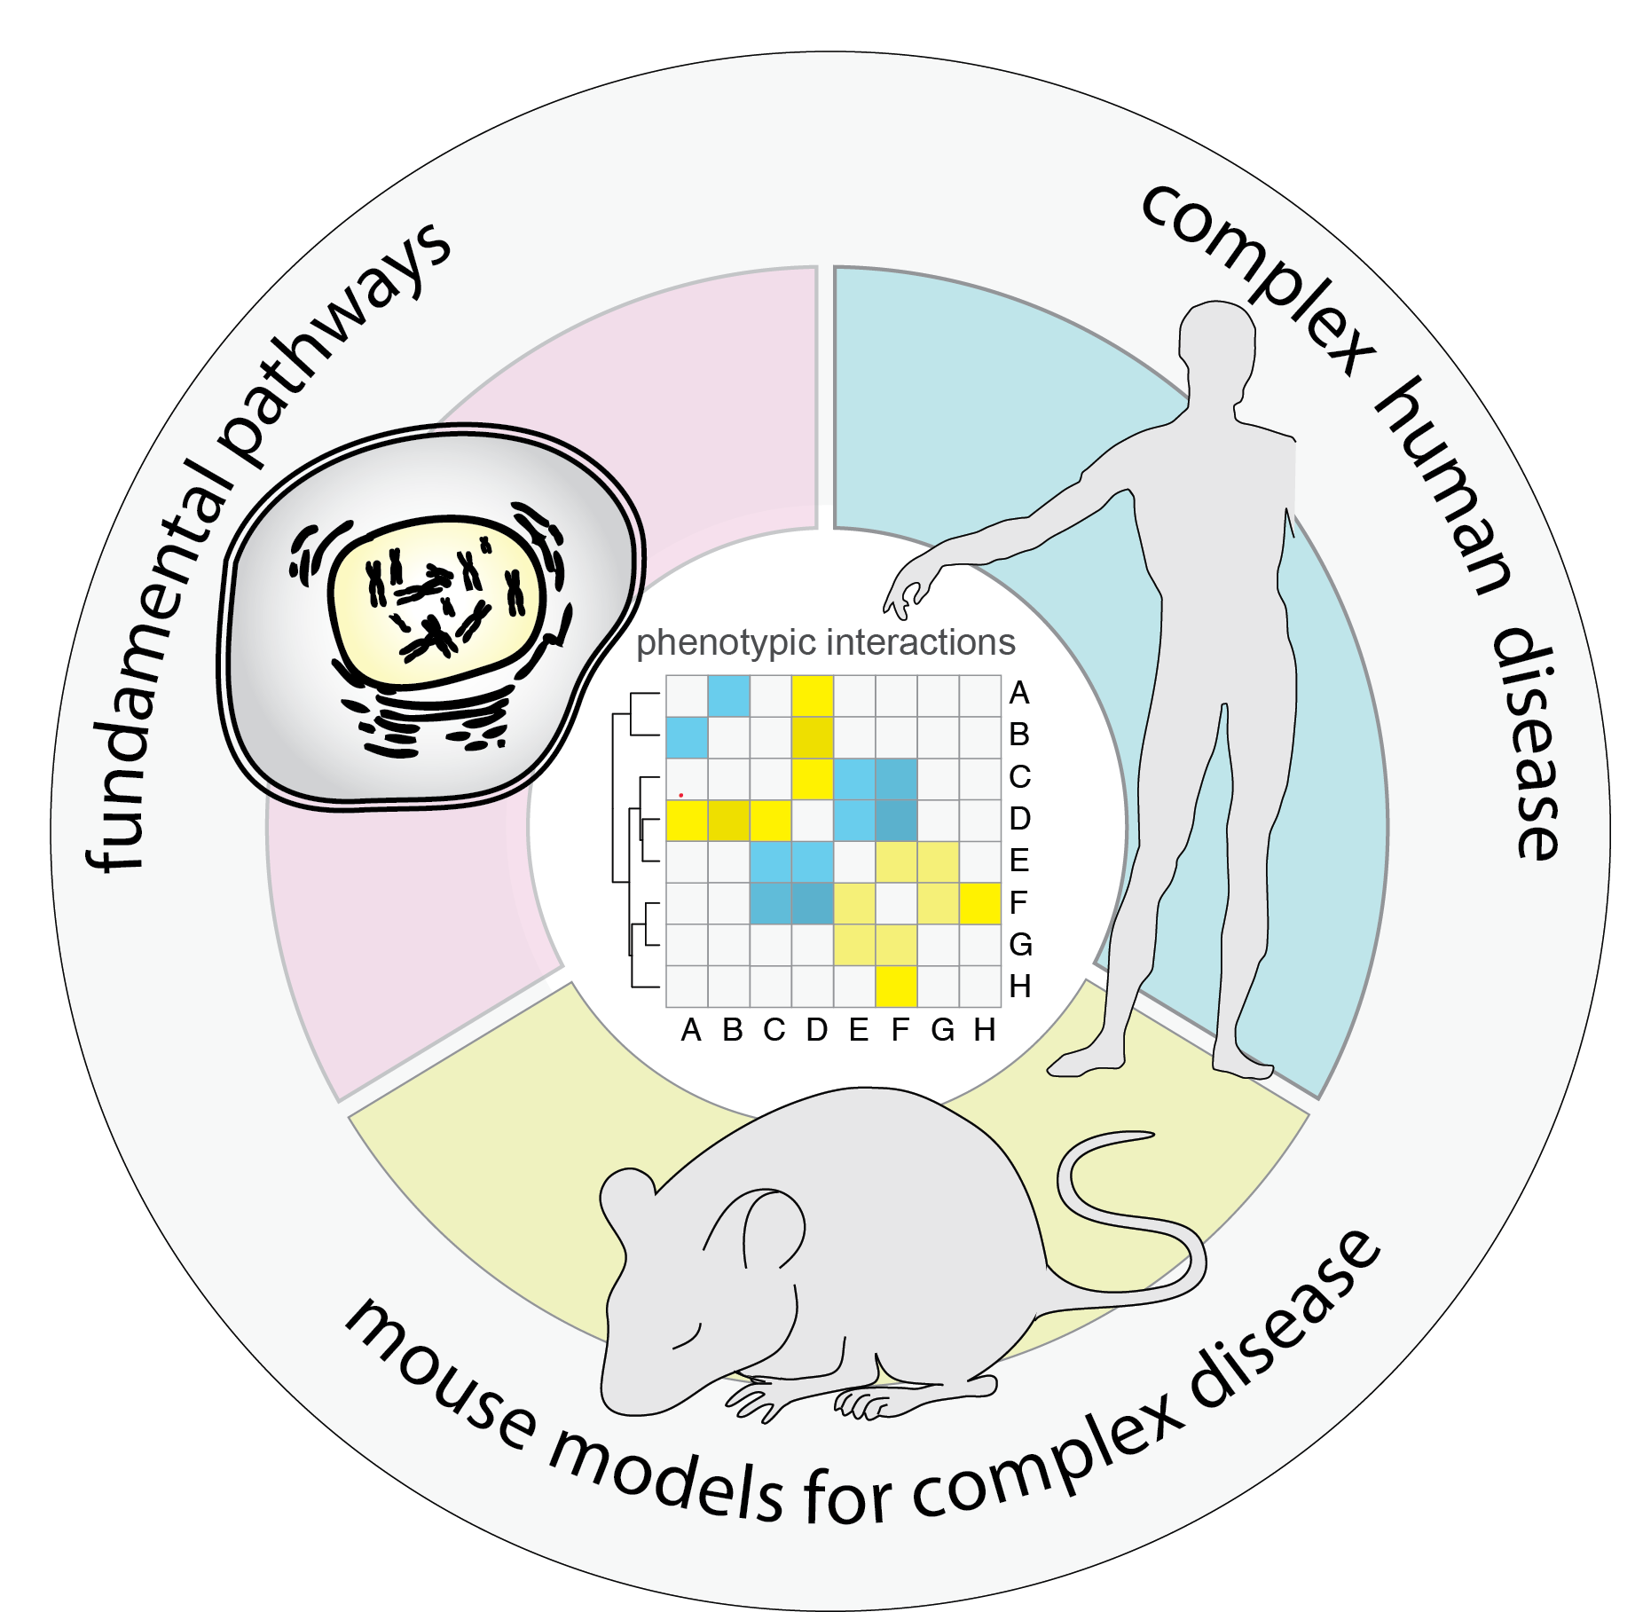
from cells to mice to humans
developing platforms for orthogonal in vivo studies

Slide 3
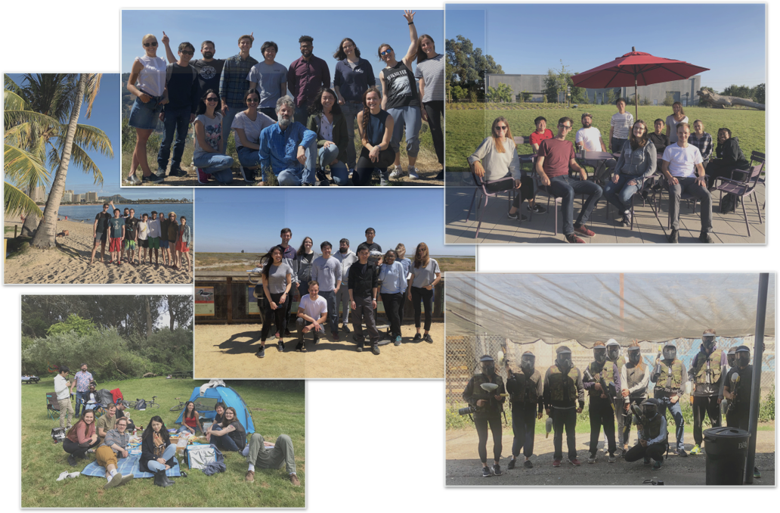
McManus Lab
solving fundamentally difficult problems in complex disease

Slide 4
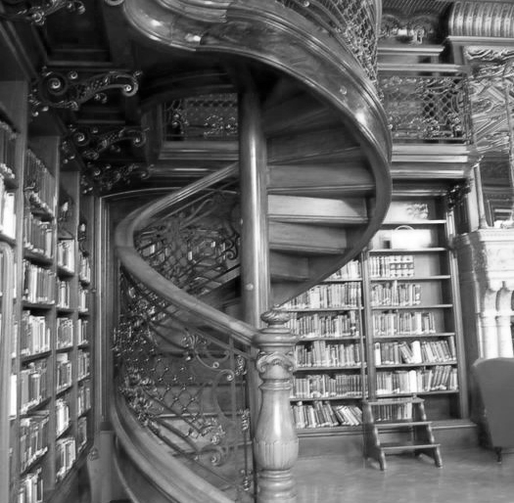
multidisciplinary innovative science
creativity in science
curiosity and exploration
read broadly, seek input
Notes:
Ideas do not come out of the blue. In order to build them you first need to gather the raw materials: facts, concepts, experiences, knowledge, feelings — that’s what ideas are made of. To get all of that, you need an attitude of ongoing curiosity and exploration.
Creative scientists are relentlessly curious and never limits themselves to a particular area of experience and knowledge. To have ideas is to connect dots. And youoften need lots of dots to connect — you need fuel for the formation of new ideas.
Be curious and alert. Poke around in unknown areas– read broadly. Be like a child, by paying attention to the world and being receptive to it. Rediscover the fun in finding things out.
Seek out as many inputs as possible. Talk to scientists, engineers, mathematicians in outside fields. Don’t limit yourself to expert advice. Go to meetings that you shouldn’t go to. Do not limit yourself to the tried and true. Read different journals from the ones you like. Read literature that “you’ll never use”.

Slide 5
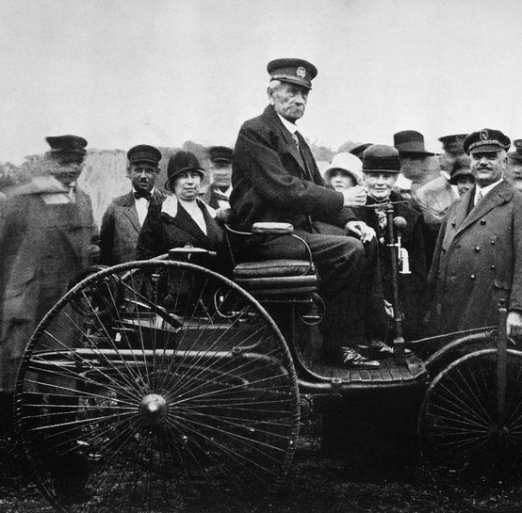
multidisciplinary innovative science
creativity in science
playful destruction and construction
question everything, ask ‘what if’
Inventor Karl Benz seated on the 1885 Benz Motorwagen. Bettmann Archive / Getty Images
Notes:
In 1885, a German mechanical engineer named Karl Benz designed and built the world's first practical automobile powered by an internal-combustion engine. A year later, Benz received the first patent for a gas-fueled car on January 29, 1886. It was a three-wheeler called the Motorwagen or Benz Patent Motorcar.
There is some debate on ‘who’ actually invented the car… made up of lots of little parts. Certainly Karl Benz invented an advanced many new parts. But the invention of a car is actually a combination of different pre-existing parts.
Some say that creativity can be defined by taking existing ideas and applying them to a new context. Like – if I asked you to draw a picture of an animal that doesn’t actually exist.
A most prominent example of innovating by imitation is Henry Ford’s development of the automobile assembly line—a system Henry Ford copied (and improved) from the Chicago meat processing business.
When people say someone’s “creative”, they’re usually referring to the Artist. The Artist has ideas mostly by trying new things. An artist applies his imagination by rearranging, turning things upside down, stirring things up. He pursues different approaches and finds unexpected connections. He’s playful; he doesn’t care about what people expect from him.
Flex your idea muscles. Write down new ideas as they come to you; it stimulates your brain to generate more and more ideas.
Play! We all know it: the most efficient way to have new ideas is by having fun. Don’t always take problems too seriously. Entertain yourself and keep your brain fresh and ready.
Use your imagination. Leave practicality aside; don’t be afraid to let your imagination run wild and visualize new possibilities. Dare to ask ‘what if’ and watch new realities unfold.

Slide 6
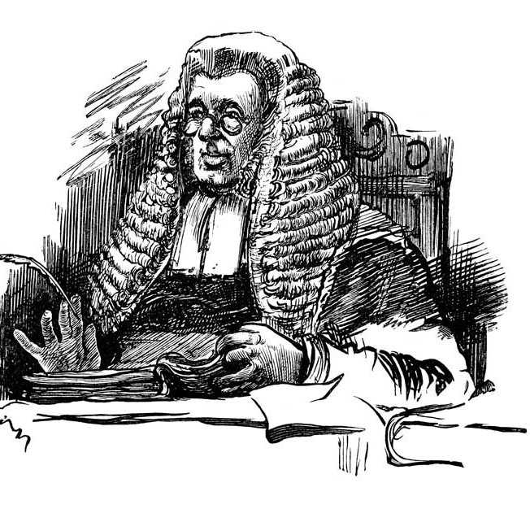
multidisciplinary innovative science
creativity in science
argument and debate
critically challenge your own ideas
Notes:
While an artist dares to invent the impossible, the Judge is all about “getting real”. A scientists is a staunch devil’s advocate– challenging their own wild ideas and assess if they’re feasible and have a basis.
The judge questions assumptions; he compares and analyzes. He checks how feasible ideas are. No matter how much the Artist loves an idea, the Judge looks for counterarguments, checks evidence, and makes hard decisions. Combining gut feeling and analytical tools, the judge must only let through feasible ideas.
The Judge gets a bad reputation — but only because people usually invoke him too early. Killing an idea before the Artist can play with it is a pity; killing it later is oftentimes a necessity.
Develop critical thinking. Check your assumptions, experimenting with hypotheses, analyzing results and drawing conclusions. Master decision making.
Be real. Will the idea give you the return you want? Do you have the resources to make it happen? Are you willing to put the effort to make it happen? Be practical and down-to-earth. If you are inventing a new technology– ask ‘does it have longevity’? If you are discovering a new set of biology, ask ‘is it significant’?

Slide 7
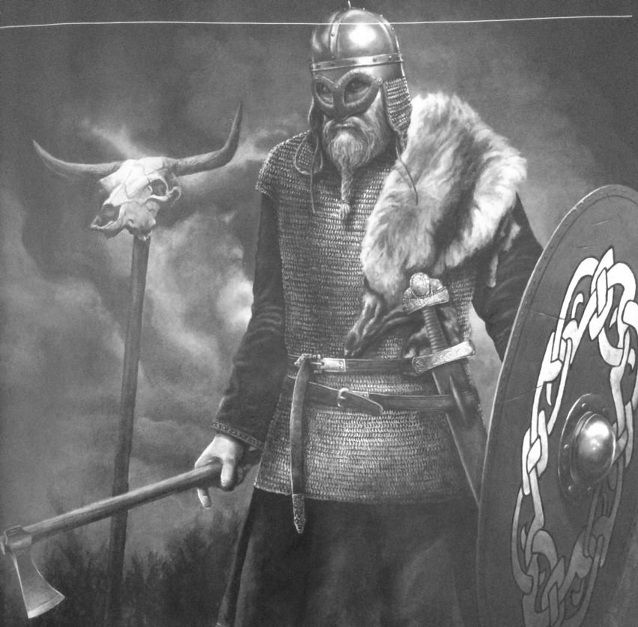
multidisciplinary innovative science
creativity in science
champion your ideas
paint your canvas, overcome resistance
Notes:
It is one thing to come up with a great idea– and quite another to execute it. One of the first steps is often to acquire funding. And for scientists, that usually means writing grants. Recruiting team members. Selling your vision.
As soon as you have an idea ready to be executed you’ll realize the world isn’t set up to accommodate every new idea that comes along. The enemies can be external: competition may be fierce, or people may just don’t “get” your beautiful ideas. Even harder than those, there are more than enough enemies already within you: think resistance, excuses and fear of failure.
Our job is to make ideas happen. That means remaining productive, developing the resilience and courage to overcome obstacles and, of course, being able to sell your ideas — whatever’s necessary to materialize them.

Slide 8
multidisciplinary innovative science
creativity in science
curiosity and exploration
read broadly, seek input
playful destruction and construction
question everything, ask ‘what if’
argument and debate
critically challenge your own ideas
champion your ideas
paint your canvas, overcome resistance

Slide 9
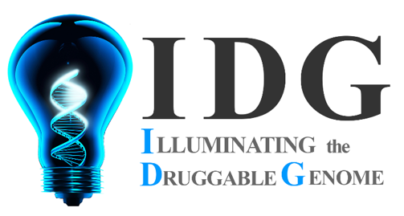
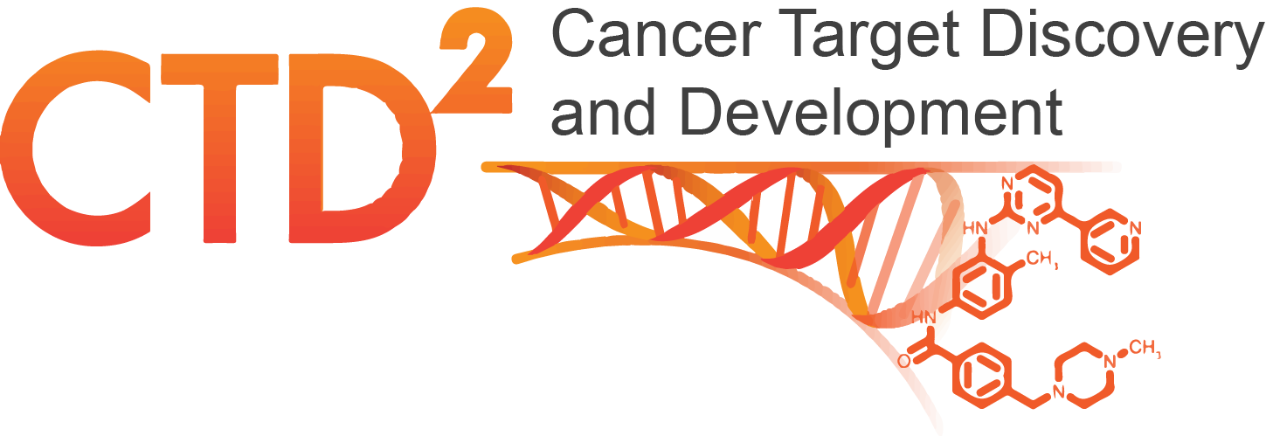
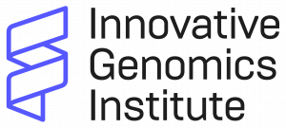
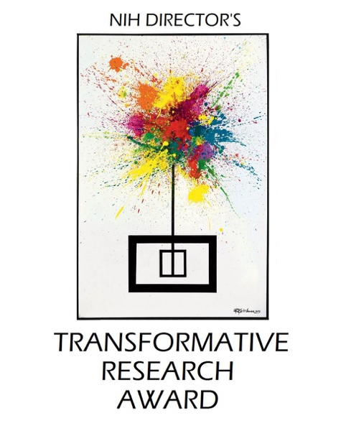


illuminating the dark matter of the genome
McManus Lab at University of California, San Francisco
McManus Lab
Gabriel Eades
Yuhao Wang
Olga Gulyaeva
Jana Gagacheva
Neil Tay
Adrienne Davis
Hannah Gruner
Stefan Oberlin
Christian Tran
Tiffany Juan
Juntaro Matsuzaki

