Slide 1
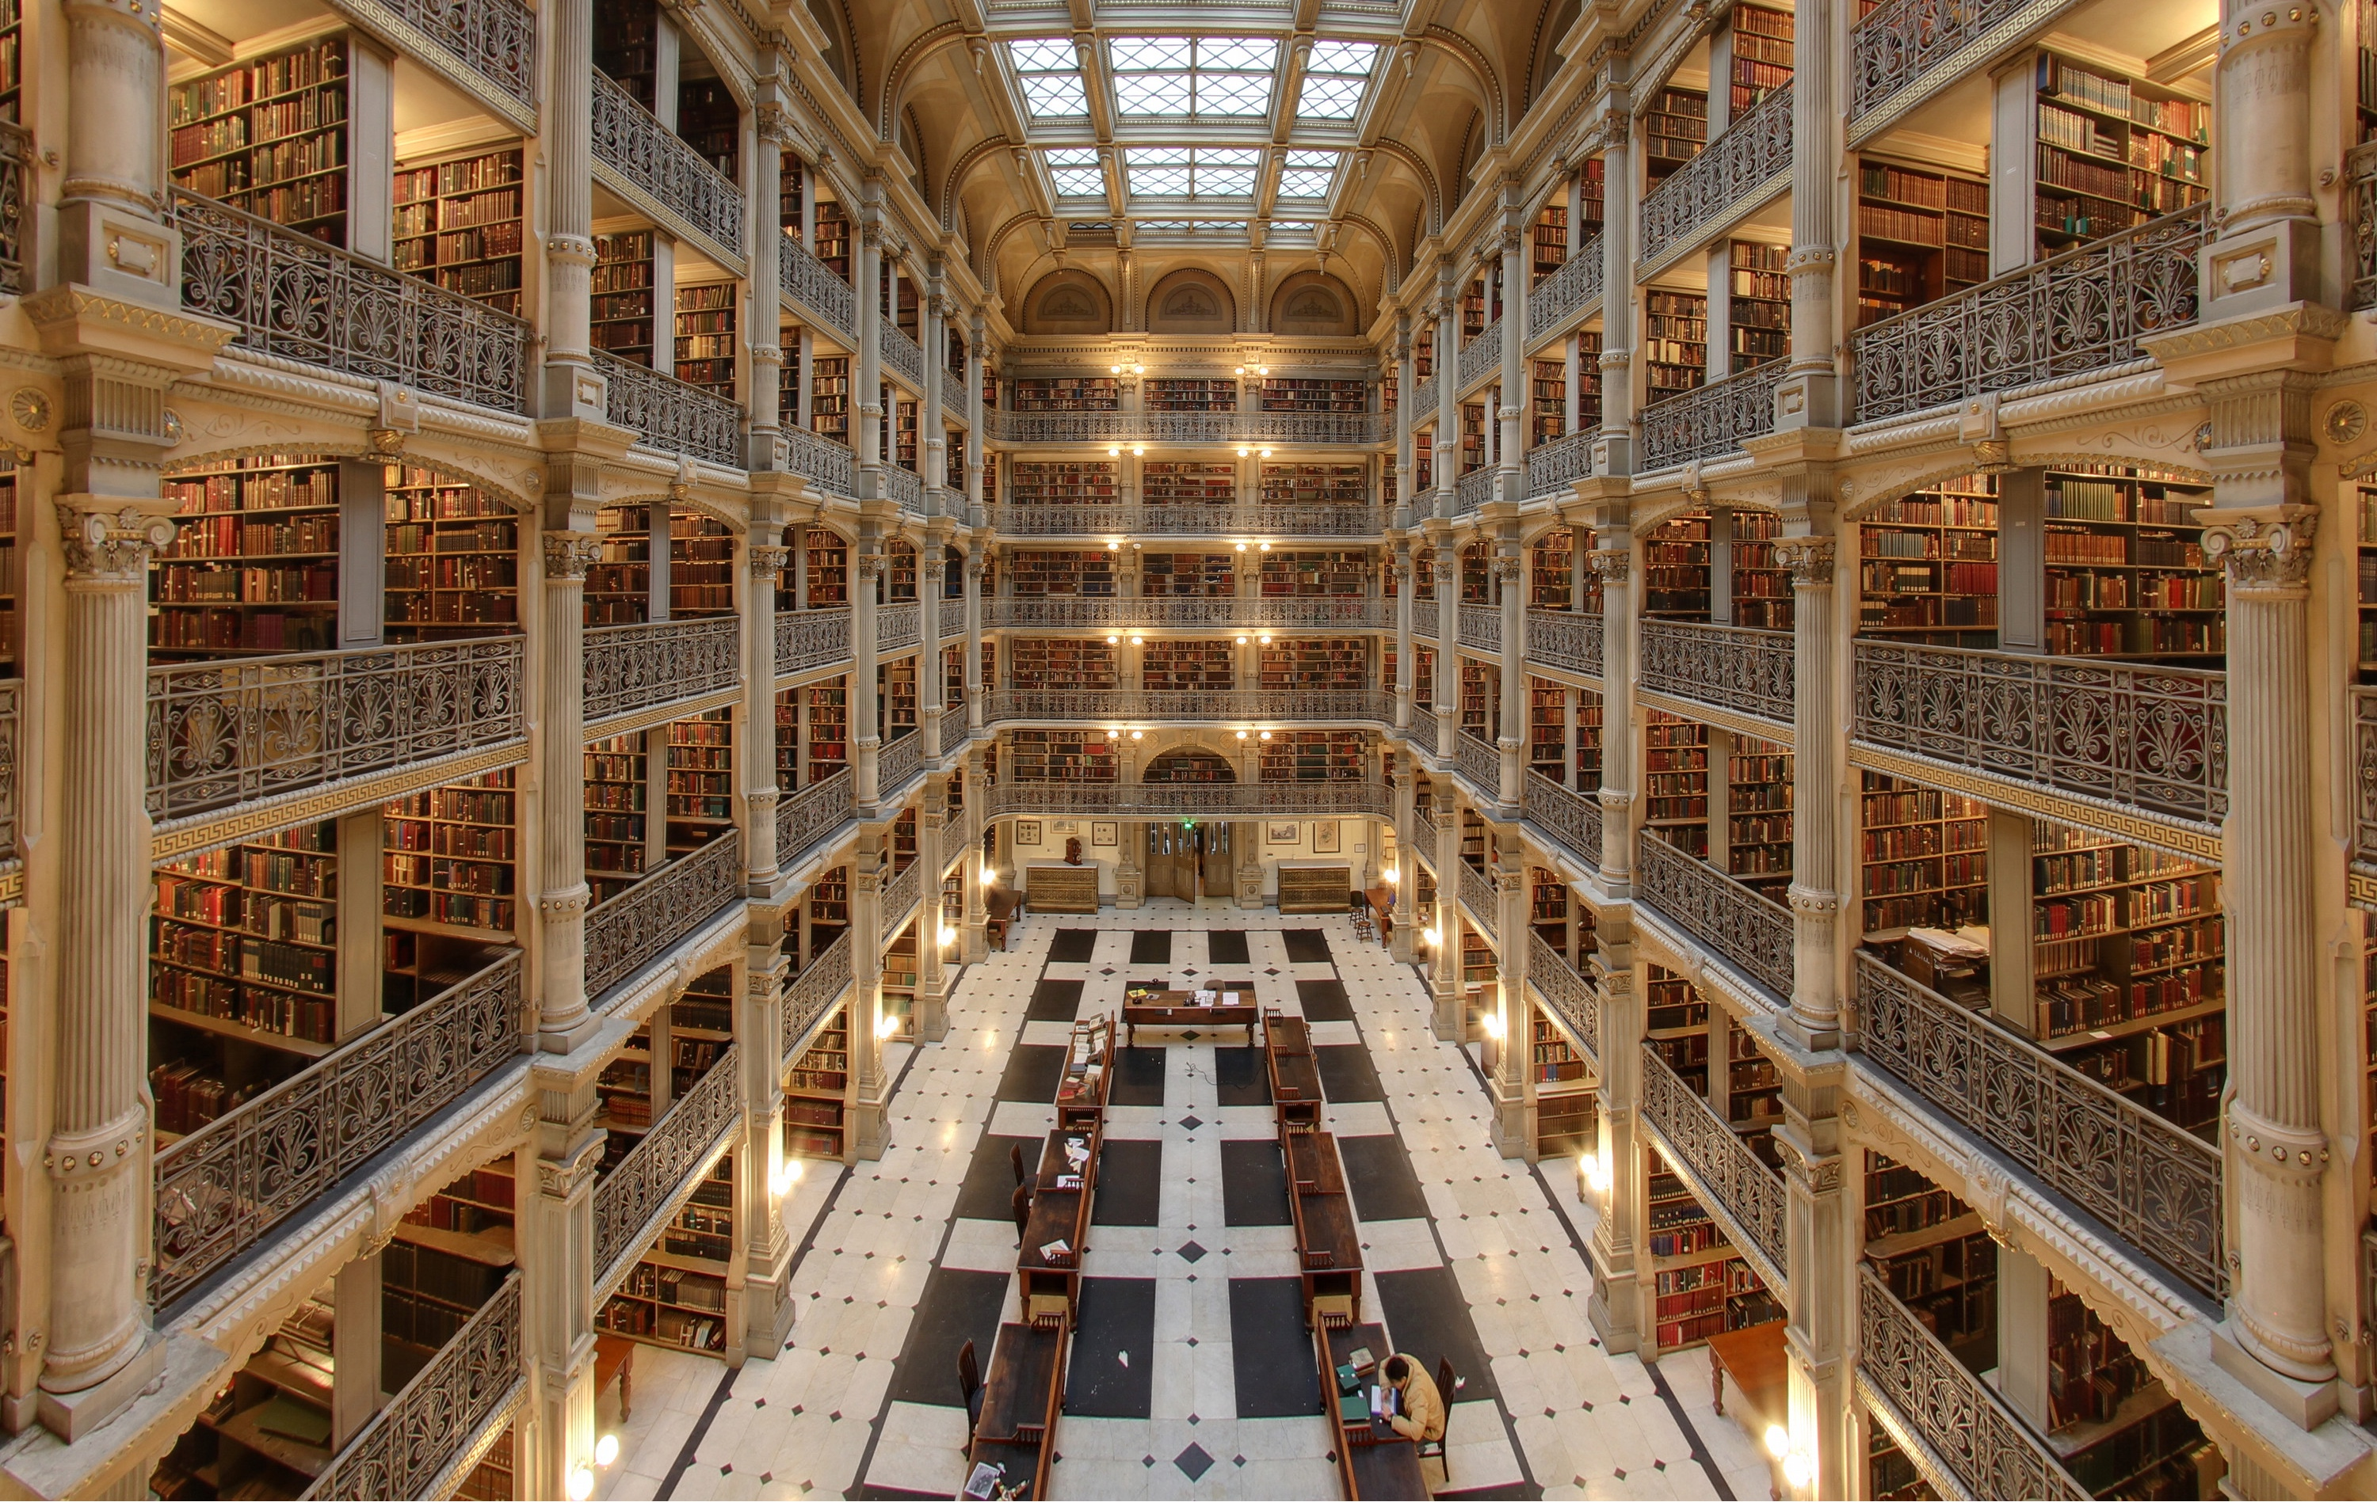
how to stay on top of the literature
how to catch the wave and enjoy the ride
Michael T McManus, PhD
University of California, San Francisco
Mentoring Workshop Lab Meeting
January 17th, 2020
Notes:
George Peabody Library (Baltimore)

Slide 2
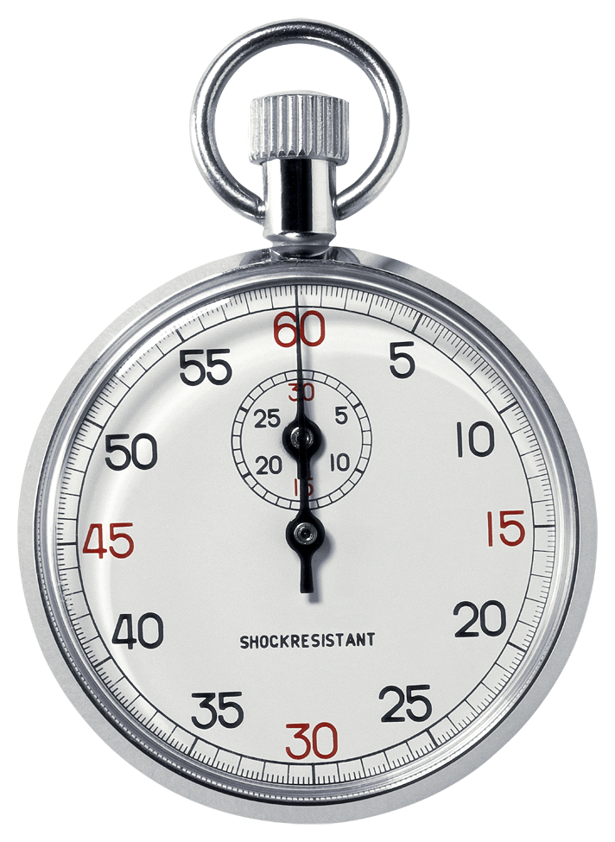
how to stay on top of the literature
making the time to build knowledge and ideas
where does the time go?
time is your most precious resource
~4 hours per week = your path to success
Reading/Writing Papers
Various Meetings
Experiments

Slide 3
imagine reading and writing more papers
why bother?
“I’d rather focus on generating data needed to get my publications out the door first, rather than waste time reading the literature now”
imagine
The gut wrenching feeling when you come across a paper that impacts your work. Imagine the feeling when you discover that the paper is months or even years old.
The feeling when (on an interview seminar), a colleague asks how your work differs from another very similar research program. Imagine the feeling when you realize that you actually don’t know the work.
Discovering that your whole research approach is fundamentally flawed, or perhaps antiquated. Imagine the feeling when you find out that others have developed solutions to your approach… after you’ve spent months or years on your project.

Slide 4
reading and writing more papers
why bother?
“I’d rather focus on generating data needed to get my publications out the door first, rather than waste time reading the literature now”
Case Study
two students, nearly identical CVs, one gets a dream postdoc slot, the other doesn’t. How?
two postdocs, nearly identical CVs, both interview, one gets a job interview, the other doesn’t. Fair?
two techs, nearly identical CVs, one excels in the interview, the other doesn’t. Why?

Slide 5
reading and writing more papers
do you feel paralyzed?
you are not alone
Notes:
Start with an objective
Think of the resulting action, ie your goal.
Learn how to Sail.
Learning the tools to help navigate the sea of data will help you sail faster
Keep it regular
Digesting smaller amounts of data avoids consttipation

Slide 6
the data deluge
the most successful scientists see this as an opportunity

Slide 7
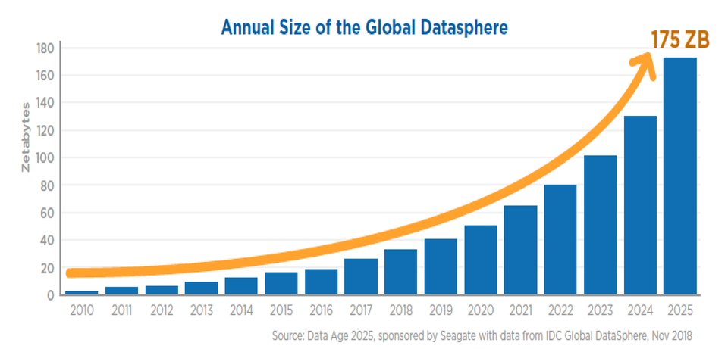
the data deluge
sound familiar?
“Genomic research makes it possible to look at biological phenomena on a scale not previously possible: all genes in a genome, all transcripts in a cell, all metabolic processes in a tissue. One feature that all of these approaches share is the production of massive quantities of data. GenBank, for example, now accommodates >10¹⁰ nucleotides of nucleic acid sequence data and continues to more than double in size every year. New technologies for assaying gene expression patterns, protein structure, protein-protein interactions, etc., will provide even more data. How to handle these data, make sense of them, and render them accessible to biologists working on a wide variety of problems is the challenge facing bioinformatics—an emerging field that seeks to integrate computer science with applications derived from molecular biology. We are swimming in a rapidly rising sea of data. . . how do we keep from drowning?”
—Roos (2001). Bioinformatics--Trying to Swim in a Sea of Data. Science. 291:1260

Slide 8
how to stay on top of the literature
discovery, analytics, reference libraries, and alerts
Discover the most relevant data.
Mining the world’s data to advance your science
Embracing analytics to decipher and distill data.
Analyzing data to identify key research, collaborations, funding sources, etc
Building a reference library to house your data.
Organizing your collected works to save time
Creating email alerts to stay on top of emerging data.
Once you have caught the wave, enjoy surfing it.

Slide 9
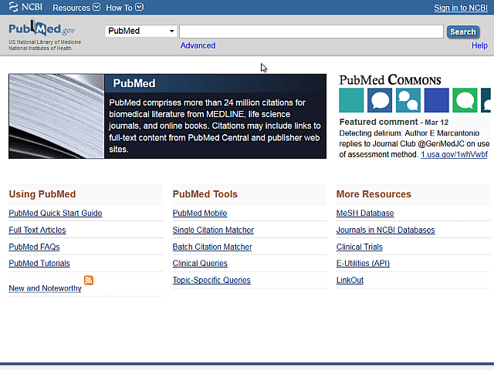
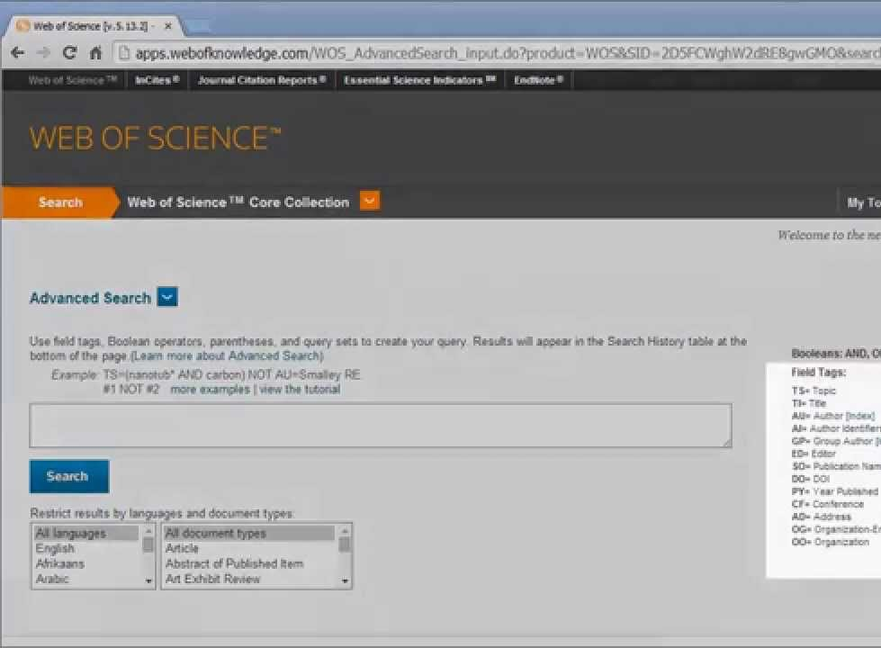
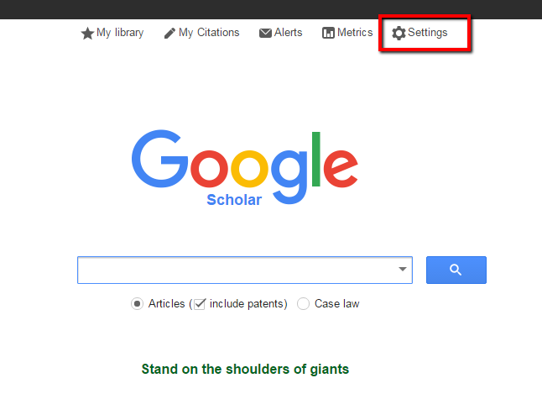
which database do you use?
three popular portals
Pubmed
Web of Science
Google Scholar
https://www.ncbi.nlm.nih.gov/pubmed/
https://webofknowledge.com/
https://scholar.google.com/

Slide 10
which database should I use?
PubMed, Web of Science, or Google Scholar?
it depends on what you are trying to do!
Both PubMed and Web of Science are human-curated databases. Google Scholar is not.
Web of Science and Google Scholar track the most citations. PubMed tracks citations only for PubMed Central articles.
Google Scholar searches full text of articles but PubMed and Web of Science search only the citation, abstract, and tagging information.

Slide 11
email alerts help you stay on top of emerging data
once you have caught the wave, enjoy surfing it
here are some options:
1: NCBI alerts
use search terms to automatically deliver results to your email
2: ETOCS
get your favorite journal contents the day that they are published
3: Meta, Stork, Readcube/Papers, etc
use semantics and machine learning to search and map biomedical research
4: Google Alerts, Awario, Altimetric, NIH Reporter, etc
don’t just monitor journals– listen to social media, news feeds, etc.

Slide 12
email alerts help you stay on top of emerging data
avoid these common mistakes
learn how to best use these powerful tools.
1: using the wrong keywords
broad terms like ‘microRNA’ or ’CRISPR’ will drown you with results
2: focusing only on journal articles
journal articles are only a fraction of the available data
3: limiting searches to only subject keywords
citation alerts, authors, grants/fellowships, conferences, seminars, etc
4: ignoring your results
frequently missing your searches and feeds will give you a false sense of security

Slide 13
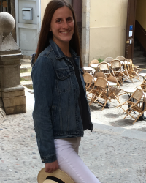
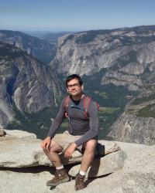
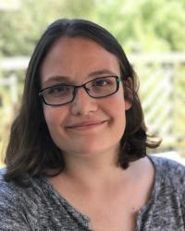
proposed mini-workshops
hands-on, how-to, help-is-here
Juntaro Matsuzaki
Olga Gulyaeva
Neil Tay
Gabriel Eades
Hannah Gruner
Yuhao Wang
Stefan Oberlin
Pubmed
Meta
Endnote
WOS
Alerts
Scholar
Twitter

Slide 14
further reading
resources
PUBMED Tutorial
Web of Science Tutorial
Google Scholar Tutorial
CHOOSING THE RIGHT CITATION
MANAGEMENT TOOL: ENDNOTE, MENDELEY, REFWORKS, OR ZOTERO
*other resources are available in this slide deck (i.e. slide 9 and 11)… as clickable links

Slide 15
mentoring
past and future topics
How To Stay On Top Of The Literature
How To Interview A Candidate
How To Prepare A Winning Poster
When, Where, And How To Publish
Imposter Syndrome
The Art Of Collaboration
Mentoring A Rotation Student
Effective Time Management
How To Give A Winning Elevator Pitch
Positive Psychology and Reinforcement

Slide 16
mentoring
past and future topics
Using Your Environment To Advance Your Career
Networking Strategies
References: managing your discovered research
Reviewing Manuscripts
Staying Sane During Your Phd/Postdoc
The Mona Lisa Effect
Achieving Work-Life Balance
Writing Letters: One For Every Purpose
Reviewing Fellowships And Grants
Making an Impact Through Your Science
Writing A Winning Fellowship

Slide 17
mentoring
past and future topics
Creating A Beautiful Figure
Scientific Career Choices
Choosing A Scientific Home
Difficult Conversations
Blow Them Away With Your Talk
Giving Solid Feedback
What Is Luck In Science
Mid-Postdoc/Phd Crisis
Acing Your Interview
How To Create a Star Academic/Industry CV

