Slide 1
While you are waiting
Pick up an index card. Please write on it any question or authorship challenge that you want to have discussed. We will dedicate time during the exercise and at the end of the session to discuss specific questions or examples.

Slide 2
Responsible Authorship, Publishing, and Peer Review
Michael McManus, PhD
Anneliese Taylor, MLIS
University of California, San Francisco
Developed from O'Sullivan P, Chauvin S, Wolf F, Richardson D, Blanco M. Authorship Issues in Publishing and Career Development Workshop. MedEdPORTAL; 2013. Available from: mededportal.org/publication/9309/.

Slide 3
Learning Objectives
At the conclusion of this session you will be able to:
Define criteria and guidelines for authorship.
Recognize dilemmas that can arise in determining authorship.
Identify professional and ethical issues and consequences of authorship and publishing decisions.
Identify resources that may be useful to help with authorship and publishing ethics decisions.
Notes:
These objectives should be appropriate to all versions of the workshop.

Slide 4
What and where are the guidelines and ethics for authorship?
International standards
Example: International Committee of Medical Journal Editors (ICMJE), Committee on Publications Ethics (COPE)
Scientific journals
- Examples: Science, Nature
Medical publications/journals
- Examples: JAMA, BMJ
Publication Manual of American Psychological Association
Education, social and behavioral science publications/journals
Notes:
This slide lists the various sources for information on these topics. All of these have notes specific to authors to provide guidance

Slide 5
Who is an author? - ICMJE
The ICMJE recommends that an author should meet all four of the following criteria:
Substantial contributions to the conception or design of the work; or the acquisition, analysis, or interpretation of data for the work; AND
Drafting the work or revising it critically for important intellectual content; AND
Final approval of the version to be published; AND
Agreement to be accountable for all aspects of the work in ensuring that questions related to the accuracy or integrity of any part of the work are appropriately investigated and resolved.
1 & 2 = roles 3 & 4 = responsibilities
http://www.icmje.org/recommendations/browse/roles-and-responsibilities/defining-the-role-of-authors-and-contributors.html
Notes:
Contributors who meet fewer than all 4 of the above criteria for authorship should not be listed as authors, but they should be acknowledged. Examples of activities that alone (without other contributions) do not qualify a contributor for authorship are acquisition of funding; general supervision of a research group or general administrative support; and writing assistance, technical editing, language editing, and proofreading.
Editors are strongly encouraged to develop and implement a contributorship policy. Such policies remove much of the ambiguity surrounding contributions, but leave unresolved the question of the quantity and quality of contribution that qualify an individual for authorship.

Slide 6
Authorship & contributorship - BMJ
“The BMJ lists contributors in two ways. Firstly, we publish a list of authors' names at the beginning of the paper and, secondly, we list contributors (some of whom may not be included as authors) at the end of the paper, giving details of who did what in planning, conducting, and reporting the work. “
https://www.bmj.com/about-bmj/resources-authors/article-submission/authorship-contributorship
Notes:
An example of a journal that follows the ICMJE authorship guidelines, but that further specifies the roles of both authors and other contributors who do not meet authorship criteria.
Footnotes from https://www.bmj.com/content/368/bmj.l6968

Slide 7
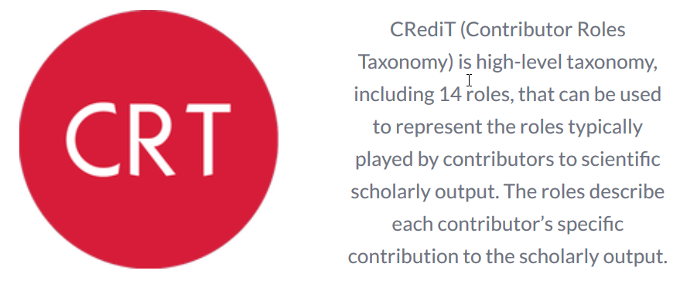
CRediT – Contributor Roles Taxonomy
Notes:
https://casrai.org/credit/
In use by 30 publishers, including Elsevier (1200 journals), Springer, Wiley, OUP
From https://www.timeshighereducation.com/features/what-can-be-done-resolve-academic-authorship-disputes?:
The journals have adopted the “Contributor Roles Taxonomy” (CRediT) system, which requires lead authors to provide an accurate summary of each author’s contribution to 14 distinct areas deemed relevant to authorship: conceptualisation, data curation, formal analysis; funding acquisition; investigation; devising methodology; project administration; contribution of resources; development of software; supervision; validation; visualisation; writing; and reviewing and editing.
The initiative originates from a 2012 workshop of researchers, publishers and others led by Harvard University and the Wellcome Trust, and has been piloted in 150 Elsevier journals. The reception from both authors and editors was “very positive”, according to a December press release announcing the expansion of the scheme to 1,200 of Elsevier’s 2,500 journals, with “hundreds” more to be added to the list through 2020.
According to the website of the Consortia Advancing Standards in Research Administration Information (CASRAI), which facilitated the workshop, a total of 30 publishers have so far adopted the system, including Springer, Wiley and Oxford University Press, although not all mandate it.
The 14 roles:
Conceptualization Data curation Formal Analysis Funding acquisition Investigation Methodology Project administration
Resources Software Supervision Validation Visualization Writing – original draft Writing – review & editing

Slide 8
Committee on Publication Ethics (COPE)
“COPE is a forum for editors and publishers of peer-reviewed journals to discuss all aspects of publication ethics. It also advises editors on how to handle cases of research and publication misconduct.”
https://publicationethics.org/
Notes:
COPE is an independent, cross-disciplinary member organization for publishers and journals.
Their web site has videos, documents and flow charts to highlight how to handle issues around research integrity.
Guidance for editors on topics like “How to spot authorship problems”, “What to do if you suspect peer review manipulation”, and “Request for addition of extra author after publication”
The forum responds to specific, anonymized cases, of which there are over 600 in ten topical groups.

Slide 9
Responsible research publication: int’l standards for authors (COPE et al.)
Soundness and reliability
Honesty
Balance
Originality
Transparency
Appropriate authorship and acknowledgement
Accountability and responsibility
Adherence to peer review and publication conventions
Responsible reporting of research involving humans or animals
https://publicationethics.org/resources/resources-and-further-reading/international-standards-editors-and-authors
Notes:
Responsible research publication: international standards for authors. A position statement developed at the 2nd World Conference on Research Integrity, Singapore, July 22-24, 2010 Elizabeth Wager & Sabine Kleinert Contact details: liz@sideview.demon.co.uk sabine.kleinert@lancet.com
Publication is the final stage of research and therefore a responsibility for all researchers. Scholarly publications are expected to provide a detailed and permanent record of research. Because publications form the basis for both new research and the application of findings, they can affect not only the research community but also, indirectly, society at large. Researchers therefore have a responsibility to ensure that their publications are honest, clear, accurate, complete and balanced, and should avoid misleading, selective or ambiguous reporting. Journal editors also have responsibilities for ensuring the integrity of the research literature and these are set out in companion guidelines.
This document aims to establish international standards for authors of scholarly research publications and to describe responsible research reporting practice. We hope these standards will be endorsed by research institutions, funders, and professional societies; promoted by editors and publishers; and will aid in research integrity training.
Summary:
The research being reported should have been conducted in an ethical and responsible manner and should comply with all relevant legislation.
Researchers should present their results clearly, honestly, and without fabrication, falsification or inappropriate data manipulation.
Researchers should strive to describe their methods clearly and unambiguously so that their findings can be confirmed by others.
Researchers should adhere to publication requirements that submitted work is original, is not plagiarised, and has not been published elsewhere.
Authors should take collective responsibility for submitted and published work.
The authorship of research publications should accurately reflect individuals’ contributions to the work and its reporting.
Funding sources and relevant conflicts of interest should be disclosed.

Slide 10
COPE Key concepts in authorship
First and last authors (author position)
To be avoided:
guest authors are those who do not meet accepted authorship criteria but are listed because of their seniority, reputation or supposed influence
gift authors are those who do not meet accepted authorship criteria but are listed as a personal favor or in return for payment
ghost authors are those who meet authorship criteria but are not listed
https://publicationethics.org/files/International%20standards_authors_for%20website_11_Nov_2011_1.pdf
Notes:
First and last authors: Generally speaking, the most sought-after position is the first, which is not surprising given the convention of referring to studies by the first-named author, e.g., ‘Smith et al. have shown that’. The first-named author is therefore generally held to have made the greatest contribution to the research.
Sometimes significance is attached to being the last named author. This is particularly true in the biomedical and translational sciences. Here the senior author is seen as the leader and responsible for the entire work. In some medical schools the two authorship positions valued are first and last. Authors have often given the last place to a senior team member who contributed expertise and guidance. This can be consistent with the ICMJE criteria if this person was involved in study design, the interpretation of the data, and critically reviewed the publication. However, views about this do seem to vary, so don’t assume that everybody feels the same way about it. References by Baerlocher and colleagues (2007) and Tscharntke and colleagues (2007) discuss this further.
However, cynics may suspect that the final author is often a guest or honorary author. In the social sciences, the last author is seen as the person who may have contributed the least. (See Order of authors.) -from How to handle authorship disputes: a guide for new researchers by Tim Albert, trainer in medical writing, and Elizabeth Wager, freelance writer and trainer on COPE site. http://www.publicationethics.org/files/u2/2003pdf12.pdf)
COPE says:
• guest authors are those who do not meet accepted authorship criteria but are listed because of their seniority, reputation or supposed influence
• gift authors are those who do not meet accepted authorship criteria but are listed as a personal favour or in return for payment
• ghost authors are those who meet authorship criteria but are not listed

Slide 11
Responsibilities of the authors
Corresponding author
Contributing author
accuracy of the data and the conclusions and claims drawn from those data for the entire paper
Accuracy of the authorship list (all deserve authorship and no one has been neglected)
handling of all correspondence and response to inquiries
Accuracy of the data and the conclusions and claims drawn from those data, but only in the field of their contribution
Accuracy of the authorship list, to the best of their knowledge

Slide 12
How to reduce the incidence of authorship problems (COPE)
Three recommended principles:
1. Encourage a culture of ethical authorship
- inform others of publication ethics
2. Start discussing authorship when you plan your research
- keep a written record of decisions
3. Decide authorship before you start each article
- confirm who will do what, in writing
- keep track of changes and inform all involved
- Set up check-ins during writing
- Use an authorship grid (see CLE)
https://doi.org/10.24318/cope.2018.1.1
Notes:
Many authorship difficulties arise because of misplaced expectations and poor communication. So it is important that, before you start to write up your project, you confirm in writing who will be doing what—and by when. Ideally you should do this face to face, though this may not always be possible. Keep everyone informed of any changes with a written note.
From How to handle authorship disputes: a guide for new researchers, Authors: Tim Albert, trainer in medical writing, Elizabeth Wager, freelance writer and trainer, on behalf of COPE Council, Version 1 2003

Slide 13
How to handle authorship disputes: a guide for new researchers (COPE)
Disputes
- refer to written record of authoring plan
- support argument with evidence
Misconduct
reiterate editorial guidelines
https://doi.org/10.24318/cope.2018.1.1
Notes:
While there is a great deal of agreement among journal editors on authorship matters, there are also some differences in detailed requirements and the ways in which by-lines are presented. You should carefully read the Instructions to Authors for your target journal.

Slide 14
Who is an author?
The PI in your lab
A student in your lab who helped you with a critical technique
A fellow postdoc in the neighboring lab who performed an experiment and provided input on how the results affect the conclusions
The PI for that student
The staff scientist in a core facility who performed experiments on your instruction
Undergrad student who was in the lab for 3 months, collected data under the instruction of the postdoc mentor

Slide 15
Authorship Case Studies

Slide 16
Authorship Case #1: A real-life example
Break into groups of 3-4 and discuss your responses
A newly hired research associate is charged with picking up a dormant project. Emeline is asked to take a look through various mutant strains that were isolated as part of a genetic screen undertaken by a postdoc who left the lab two years earlier. Emeline confirms that the phenotype in one of these strains is reproducible and robust, so she pursues this mutant further. She and the new postdoc work through the genetics and the cell biological experiments to eventually determine the identity of the causative gene, and write a paper on its role in the mutant phenotype.
Questions:
What role does the original postdoc have?
Does the original postdoc merit authorship?

Slide 17
Your authorship cases

Slide 18
Standards meet Reality
46/82 scholars surveyed; response rate = 56.0%
22 (51.2%) experienced unethical pressure regarding authorship order
15 (34.9%) not included as author when qualified
25 (58.1%) saw unqualified authors included
25 (58.1%) correctly identified authorship standards
Uijtdehaage, S; Mavis, B; Durning, S Whose Paper Is It Anyway? Authorship Criteria According to Established Scholars in Health. Academic Medicine, 01/2018

Slide 19
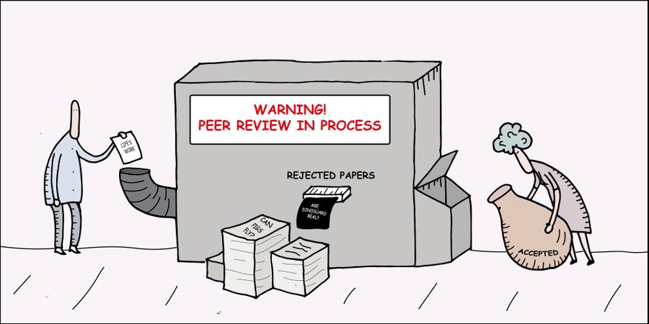
Peer Review
https://twitter.com/digitalsci/status/781860071831642113
Notes:
Anneliese is checking permission with Digital Science to use this image

Slide 20
“Peer review is the process by which a piece of scientific research is assessed by others—a researcher’s fellow peers—who are suitably qualified and able to judge the piece of work under review in terms of novelty, soundness and significance. The process assists editors in deciding whether the research is suitable for publication in their journal.”
COPE Discussion document: Who “owns” peer reviews?
https://publicationethics.org/files/Who_owns_peer_reviews_discussion_document.pdf
Notes:
Peer review in all its forms plays an important role in ensuring the integrity of the scholarly record. The process depends to a large extent on trust, and requires that everyone involved behaves responsibly and ethically. Peer reviewers play a central and critical part in the peer-review process,
but too often come to the role without any guidance and unaware of their ethical obligations. COPE has produced some guidelines which set out the basic principles and standards to which all peer reviewers should adhere during the peer-review process in research publication. The aim has been to make them generic so that they can be applied across disciplines.

Slide 21
Peer reviewing guidelines & training
COPE’s Ethical guidelines for peer reviewers (available in English, Chinese, Spanish): https://doi.org/10.24318/cope.2019.1.9
Includes peer review models table and conducting a review
PLOS’ Reviewer Center: http://reviewers.plos.org/resources/
How to become a peer reviewer, how to read a manuscript as a reviewer and write a peer review, including checklists and templates
Publons Academy: https://publons.com/community/academy/
Free online training via ten modules, working with a mentor and writing real reviews
Using preprints for peer review training: https://tinyurl.com/preprintsprtraining
UCSF Library guide
Notes:
Peer review in all its forms plays an important role in ensuring the integrity of the scholarly record. The process depends to a large extent on trust, and requires that everyone involved behaves responsibly and ethically. Peer reviewers play a central and critical part in the peer-review process,
but too often come to the role without any guidance and unaware of their ethical obligations. COPE has produced some guidelines which set out the basic principles and standards to which all peer reviewers should adhere during the peer-review process in research publication. The aim has been to make them generic so that they can be applied across disciplines.
PLOS’ tips are not specific to their journals

Slide 22
Getting credit for peer review
Publons: publons.com
ORCID: orcid.org
Transpose: transpose-publishing.github.io
database of journal policies on peer review, co-reviewing and preprinting
co-reviewing means contributing ideas and/or text to a peer review report when one is not the invited reviewer
Related study: McDowell et al, Research Culture: Co-reviewing and ghostwriting by early-career researchers in the peer review of manuscripts. eLife 31 October 2019, https://doi.org/10.7554/eLife.48425
Notes:
Through both Publons and ORCID, researchers can track their peer review service for publisher partners that are set up to register peer review service. This helps researchers demonstrate a more complete record of their scholarly activity. https://support.orcid.org/hc/en-us/articles/360006971333-Peer-Review
Co-reviewing is the practice by which a reviewer involves colleagues (typically trainees) in the process of peer review without independent invitation.
An article published in the open access journal eLife on October 31 explored the practice of co-reviewing by ECRs through a survey and a lit review: “About half of the respondents have ghostwritten a peer review report, despite 81% responding that ghostwriting is unethical and 82% agreeing that identifying co-reviewers to the journal is valuable. Peer review would benefit from changes in both journal policies and lab practices that encourage mentored co-review and discourage ghostwriting.”
“The IRB-approved, online survey garnered 498 responses over a month-long data collection period in September, 2018 (see Methods: Survey of peer review experiences and attitudes for details; the survey itself is available in Supplementary file 2). Respondents came from 214 institutions that were geographically diverse both within and beyond the United States. Most participants were from institutions in North America (n = 370), Europe (n = 87) and Asia (n = 21). ”
Co-reviewing definition: Contributing ideas and/or text to a peer review report when one is not the invited reviewer. Equivalent to a co-author on a manuscript when one is not the corresponding author. Note: We use this term to mean significant contributions to the peer review report, and so differentiate from casual or insignificant conversations about the manuscript under review that do not provide novel ideas and/or text to the peer review report.
Ghostwriting definition: Co-reviewing without named credit to the journal editorial staff. Note: We use this term to mean only the identification of a co-reviewer to the journal staff in an identical manner to the identification and naming of the invited reviewers. We are not referring to the public naming of peer reviewers, or reviewers signing reviews, or other forms of open peer review which is beyond the scope of this study (Ross-Hellauer, 2017).

Slide 23
Beware of questionable journals and conferences
https://thinkchecksubmit.org/
Resources for evaluating publishers from the UCSF Library: http://tiny.ucsf.edu/publishers
https://thinkcheckattend.org/
Notes:
Sometimes referred to as “predatory” journals and conferences, there are publishers and groups that capitalize on the “publish or perish” phenomenon, and in particular the open access, per article processing charge model. Some of these journals have unethical practices such as not conducting true peer review, and listing academics as editors or reviewers without their knowledge or permission. With conferences, false advertising about keynote speakers might occur, and organizers mimic titles of existing conferences to trick scholars into submitting and attending.
Beware of email solicitations from unknown journals and conference organizers. Check journal/conference information carefully, using the checklists at the resources above.
Think Check Submit is a global campaign to help researchers identify trusted journals for their research. It is a simple checklist that researchers can use to assess the credentials of a journal or a publisher. The 3-step approach encourages researchers to ‘Think’ about whether the journal to which they are submitting their research is a trusted journal, to ‘Check’ the journal against a set of criteria to ensure it is right for their work, and to ‘Submit’ their work only if the journal adheres to certain standards and criteria. Checklist: http://thinkchecksubmit.org/check/ Available in dozens of languages.
The Library points to some specific, relevant resources for validating a journal or publisher. You can also contact us if you are uncertain about a specific journal or publisher.
Think Check Attend is an international industry resource to guide researchers considering participation in a scholarly conference that’s unfamiliar to them. They present a dozen questions to consider when evaluating a conference. Their Conference Checker tool allows you to provide answers to these questions about the conference online and submit them to Knowledge E, a Dubai-based company that provides publishing services.
Think. Check. Attend. is an initiative that aims to guide and assist researchers and scholars to judge the legitimacy and academic credentials of conferences in order to help them decide whether to or not attend the same. Nowadays, the scholarly community faces an increasing number of invitations to present at or attend conferences. Some of these are respectable, academic events, while others are misleading, exaggerated or even fake. Think. Check. Attend. provides guidelines that help researchers to differentiate between an authentic conference and the one they should avoid. In this initiative, we help scholars to recognise the characteristics of a trusted conference to attend and submit their abstracts through a number of steps and a check list. Simply follow these steps and you will rest assured that you attend only the most appropriate conferences.

Slide 24
Your Questions from the Index Cards

Slide 25
Your Questions
other
^

Slide 26
Research integrity objectives touched upon today
Honesty and fairness in proposing, performing, and reporting research;
Accuracy and fairness in representing contributions to research proposals and reports;
Collegiality in scientific interactions, communications and sharing of resources;
Adherence to the mutual responsibilities of mentors and trainees.
Notes:
Please turn in your index cards, so we can record the scenarios, anonymously, and provide additional resources to address questions we weren’t able to get to today.

Slide 27
Thank you!

Slide 28
Case #2 (on CLE): Who is an Author?
Themes:
Who qualifies for authorship?
Guest (and ghost) authors
Power dynamics in decision making
Authorship order
Responsibilities of authors
Responsibility of journal

Slide 29
Case #2 : Who is an Author?
Could Ms. Jacobs have avoided this conflict? How?
Why does Ms. Jacobs care who else is on her paper?
What do you think of Dr. Frank’s attitude towards authorship?
What might happen if someone is listed as an author on a paper for which he or she did not do any work?
What should Ms. Jacobs do at this point?
What are some potential problems with submitting a paper on preliminary findings?
What kind of problems may arise if the same data is used in multiple papers in the research literature?
Notes:
I don’t have this case, do you recognize it? Liz should have it if we want to use it, or, we can use a different case. If we use this one, ask students to select 2-3 questions to address?

