Slide 1
networking for biomedical research scientists
do it today, benefit tomorrow

Slide 2
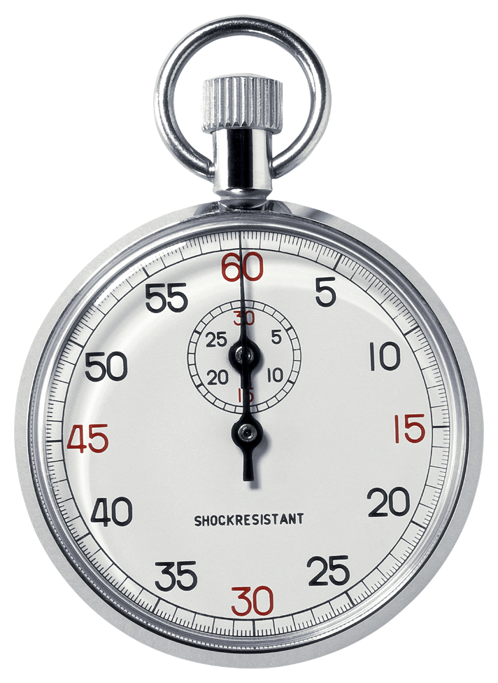
networking for biomedical research scientists
making the time to network
where does the time go?
time is your most precious resource
Reading/Writing Papers
Various Meetings
Experiments
30 minutes per week = pure gold

Slide 3
networking for biomedical research scientists
why bother?
“I’d rather focus on generating data and getting my publications out the door first, rather than waste time networking now”
Case Study:
two students, nearly identical CVs, one gets a dream postdoc slot, the other doesn’t. How?
two postdocs, nearly identical CVs, one gets a job interview, the other doesn’t. Fair?
two techs, nearly identical CVs, one gets a job interview, the other doesn’t. Why?

Slide 4
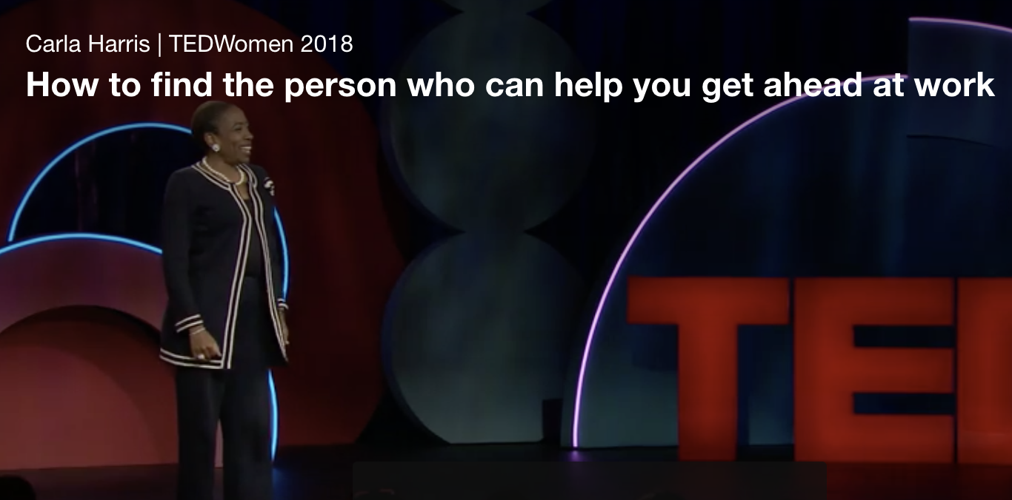
networking for biomedical research scientists
first, get a sponsor
the myth of meritocracy
“I’d rather focus on getting my publications out the door than to waste time networking”
“In the end, all that really matters are publications”
Carla Harris TedWomen 2018: the value of a sponsor
Notes:
This story is a parallel and re-derivitized perspective of the Carla Harris dialogue:
It was the Winter of 2009 when I had my first aha moment. I was asked to serve on a selection committee to identify funding awards for the NIH. For those of you don’t know how this works, prominent scientists are asked to sit on a ‘study section’, Here is how it works…
”I know this scientist. This is a great application, outstanding, has great analytical and quantitative skills. This is a superstar." One reviewer then said, "Sounds like Joe should go in the top of the pile." Second applicant, Mary Smith. Halfway through that review, someone said, "Solid application. Nothing really special, but important work." Another reviewer said, "Sounds like Mary should go in the middle of the pile." And then someone said, "Arnold Smith." Before the reviewer could present Arnold's case, somebody said, "Disaster. Disaster. This guy doesn't have a clue. Can't model a set of data." And before the review was complete, another reviewer said, "Sounds like Arnold should go in the bottom of the pile.”
At this moment, I wondered, "Who is going to speak for me?" Who is going to speak for me? It was that moment that I realized that this idea of a meritocracy that every organizations sells is really just a myth. You cannot have a 100 percent meritocratic environment when there is a human element involved in the evaluative equation, because by definition, that makes it subjective. I knew at that moment that somebody would have to be behind closed doors arguing on my behalf, presenting content in such a way that other decision makers around that table would answer in my best favor.
What do you think about: “Tuck your head down, get your papers out the door, and everything will work out just fine”.

Slide 5
networking for biomedical research scientists
who are your sponsors
who is your number one sponsor?
your goal:
foster a long-term, meaningful partnership
is one sponsor enough? who else can help me?
advisors, committee members, co-mentors
experts in the field, do you know them?
do they know you?

Slide 6
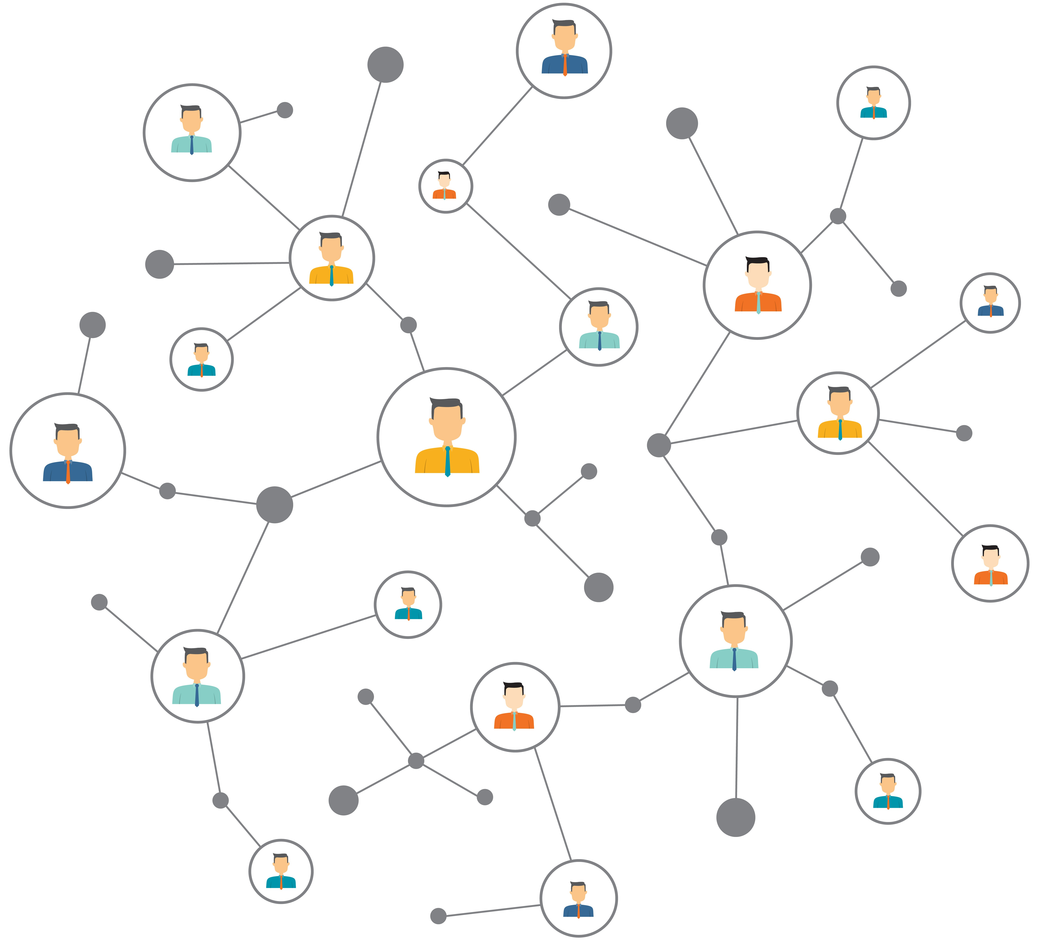
networking for biomedical research scientists
six degrees of separation
let’s play the name game
how many:
UCSF
Prior Institution
Other Institutions

Slide 7
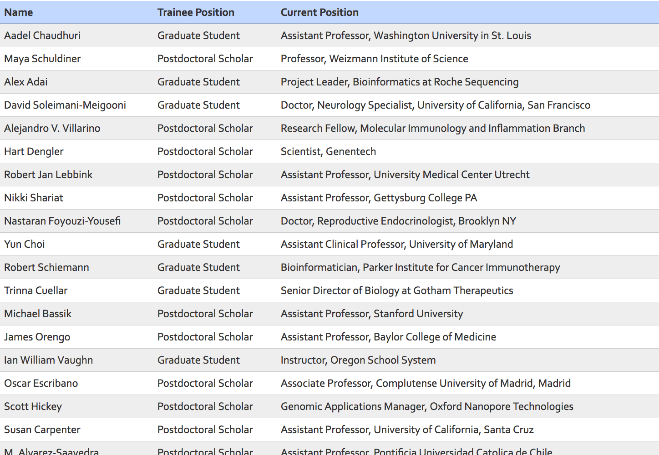
networking for biomedical research scientists
affiliated student and postdoc alumni colleagues
a really easy place to start: your family

Slide 8
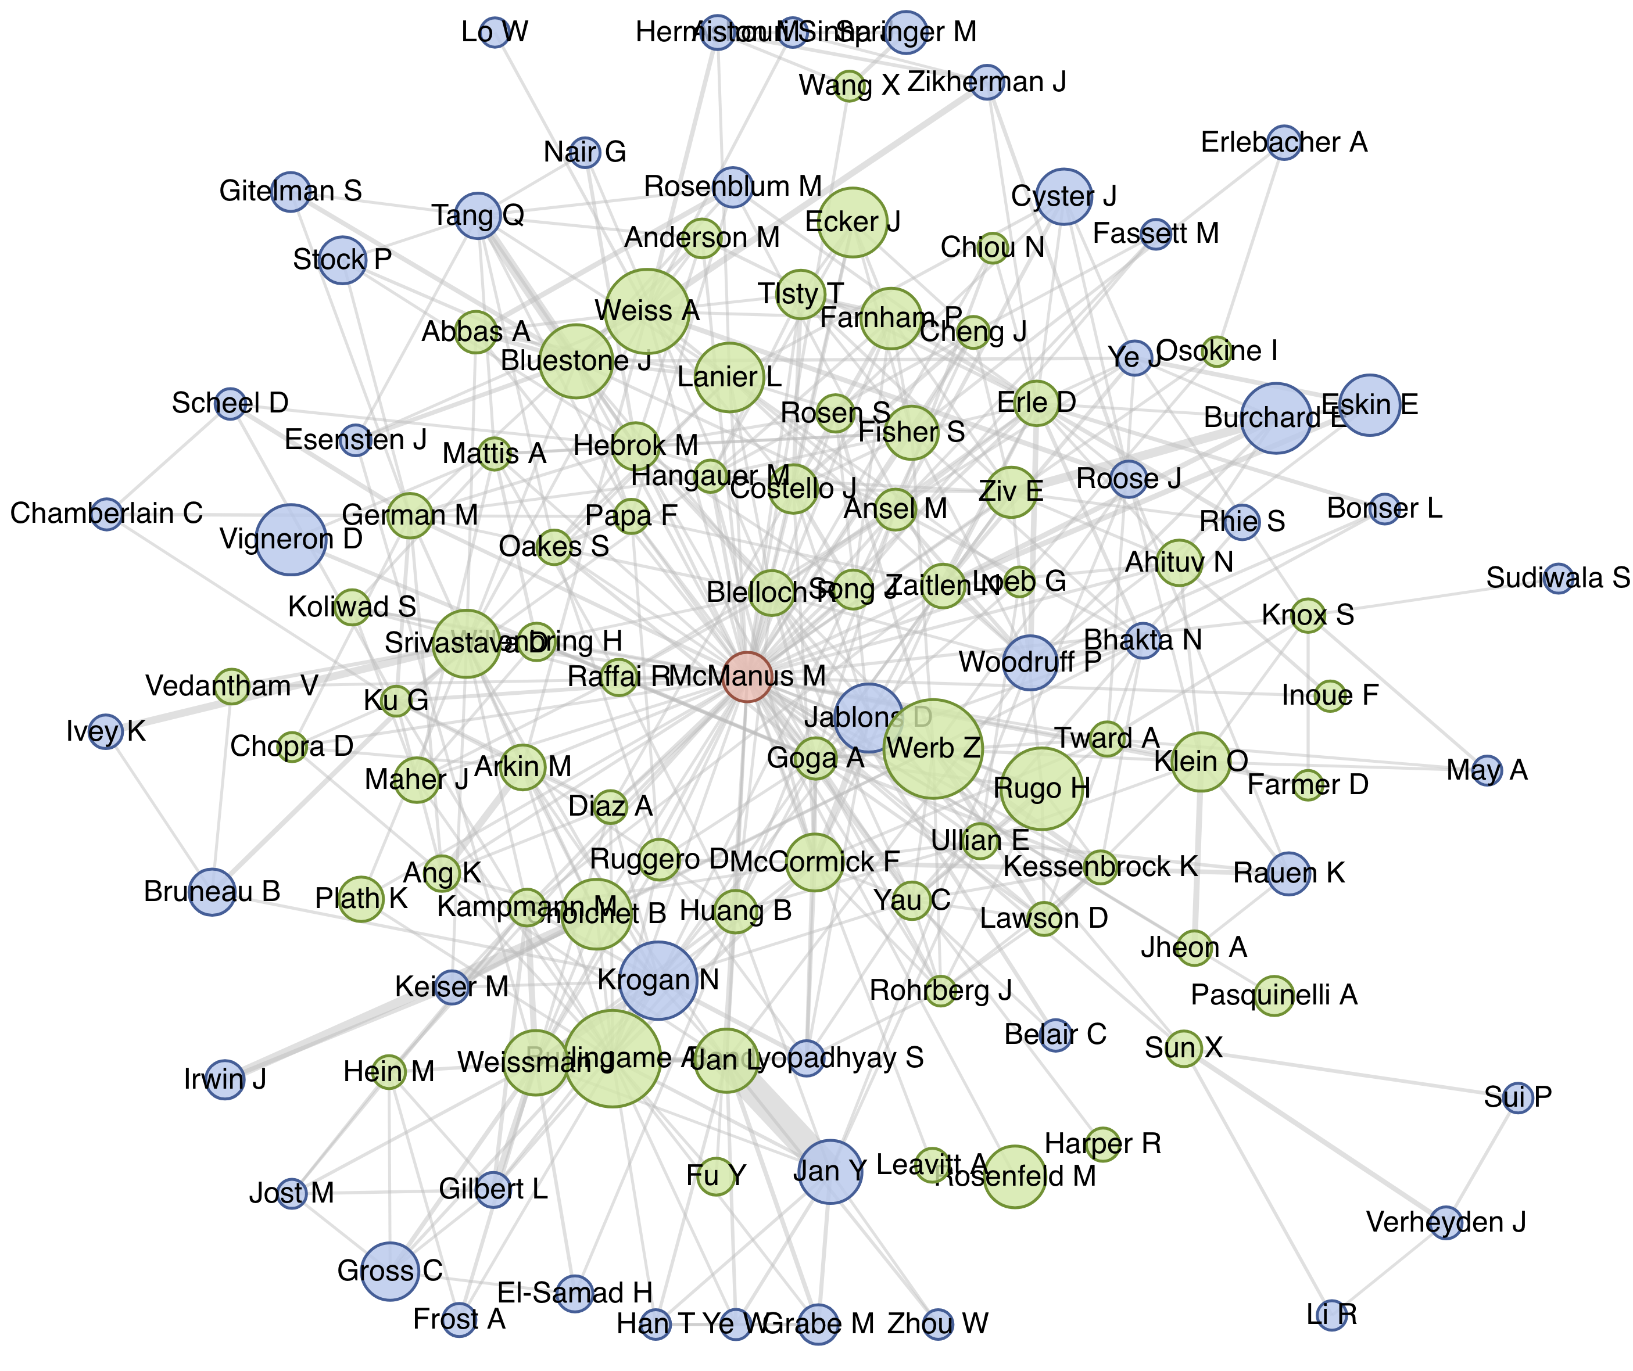
networking for biomedical research scientists
electronic networks for publications
your family is actually bigger
https://profiles.ucsf.edu

Slide 9
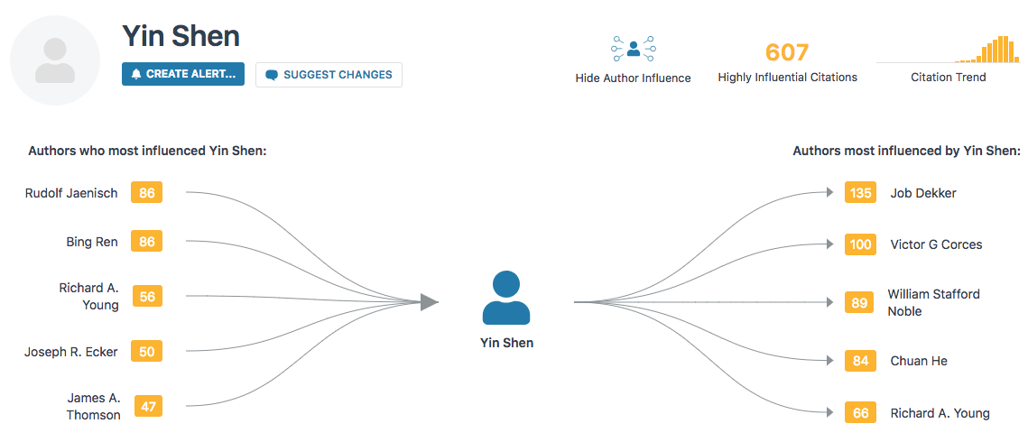
networking for biomedical research scientists
electronic networks for publications
your family is even bigger
https://www.semanticscholar.org/

Slide 10
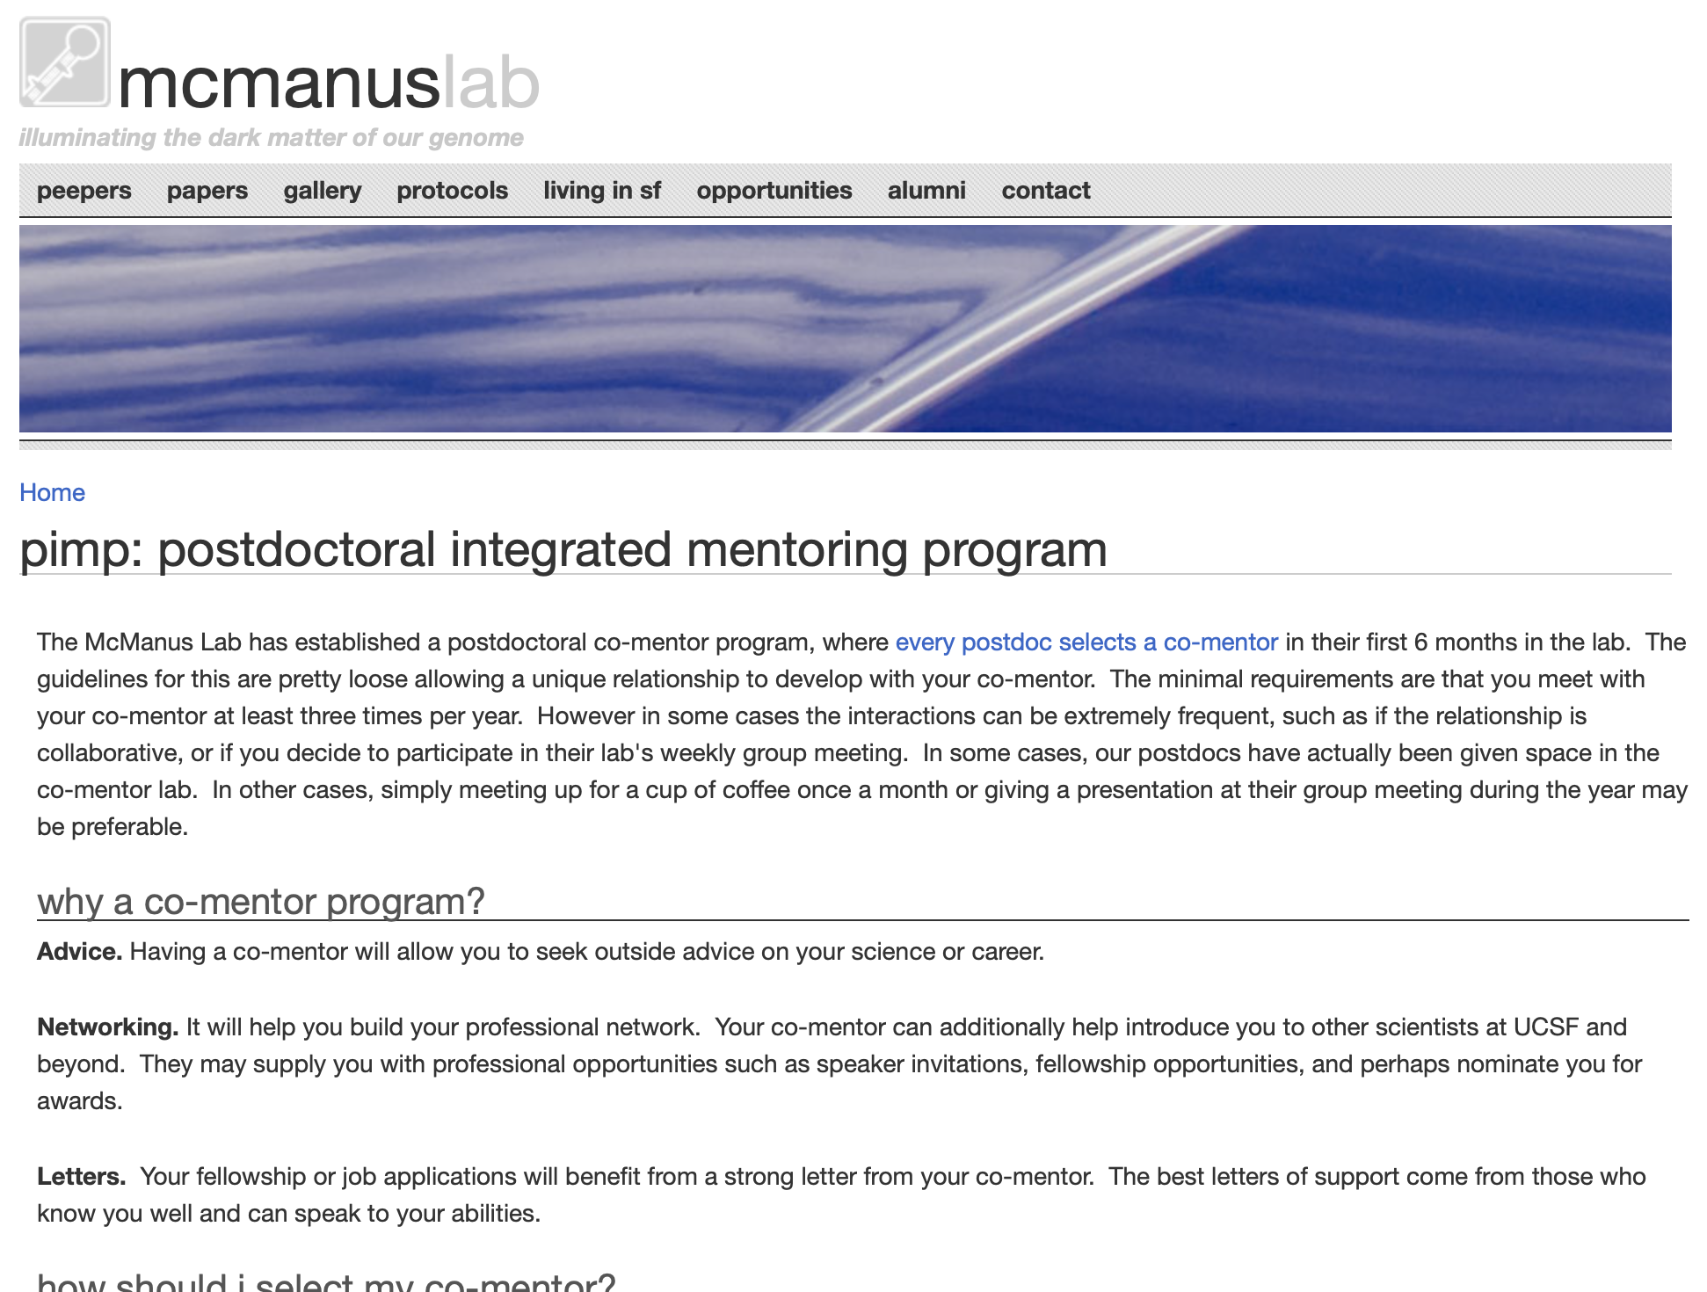
networking for biomedical research scientists
adopt a PiMP
https://mcmanuslab.ucsf.edu/PiMP

Slide 11
networking for biomedical research scientists
find your tribe
“a flower in the wrong place is a weed”
recognize that humans are tribal
circulate among people who do what you do and who are interested in the same things you are interested in
read what they read, hang out where they hang out, focus your efforts
join societies and volunteer

Slide 12
networking for biomedical research scientists
ignore authority, develop yourself
“colleagues are interesting, fans are annoying.”
DO
formulate and discuss your own ideas
hybridize fields and concepts
create your own mantra and logo
develop yourself into an independent scientist
DON’T
blindly follow the field (unless you want to be a minion)
do incremental science (unless that’s what you really want to do!)
Notes:
Do not come off as an elitist, selfish jerk

Slide 13
networking for biomedical research scientists
getting out there…electronically
DO
use social media
LinkedIn
Twitter
FaceBook
YouTube
Websites
Blogs
DON’T
use social media
primarily to sponge
to advertise your inability to stay current
SOCIAL MEDIA:
these are supplemental, not a replacement for professional networking

Slide 14
networking for biomedical research scientists
conferences
DO
go to conferences primarily to:
connect with specific scientists and colleagues
make and meet new connections
set up collaborations and alliances
get visibility for you, your lab/institution
showcase your science and advocate
DON’T
go to conferences primarily to:
learn new things
hang out with your lab, or the same person
vacation

Slide 15
networking for biomedical research scientists
conferences
six simple points
1. Have a plan. Don’t just show up.
2. Do your homework. Do your research before the event.
3. Maximize coffee breaks. Seek and connect. Introduce. Listen.
4. Have your elevator pitch ready. “What are you working on?”
5. Return the favor. Actively listen and ask questions.
6. Follow up and through. A simple email, within 24 hours

Slide 16
networking for biomedical research scientists
how to network
which conferences, meetings, seminars, journal clubs will you attend this year?

Slide 17
networking for biomedical research scientists
when one equals zero
nobody really does biomedical research alone anymore
Building a professional relationship much like a romantic one, it takes time. It takes faith and trust and good communication.
It takes hard work. It takes consistent effort.
Notes:
Simple thing to keep in mind: we’re all in this together.

Slide 18
networking for biomedical research scientists
setting your goals
good goals are measurable
EXAMPLES (your mileage will vary)
by the end of a conference, establish a real connection with six key people
volunteer to give six talks/year (local or distal)
Tweet/email/connect once a day
write one editorial/letter/blog per year
have power lunch/coffee/etc with six colleagues per year
attend monthly happy hour and NOT hang out with folks you know
meet with a committee menber or co-mentor every two months
use your IDP, meet with sponsor monthly

Slide 19
networking for biomedical research scientists
a tale of two scientists
2018
2019
2020
2021
2022
deliverable
Joe Arnold
kept head down
five connections
Mary Smith
head down
20 real connections
Joe Arnold
Great student. Focused on science. Productive, two first author papers, one review.
Presented at his first conference in the final year
Planned a meritocratic strategy
Began emailing about jobs in the final year
Mary Smith
Great student. Focused on science. Productive, two first author papers, one review.
Presented a poster at her first conference in year two
Started networking in year two, with defined goals
Began emailing about jobs in the final year
“I’d rather focus on generating data and getting my publications out the door first, rather than waste time networking now”
Notes:
Who do you think got the job? Who do you think got the fellowship? Whose publication review was more favorable?

Slide 20
networking for biomedical research scientists
it is 100% up to you
where to learn more
How to Network Effectively, Science 2015
A comprehensive collection of narratives and guides
Taking the Work Out of Networking: An Introvert's Guide to Making Connections That Count
Karen Wickre, 2018, ISBN-10: 1501199277
The Seven Habits of Highly Effective People
Stephen Covey, 1989, ISBN 0-671-70863-5

Slide 22
networking for biomedical research scientists
what is networking?
Have fun making professional friends
Learning and developing yourself
Advocating your contributions
Promoting your science
Broadening and deepening your opportunities

